Slide 1

Creating and Publishing
Static Catalogs for Union Pacific

Slide 2
Session Agenda
The Catalog Upload Process
The CIF Catalog Template
Creating a CIF Catalog
The Catalog User Interface
Uploading and Publishing New Catalogs
Replacing Existing Catalogs
Appendix
  Creating a CIF from an Excel File

Slide 3
The Catalog Upload Process

Slide 4

The Catalog Upload Process
Supplier
Buyer
SAP Business Network
Notified a new or updated Catalog is published
from Supplier
Start
New or Updated Supplier Catalog File (from Template) uploaded and published
to the Customer on
SAP Business Network (SBN)
Network validation (errors reported back to Supplier during upload)
Catalog File downloaded from the Network to
Buyer-specific Catalog
Catalog File
updated or corrected
Buyer Validation Rules audit
FAIL
PASS
Catalog sent for
Buyer Approval
Denied
Approved
Catalog Activated and available for Users

Slide 5
The Catalog Upload Process
When you upload a Catalog for your Customer, you are loading the file to SAP Business Network (SBN)—not directly to your Customer’s Catalog.
Once the file is loaded to the Network, your Customer is notified that a Catalog has been loaded.
Depending on the configuration of the Customer’s environment:
    The Catalog will then be validated, audited and sent for Approval.
      If Approved, it will be Activated and available for Users.
      If Rejected, it will be returned to the Supplier for corrections, and the process starts over again.

Slide 6
The Catalog Template

Slide 7
The Catalog Template
Both Static and PunchOut Catalogs use Catalog Templates.
Static Catalogs are generally created offline and uploaded to the SAP Business Network.
PunchOut Catalogs can be created offline, but there is also a Wizard on the Network to create PunchOut Catalog files—these are special static files called “Index Files”.
Creating PunchOut Index files is covered in another document.

Slide 8
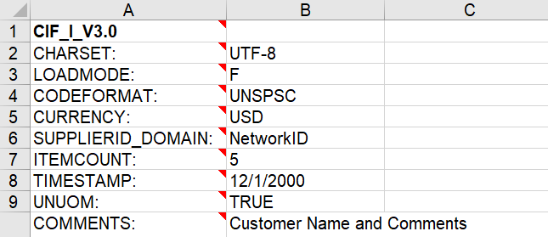
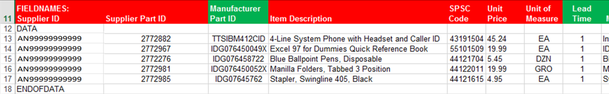
The CIF Catalog Template
CIF Catalogs are the most common type of static Catalogs. For ease of CIF Catalog creation, we provide Suppliers with an Excel template. The Supplier then creates and uploads the Catalog file to the SAP Business Network. Below is a sample of an Excel CIF Template:
Header section
Data section
Notes:
To make catalog creation easier, we provide Suppliers with an Excel template to help them collect and manipulate their Catalog data. Suppliers create specific Catalogs for their Customers, then load the files on Ariba Network and publish them to their Customers.
The Catalog Template has two sections—the Header Section and the Data Section.
The Header Section sets global information and tells the system that this file is a CIF Catalog. The Data Section is where the individual information about each Catalog item is populated. You’ll notice that the first line of the Data section (line 11 here) lists each field name. Under the field name listing, and before data for each item is populated, the value “DATA” is inserted, and after the last item, the value “ENDOFDATA” is inserted. These data elements are required, and tell the system to process the Catalog data on the rows between these labels.

Slide 9
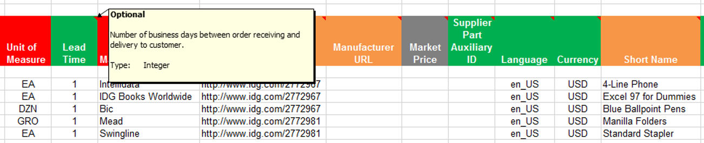
The CIF Catalog Template
The Template is color coded and has Tool Tips that provide information about how to treat each field.
Each Template includes specific instructions, including custom fields or other requirements set by your Customer.
The CIF Template and instructions are provided to Suppliers as part of this education and can also be found on the Customer’s Supplier Portal page on the SBN.
F I E L D C O L O R C O D E S
 | Required
 | Optional
 | Optional, but preferred
 | Do not use

Slide 10
Creating a CIF Catalog

Slide 11
Creating a CIF Catalog
General Rules
All fields marked “Required” must be populated.
Supplier Part Numbers must be unique per item.
Commodity Codes must be assigned to each item.
Ensure all catalog URLs are HTTPS: only as required by SAP.
Best Practices
    Data should be submitted in “Sentence case”—using both upper and lower case letters—not in ALL CAPS or all lower case text.
    Abbreviations should be kept to a minimum—if you have the space, spell it out.
    Be descriptive in the Description field—all the words are indexed for ease of finding the items.
    Use Short Names not just Descriptions—it makes it easier for Users, and you get an additional 50 characters to describe your item.
    Always include images.
Notes:
10/4 NAMER – added #4 to General Rules

Slide 12
The SAP Business Network – File Size Limits
CIF Format : When using the catalog wizard, the catalog file can't exceed 95 MB or 400,000 lines.
Excel Format : The maximum size of zipped Excel file that you can upload is 1 MB (uncompressed). If your Excel files exceed these size, you can convert them to CIF manually and upload the CIF files. The SAP Business Network uploads the file, unzips it if necessary, converts it to CIF format, and starts validation. Conversion from Excel to CIF can take several minutes depending on the catalog size. As Excel files convert, their status is Validating.
cXML Format: If you use the cXML CatalogUploadRequest transaction, the zipped catalog file cannot exceed 10 MB, and the unzipped CIF file cannot exceed 95 MB (approximately 400,000 line items). To have this default size limit increased to 200 MB, contact SAP Ariba Customer Support.

Slide 13
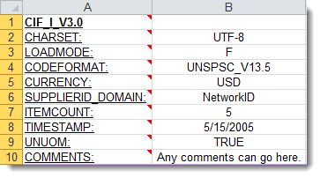
Creating a CIF Catalog
The Header Section
CIF_I_V3.0—Specifies the Catalog format (CIF 3.0). Do not change this value.
CHARSET—UTF-8 Specifies the data coding type. Do not change this value, unless instructed by your Catalog Expert.
LOADMODE—F (Full) or I (Incremental)
CODEFORMAT—Specifies the commodity coding (UNSPSC: United Nations Standard Products and Services Code) in the field “SPSC Code”
CURRENCY—Specifies the currency used for the prices. The value “USD” (United States Dollar) is here by default and can be changed to a difference currency.
SUPPLIERID_DOMAIN—Specifies the Domain used. The preferred value is the Supplier’s SAP Business Network ID Number—“NetworkID”. Other values include “DUNS”, “internalsupplierid” or other custom values.
ITEMCOUNT—Specifies the number of items of the Catalog. Enter the total number of all item between the DATA and ENDOFDATA markers.
TIMESTAMP—Enter the date you created your Catalog.
UNUOM—If set to “TRUE”, the Unit Of Measure is set to UNUOM (United Nations Unit of Measure); if set to “FALSE”, the value is set to ANSI. (Ariba recommends UNUOM).
  COMMENTS—This field is optional, but can be used for comments related to your Catalog. It is a good place to enter the Supplier Name, the Customer Name and Catalog Name.
Note: The only fields that Suppliers should modify in the Template are indicated in red: CURRENCY, ITEMCOUNT, TIMESTAMP and COMMENTS. All the other fields are predefined in the Template for the Customer and should not be modified, unless instructed by a Catalog Expert.

Slide 14
Creating a CIF Catalog
The Data Section
Supplier ID | Supplier Part ID | Manufacturer Part ID
AN99999999999 | 12345 | CFG 11562
AN99999999999 | 87690 | 87690-12
AN99999999999 | 479-56 | A100-BLK
Supplier ID - Required
Description: If the Header is set to “NetworkID”, then enter the Supplier’s SAP Business Network ID, otherwise the appropriate value for the Domain used—DUNS, internalsystem, etc. Ask your Catalog Expert if you have questions.
Type of data: String
Maximum length: 255
Example: AN99999999999
Note: If you publish the Catalog in your test account, add a suffix –T to your ANID or DUNS number like this: AN99999999999-T.
Supplier Part ID - Required
Description: Part Number used by the Supplier. The Part Number must be unique for each item in the Catalog.
NOTE: If you provide more than one catalog for the same customer, make sure the items across these catalogs do not share the same Part ID + Part Auxiliary ID as this duplicates will cause erratic behavior in the application.
Type of data: String
Maximum length: 255
Example: 2772882
Manufacturer Part ID - Optional
Description: A Part Number that a Manufacturer uses.
Type of data: String
Maximum length: 255
Example: TTSIBM412CID

Slide 15
Creating a CIF Catalog
Item Description | SPSC Code | Unit Price
Pens, Bic, Ballpoint, Blue, 1 dozen | 43191504 | 3.48
Stapler, Swingline, Black | 55010125 | 18.72
Post-It, Yellow, 1”x2”, pad of 100 | 15874236 | 6.49
Folders, Letter, Manilla, 100 | 89745125 | 12.98
Item Description - Required
Description: Description of the product or service. Make your descriptions as clear and complete as possible (Item type, brand, model, color, etc.).
Note: To use a special character as a literal value, you need to “escape” it by putting a backslash (\) in front of it. For example, \" lets a double quote be seen as a quote instead of a delimiter for an entry. To escape a quote (") within a quoted field, use two quotes ("").
Type of data: String
Maximum length: 2000
Example: Printer, Laser, A4, Epson Stylus Color 740
SPSC Code – Required
Description: Classification of the product or service. Use a UNSPSC code if the Header specifies “UNSPSC” as the CODEFORMAT.
Type of data: String
Maximum length: 40
Example: 45678900 (level 3) and 45678923 (level 4)
Note: Ariba supports UNSPSC Version 13.5. A code list is available in your Customer’s Supplier Information Portal.
Unit Price - Required
Description: Customer-specific price
Type of data: Decimal
Example: 4.32 or 1234.78
Note: To separate the integer from the decimal, you must use a ‘dot’ and not a comma. Also, do not use a comma to indicate ‘thousands’. Do not include any currency symbols such as $, £ or ¥.

Slide 16
Creating a CIF Catalog
Unit of Measure | Lead Time | Manufacturer Name
EA | 1 | Intelidata
EA | 1 | IDG Book
DZN | 3 | Bic
EA | 1 | Swingline
Unit of Measure - Required
Description: Unit of measure related to the Unit Price. Use a United Nations UOM if the UNUOM in the Header is set to “True”.
Type of data: String
Maximum length: 32
Example: BX
Note: A file containing the Units of Measure is available in your Customer’s Supplier Information Portal.
Lead Time - Optional
Description: Number of working days for the product to be shipped from the date you receive the Purchase Order
Type of data: Integer
Maximum length: 40
Example: 1
Manufacturer Name - Optional
Description: Name of the manufacturer
Type of data: String
Maximum length: 255
Example: Epson

Slide 17
Creating a CIF Catalog
Supplier URL | Manufacturer URL | Market Price
https://www.supplier.com | https://www.manu.com | 12.95
https://www.supplier.com |  | 2296.56
https://www.supplier.com |  | 4.86
https://www.supplier.com |  | 12.86
Supplier URL - Optional
Description: A URL that links to a Supplier static page about the item (could be a MSDS, construction info, packaging info, etc.), in https: format as required by SAP.
Type of data: String
Maximum length: 255
Example: https://www.supply.com/Catalog/product18.htm
Manufacturer URL - Optional
Description: A URL that links to a Manufacturer’s static page about the item (could be a MSDS, construction info, packaging info, etc.), in https: format as required by SAP.
Type of data: String
Maximum length: 255
Example: https://www.manu.com/Catalog/product18.htm
Market Price – Do Not Use
Description: List or retail price.
Note: Does not show on the Ariba UI—this is an informational-only field for Suppliers.
Type of data: Decimal
Example: 4.32 or 1234.78
Note: To separate the integer from the decimal, you must use a ‘dot’ and not a comma. Also, do not use a comma to indicate ‘thousands’. Do not include any currency symbols such as $, £ or ¥.

Slide 18
Creating a CIF Catalog
Supplier Part Auxiliary ID | Language | Currency
1234-75 | en_US | USD
 | en_US | USD
1234 French | en_US | USD
 | en_US | USD
Supplier Part Auxiliary ID - Optional
Description: Uniquely identifies a single item. For example, items in multiple languages or available in multiple units of measure.
NOTE: If you provide more than one catalog for the same customer, make sure the items across these catalogs do not share the same Part ID + Part Auxiliary ID as this duplicates will cause erratic behavior in the application.
Type of data: String
Maximum length: 255
Example: 1234 French
Note: If any items have the same reference (Supplier Part ID column), this column allows you to differentiate them.
Language – Optional (If blank, defaults to ‘en_US’)
Description: Specifies the language used to describe the item.
Type of data: String
Maximum length: 255
Example: en_US
Note: A listing of language codes is in your Customer’s Supplier Information Portal.
Currency – Optional (Set in Header)
Description: Specifies the currency used for the prices
Type of data: String
Maximum length: 32
Example: USD, CAD (Canadian Dollar)
Note: A listing of currency codes is in your Customer’s Supplier Information Portal.

Slide 19
Creating a CIF Catalog
Short Name | Image
Soft Drink, Soda, Dr Pepper | 12354.jpg
Dairy, Milk, 1% milkfat | https://www.1.com/34.jpg
Coffee, Dark Roast, Starbucks | 587.jpg
Soft Drink, Juice, Minute Maid | https://www.1.36.jpg
Short Name – Optional
Description: Short description of the item. The Short Name is displayed first in the UI, and is in a larger type face and blue color. You can use the Short Name to describe a category or Item type, then give the specifics in the Item Description.
Type of data: String
Example: Nylon Glove, Blue
Maximum length: 50 characters
Note: If the “Short Name” field is left blank, the first 50 characters of the Item Description column will automatically fill the “Short Name” field.
Image - Optional but Preferred
Description: URL of the item’s image (preferred and in https: format as required by SAP), or filename of the image (sent in a zip file)
Supported image formats: JPG, JPEG, GIF, PNG, BMP—(JPG preferred)
Type of data: String
Maximum length: 255
Recommended Size: 250 x 250 pixels

Slide 20
Creating a CIF Catalog
Thumbnail | Keywords
https://www.1.com/12354.jpg | IT, communication, paper, pens
https://www.1.com/34.jpg
https://www.1.com/587.Jpg
https://www.1.36.jpg
Detail: Thumbnail – Optional
Description: URL of an Icon-size image of the item (in https: format as required by SAP), or filename of the image (sent in the zip file)—can be different from the product’s full-size Image.
Supported image formats: JPG, JPEG, GIF, PNG, BMP—(JPG preferred)
Type of data: String
Maximum length: 255
Recommended Size: 85 x 85 pixels
Note: If the “Thumbnail” field is left blank, the file in the “Image” field will be resized and populate the Thumbnail.
Keywords - Optional
Description: Additional keywords to help users find items
Type of data: String
Maximum length: 255
Example: Pens, Pencils, Paper, Copier

Slide 21
Creating a CIF Catalog
Special Notes for Images
In the Catalog file, you can refer to a Remote Image—using a URL—or you can refer to a Local Image, and send that image to Ariba to store.
Using Remote Images is preferred.
  Be sure the URL in the Template is complete (including https:// as required by SAP).
    Example: https://server/directory/imagefilename.jpg.
Point to the image itself—not a program that serves up images.
If you use Local Images,
  Be sure the filename in the Template is exact—including upper and lower case
  Example: FileName.jpg -or- lowercasename.jpg.
Load images in a zip file format with the Customer Name and Supplier Name on the AN.

Slide 22
The Catalog User Interface

Slide 23
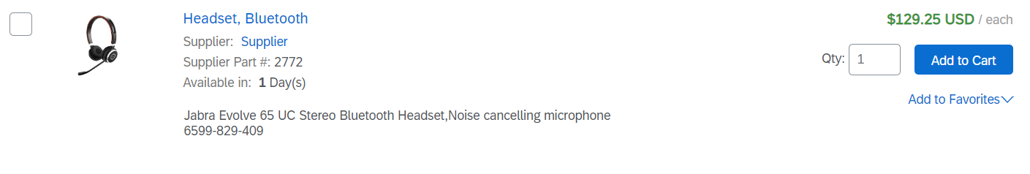
The Catalog Interface Item View
This is how a static Catalog item is displayed in the Catalog interface. Clicking on the Short Name takes you to the Details screen for this item.
Short Name (50 characters)
Description (2,000 characters)
Notes:
10/4 NAMER – should this slide match slide 24 in the ARC document?

Slide 24
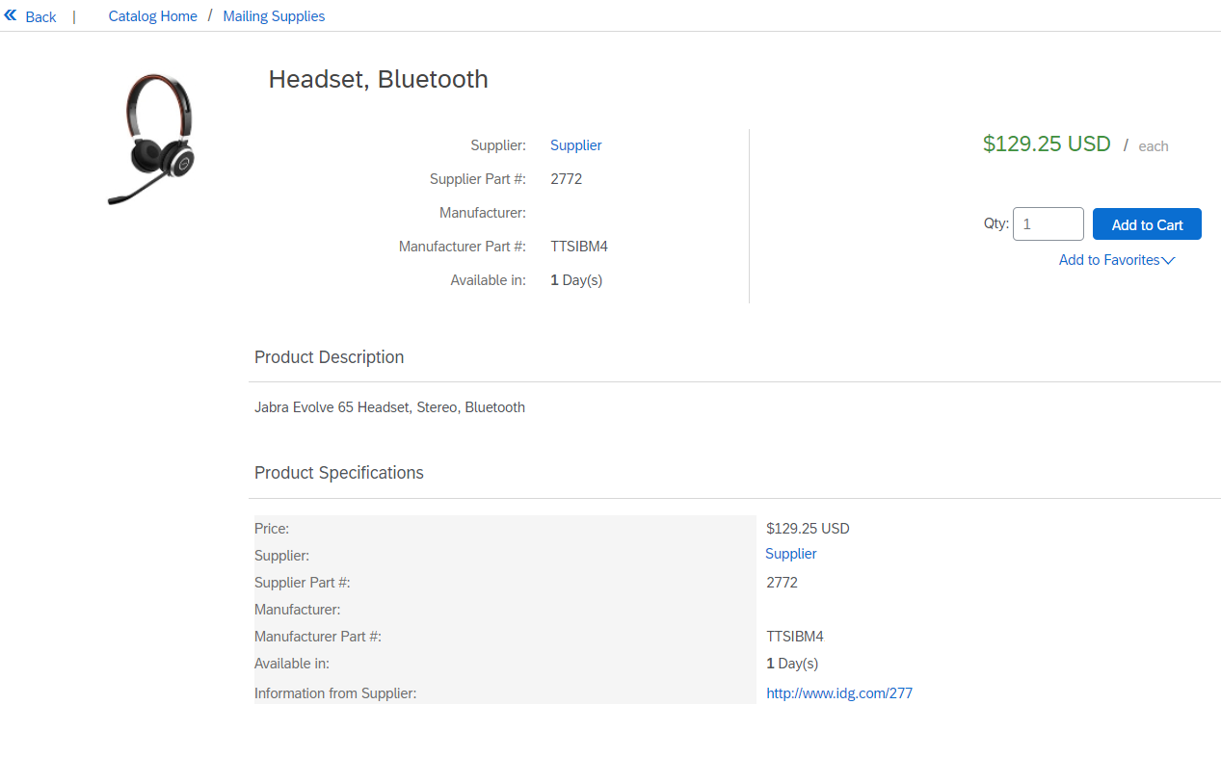
The Catalog Interface Detail View
This is a how a static Catalog Item Detail view is displayed in the Catalog interface.
Additional Information,
links and
custom fields
Notes:
10/4 NAMER – should this slide match slide 25 in the ARC document?

Slide 25
Uploading and Publishing
New Catalogs

Slide 26
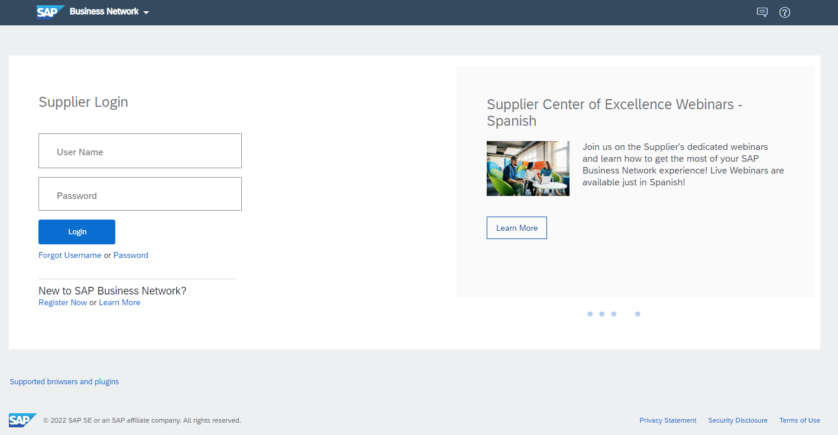
Uploading and Publishing New Catalogs
Login to SAP Business Network
    Go to: https://supplier.ariba.com
    Log in with your Username and Password

Slide 27
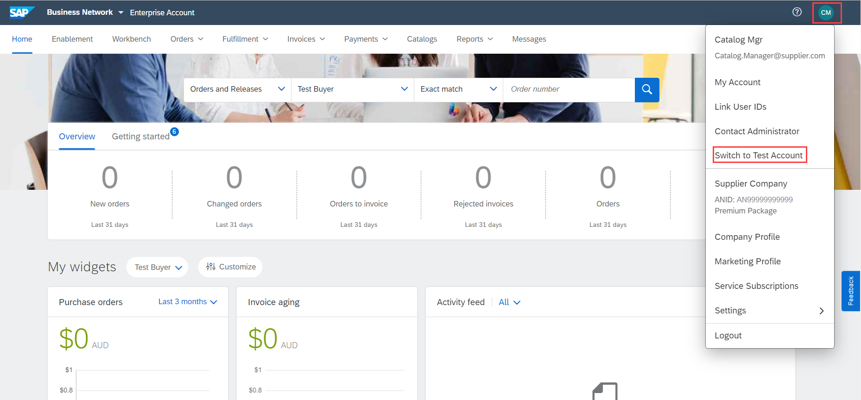
Uploading and Publishing New Catalogs
Switch to your Test Account
  Your Catalog should be loaded and tested in your Test Account. (Note: If you are instructed to load a Catalog to a Production account, just skip this step)
  Find your name and click for the pull down menu, then click “Switch To Test Account”
  If you don’t see a “Switch to Test Account” link, your Test account has not yet been set up. Contact your SAP Business Network Administrator
  You will get a warning. “You are about to switch to Test Mode.” Click “OK”

Slide 28
Uploading and Publishing New Catalogs
When uploading a Catalog on SAP Business Network, there are four steps you will follow:
  Uploading—Transfers the Catalog file from your local drive to SAP Business Network. During the upload process, you enter the Catalog name (this becomes the “Subscription Name” in the Buyer’s local Catalog) descriptive text, and classify it so that buying organizations that are looking for specific products and services can find your Catalog
  Setting Visibility—Allows you to specify whether the Catalog version is “Public” or “Private” and determines which of your Customers can access it
  Validating—The network checks the Catalog for errors, checks for zero price values and does a high-level validation of UNSPSC codes and Units of Measure
    (Note: Customer-specific validation rules for UNSPSC and UOM codes, and zero price values can be more detailed and much more strict than the high-level network validations, therefore your Catalog may pass the network validations but fail the Customer-specific validations for these same items)
  Publishing—Freezes the current version and notifies your Customer of the Catalog’s availability

Slide 29
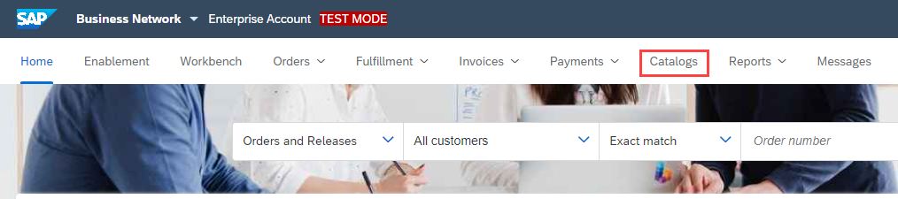
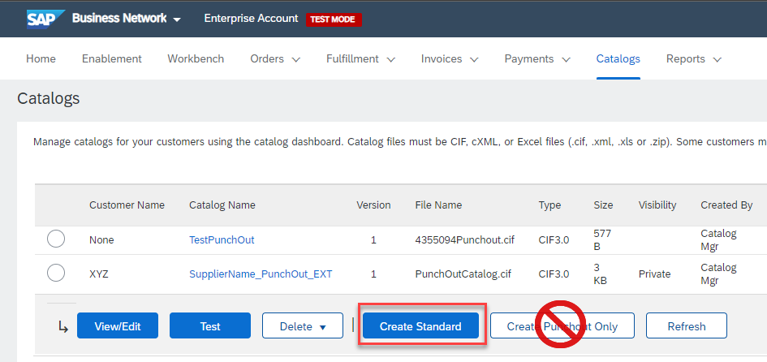
Uploading and Publishing New Catalogs
Navigate to the Catalogs Tab
On the Catalogs screen, click the “Create Standard” button

Slide 30
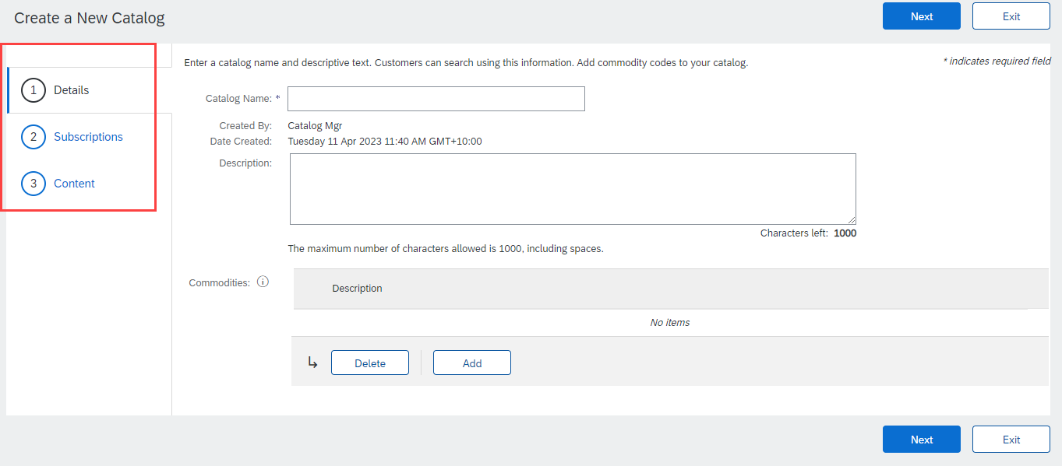
Uploading and Publishing New Catalogs
You are now on the Create a New Catalog Screen
To create the Catalog, there is a 3-step Wizard:
  Details—General information about the Catalog
  Subscriptions—Who you are publishing the Catalog to
  Content—Uploading the actual Catalog file

Slide 31
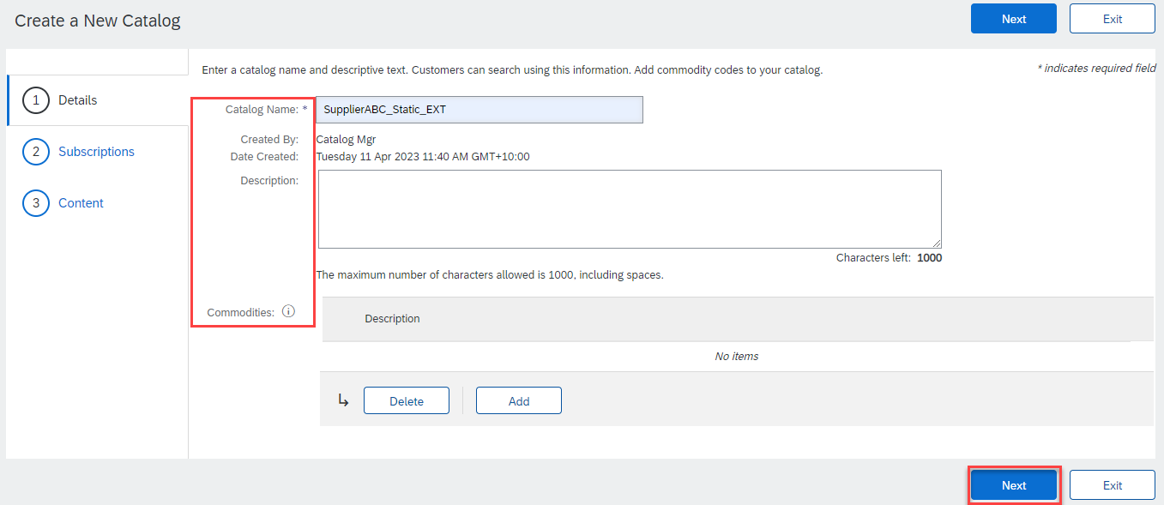
Uploading and Publishing New Catalogs
Details
  Catalog Name: This becomes the “Subscription Name” for this Catalog that will not change. The format for this Name is set by your Customer. Use this format (no special characters are allowed, you can use a dash (-) or underscore(_)):
  SupplierName_UnionPacific_Region_CatalogType, for example: MySupplier_UnionPacific_US_CIF
  Description: (Optional) Brief description of the content of your Catalog
  Commodities: (Optional) The UNSPSC
  code(s) that corresponds to the items family/ group of your Catalog. Use the “Add” button to find the code
  When you complete this screen, click “Next”

Slide 32
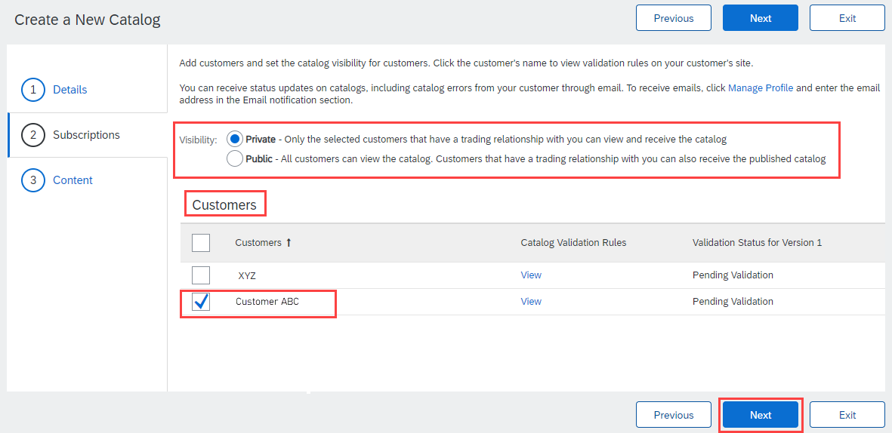
Uploading and Publishing New Catalogs
Subscriptions
  You determine which Customers subscribe to your Catalog—specific Customer(s) or to all Customers on the network
  Set the Visibility to “Private”. You can select a single customer.
  To select your Customer, check the box next to their name in the “Customers” list.
  If the Supplier does not appear,
  it means that they have not established
  a relationship with your company yet.
  This is required prior to uploading a
  Catalog to them.
  When you complete this screen,
  click “Next”.

Slide 33
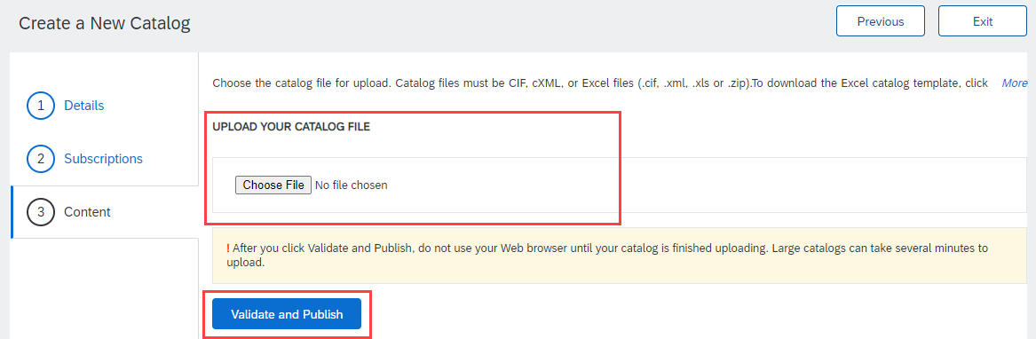
Uploading and Publishing New Catalogs
Content
  Select your Catalog File, by clicking “Browse” and pointing to your file
    Your Excel file must not exceed 1 Mb, however you can use zip compression
    If your Excel file is too large, you will need to convert it to a CIF. See the Appendix—“How to convert an Excel file to CIF”
  After you have selected your Catalog file, click the “Validate and Publish” button
  As your Catalog loads, the
  status will read “Validating”
  Click the “Refresh” button
  at the bottom of the screen
  to see the status change

Slide 34
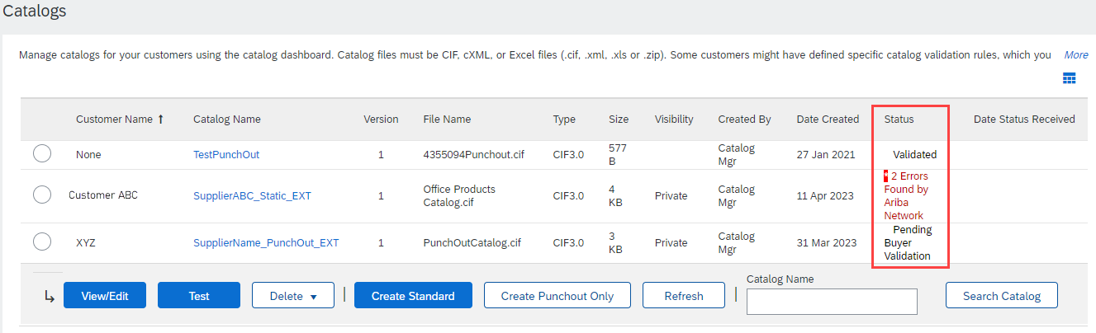
Uploading and Publishing New Catalogs
Network Catalog Validation
  After the network completes validation, it changes the Catalog status from “Validating” to one of the following statuses:
    Validated, Published or Pending Buyer Validation—your Catalog is error-free
    Errors Found by SAP Business Network—the network detected Catalog content that violates validation rules
    Bad Format—your Catalog failed the file validation check. Audit the file for problems in format
  A Catalog with an error status means you need to review the error results and correct them before going on

Slide 35
Uploading and Publishing New Catalogs
Correcting Validation Errors
  To see the error detail, click on the “Errors Found” hyperlink:

Slide 36
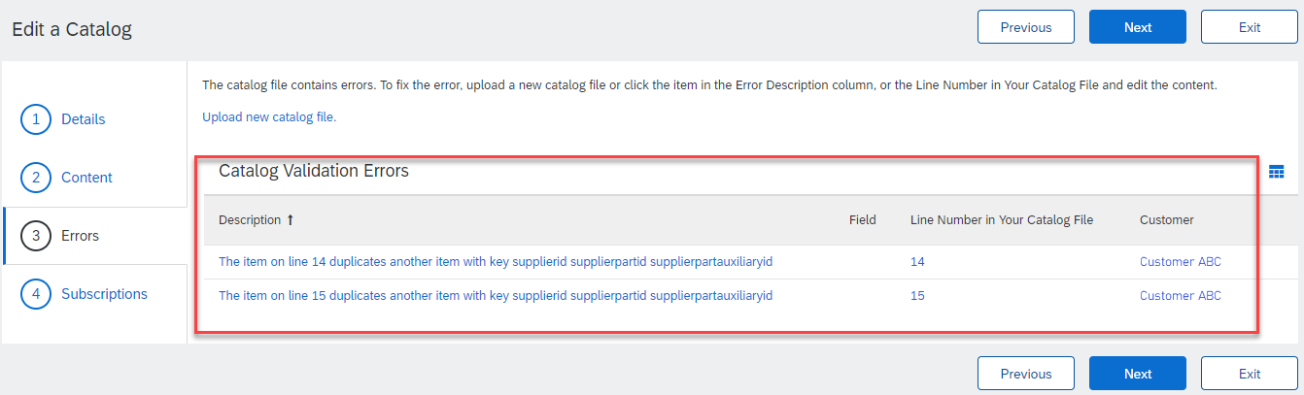
Uploading and Publishing New Catalogs
Viewing Validation Errors
  The network displays Description, Field and Line Number for each error
  In this case, the network is telling us that the Supplier Part ID / Supplier Part Auxiliary ID combo is not unique on lines 14 and 15
  To correct any issues, go back to the original Excel Catalog file, make the corrections, then update the Catalog file, and upload the new version to replace the existing Catalog

Slide 37
Uploading and Publishing New Catalogs
Customer Approval
  When your Catalog passes the network upload validation, your Customer is then notified to audit, validate and approve your Catalog. The network may show any of these statuses: “Published”, “Validated by Customer” or “Pending Buyer Validation”—note that these are all valid statuses
  Each Customer may have specific validation rules—and these rules may be more strict than the standard network rules. This means that your Catalog could pass the network validation, but fail the Customer-specific rules and be returned to you
  If your Customer finds anything in your Catalog file that requires your attention, you will be notified by e-Mail
    Corrections should be made to the original Excel file, then the corrected Catalog file needs to be uploaded to the network
    Each Catalog must pass both the network validation, and the Customer audit before it can be loaded into the Customer’s buying application and be available for their Users

Slide 38
Replacing Existing Catalogs

Slide 39
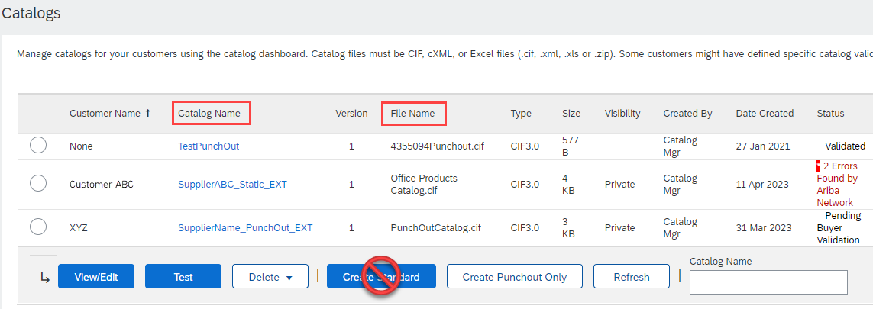
Replacing Existing Catalogs
To replace an existing Catalog, the steps are almost the same as uploading a new Catalog for the Customer.
Log into your SAP Business Network account
Navigate to Catalogs
Update the Catalog—using “View/Edit”
  When replacing an existing Catalog, do not Create a new Catalog—it is important to keep the same Catalog Name. The file name can be different:

Slide 40
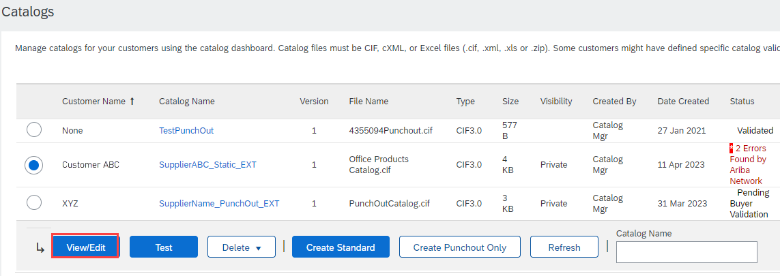
Replacing Existing Catalogs
Find the existing Catalog you wish to replace with a new version
  Click on the radio button to select the existing Catalog
Click “View/Edit”

Slide 41
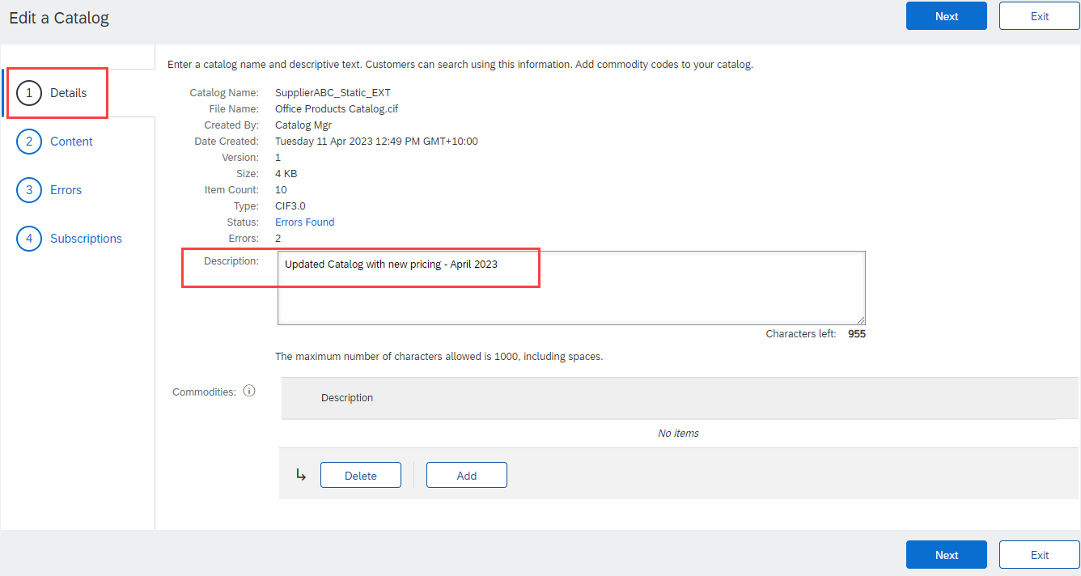
Replacing Existing Catalogs
You are now taken to the Edit a Catalog Screen
You see the same 3 steps as a New Catalog
  Details—Most of the fields are pre-populated with the existing information, but you can add a new Description for the updated Catalog
  Click “Next”

Slide 42
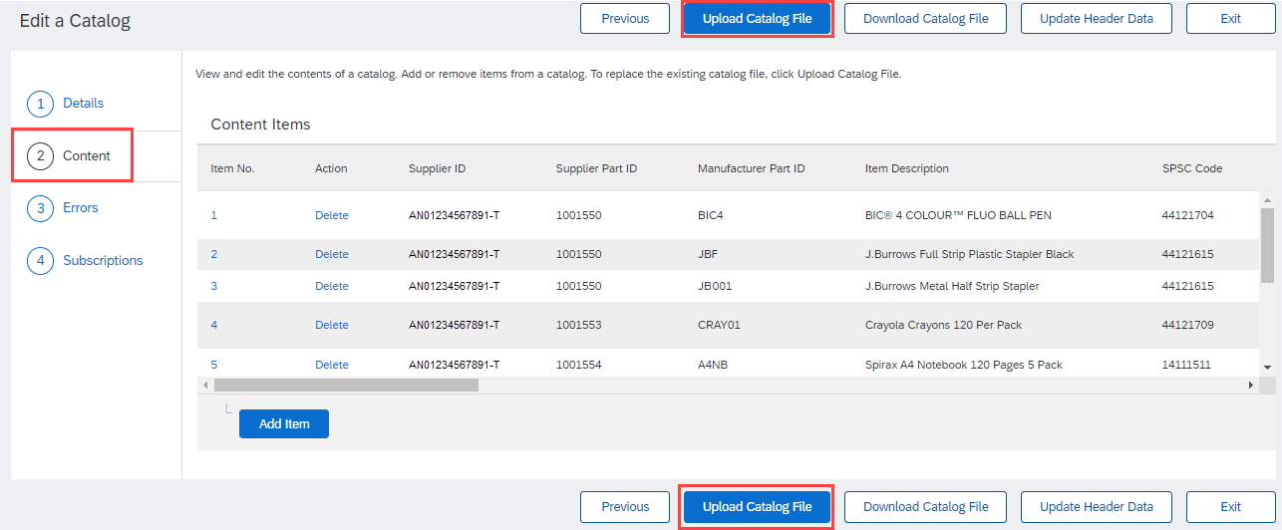
Replacing Existing Catalogs
  Content—The network will display the current Catalog (if it is under 4Mb)
  We want to “Upload a Catalog File”—this will replace the existing Catalog File with our updated Catalog. Click the Upload Catalog File button

Slide 43
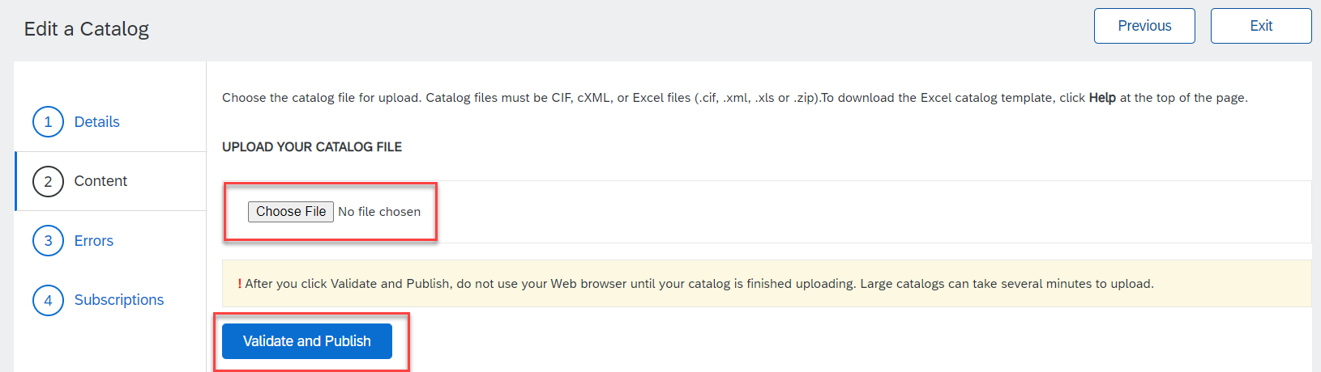
Replacing Existing Catalogs
  Select your Catalog file, by clicking the Choose File button, then “Browse” and point to your file
    Your Excel file must not exceed 1 Mb, however you can use zip compression
    If your Excel file is too large, you will need to convert it to a CIF. See the Appendix—“How to convert an Excel file to CIF”
  After you have selected your Catalog file, click “Validate and Publish”
  As your Catalog loads, you will be returned to the Catalog Home screen and the status will read “Validating”. Click the “Refresh” button at the bottom of the screen to see the status change. Be sure to wait for the validation to finish

Slide 44
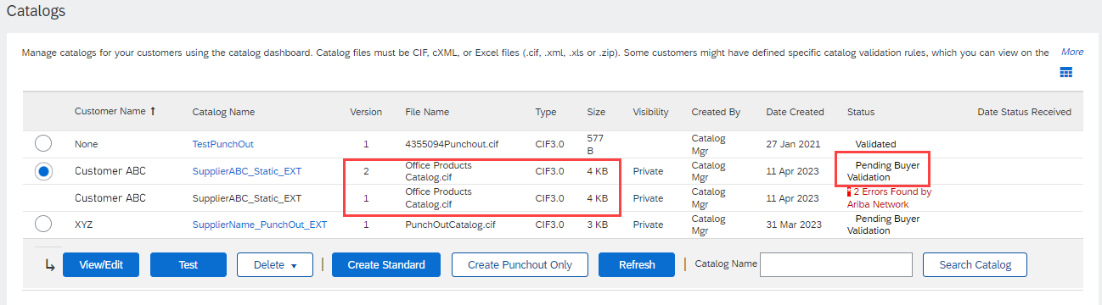
Replacing Existing Catalogs
  When your Catalog passes the network upload validation, the network may show any of these statuses: “Published”, “Validated by Customer” or “Pending Buyer Validation”—note that these are all valid statuses. The upload is complete
  Notice that the Catalog Name stayed the same, but the new File Name we loaded is reflected on the network
  The network does Catalog version control for you. See that our replacement Catalog is now Version 2, and is active. Note that the radio button has moved up to our new active version

Slide 45
Replacing Existing Catalogs
Customer Approval
  When your Catalog passes the network upload validation, your Customer is then notified to audit, validate and approve your Catalog.
  Each Customer may have specific validation rules—and these rules may be more strict than the standard network rules. This means that your Catalog could pass the network validation, but fail the Customer-specific rules and be returned to you
  If your Customer finds anything in your Catalog file that requires your attention, you will be notified by e-Mail
    Corrections should be made to the original Excel file, then the corrected Catalog file needs to be uploaded to the network
    Each Catalog must pass both the network validation, and the Customer audit before it can be loaded into the Customer’s buying application and be available for their Users

Slide 46
Appendix

Slide 47
Creating a CIF from an Excel File

Slide 48
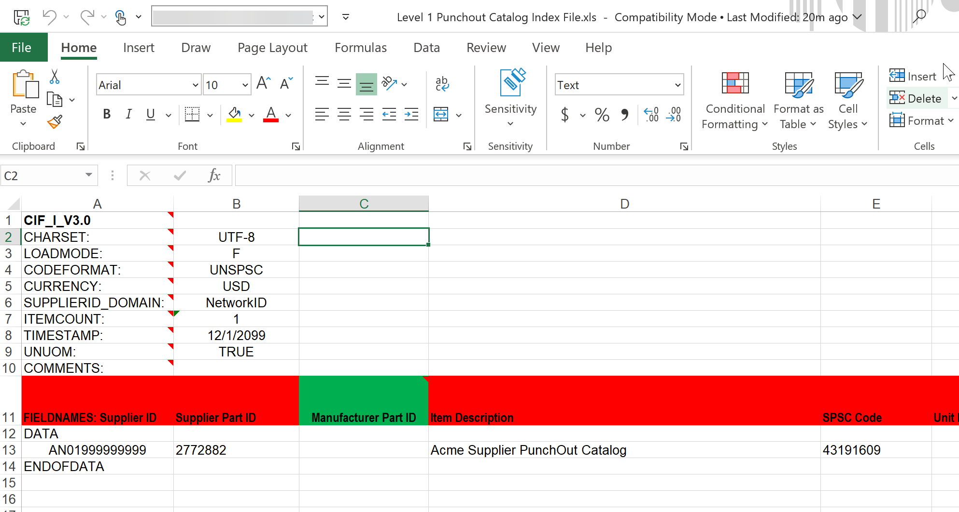
Creating a CIF from an Excel File
Open your Excel Catalog file.

Slide 49
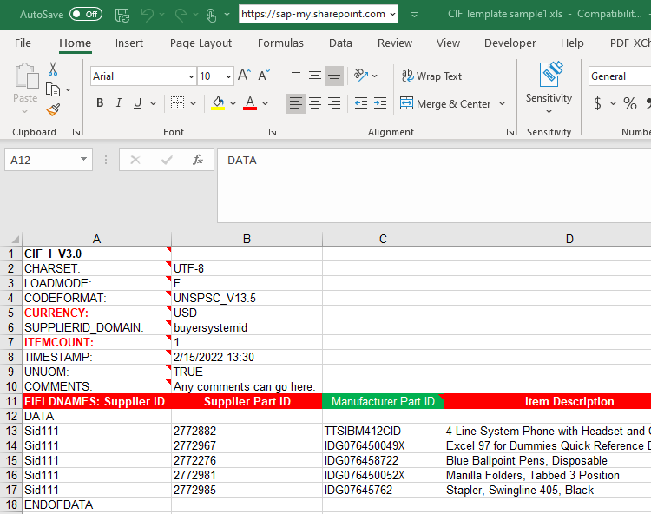
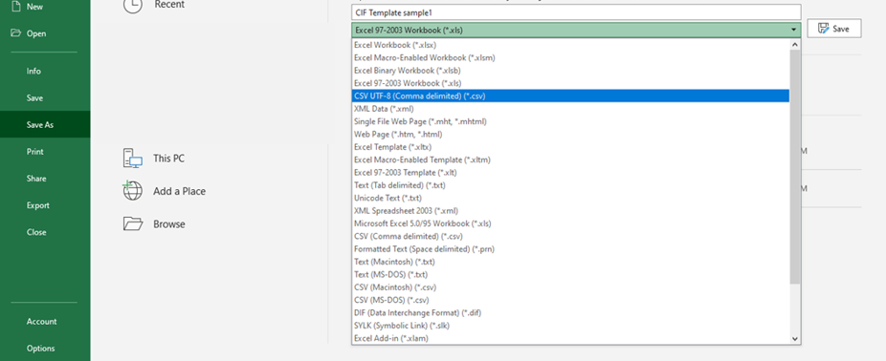
Creating a CIF from an Excel File
Click on the drop down menu and save it as a “.csv” file.

Slide 50
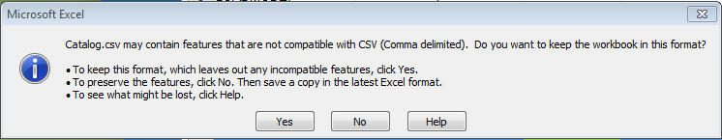


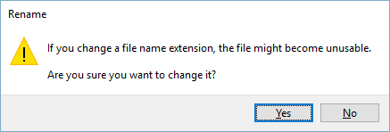
Creating a CIF from an Excel File
You will get a system warning about saving it as a .csv—click “Yes” to continue.
Rename your saved file, by changing the extension to “.cif”.
The system will warn you about changing the
extension. Click “Yes” to continue.

Slide 51
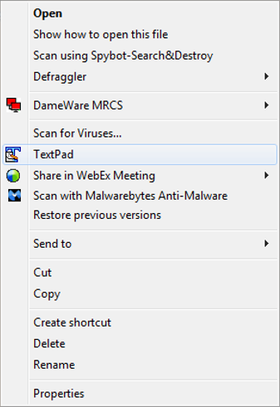
Creating a CIF from an Excel File
Open your CIF Catalog file with Notepad, or your favorite text editor.

Slide 52
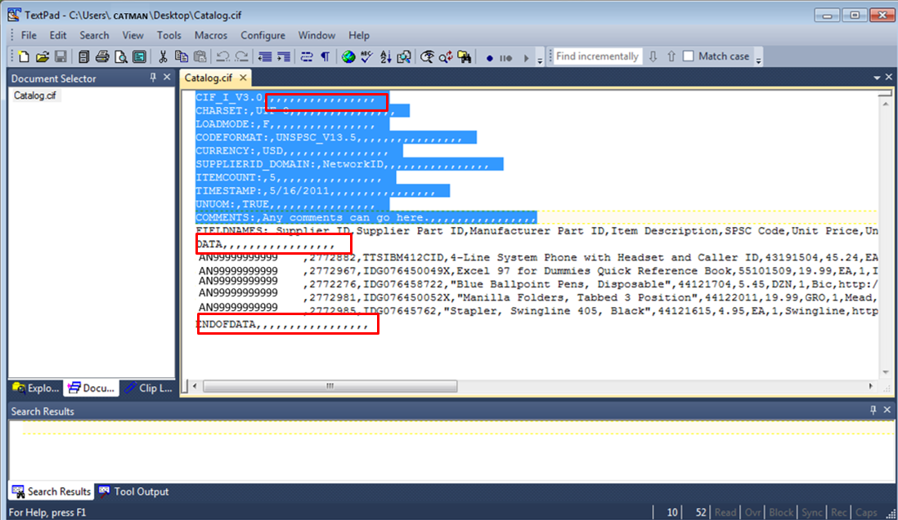
Creating a CIF from an Excel File
Notice that the file has new, added commas in the Header, and after the DATA and ENDOFDATA markers.

Slide 53
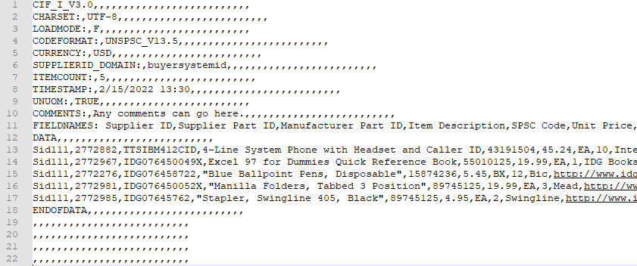
Creating a CIF from an Excel File
Remove these extra commas after the Header values and the DATA and ENDOFDATA markers. Be sure to remove any commas in front of the data in the Header as well.
Be careful if you use the “Replace” function—you don’t want to replace any of the commas in the actual Catalog data.

Slide 54
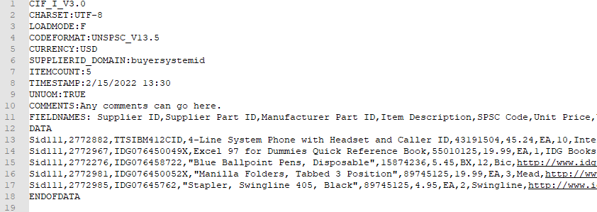
Creating a CIF from an Excel File
Once the commas are deleted, save the CIF Catalog file. It is now ready to be loaded.
Your completed file should look like this.

Slide 55
CAT 101 G R-3 (1/2020)

