Slide 1

Understanding, Creating and Publishing PunchOut® Catalogs

Slide 2
Agenda
  Configuring a SAP Business Network (SBN) Account for PunchOut
  Creating the default PunchOut Connection
  Native cXML Transaction Setup
  Configuring your Customer Specific PunchOut URL connection
  Creating a customer-specific PunchOut connection
  Setting up Default Level 1 Index File Template Details
  Creating and Publishing PunchOut Level 1 Catalogs Online
Templates and Catalog File Creation
  For Level 1 and Level 2 PunchOut Catalogs
Uploading and Publishing PunchOut Catalogs
  Replacing Existing Catalogs
  Appendix
  Creating a CIF from an Excel Catalog File

Slide 3
Configuring a SAP Business Network (SBN) Account for PunchOut

Slide 4
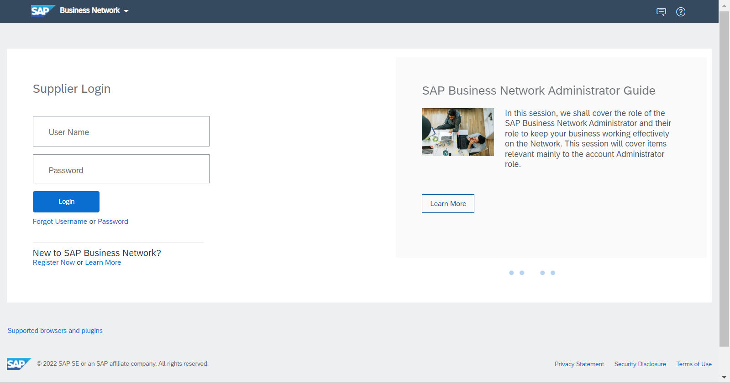
Configuring a SAP Business Network Account for PunchOut
Login to your Business Supplier Account (https://supplier.ariba.com)
Assistance from your IT Manager may be needed for the following slides.

Slide 5
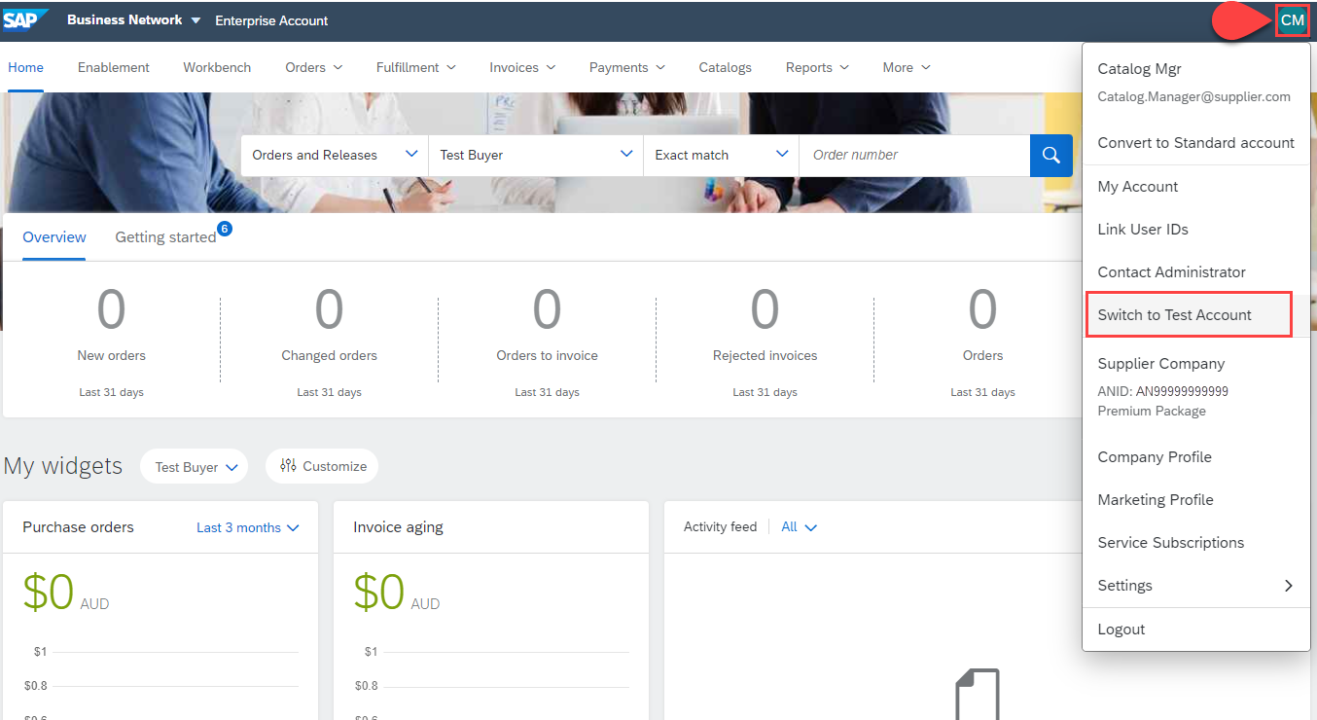
Configuring a SAP Business Network Account for PunchOut
Switch to your Test Account
  Your Network Account needs to be set up in both your Test and Production environments
  Find your initials in the upper right corner and click for the pull down menu, then click “Switch To Test Account”
  If you don’t see a “Switch to Test Account” link,
  your Test account has not yet been set up.
  Contact your SAP Business Network
  Administrator
  You will get a warning.
  “You are about to switch to Test Mode.”
  Click “OK”

Slide 6
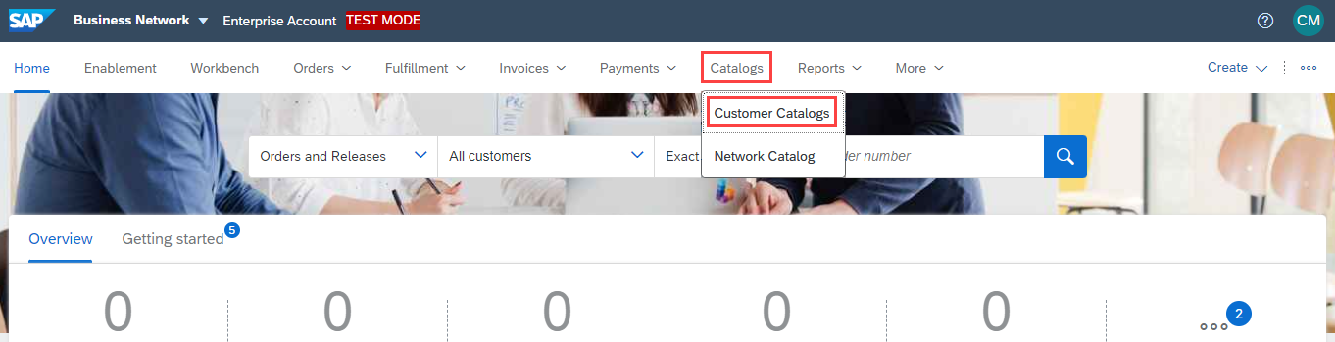
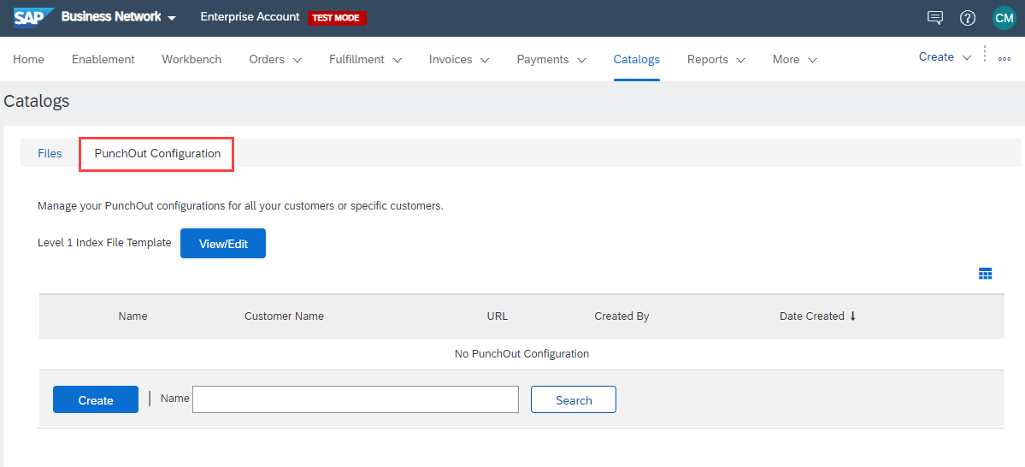
Configuring a SAP Business Network Account for PunchOut
Go to Catalog tab, choose Customer Catalogs, and click PunchOut Configuration.
This area allows you to create your default PunchOut connection as well as a unique connection with your customer (if applicable).
Please note the next steps need to be completed in your Test and Production environments.

Slide 7
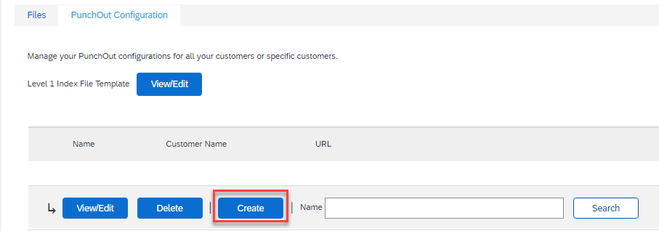
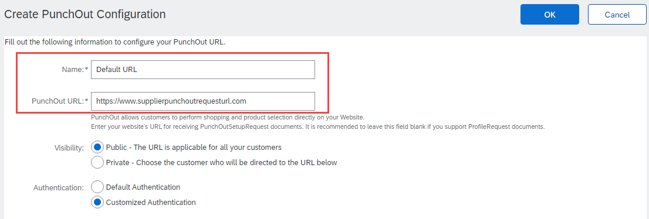
Configuring a SAP Business Network Account for PunchOut
To create your default PunchOut Catalog:
Click on Create
In the Name field, write “Default URL” as seen in the image.
Add your company’s complete PunchOut Request URL within the PunchOut URL field.
  This is the default URL that will be used for all of your customers, each time they initiate a PunchOut session.
  Note: Refer to the section Configuring your Customer Specific PunchOut URL connection, to use a unique URL.

Slide 8
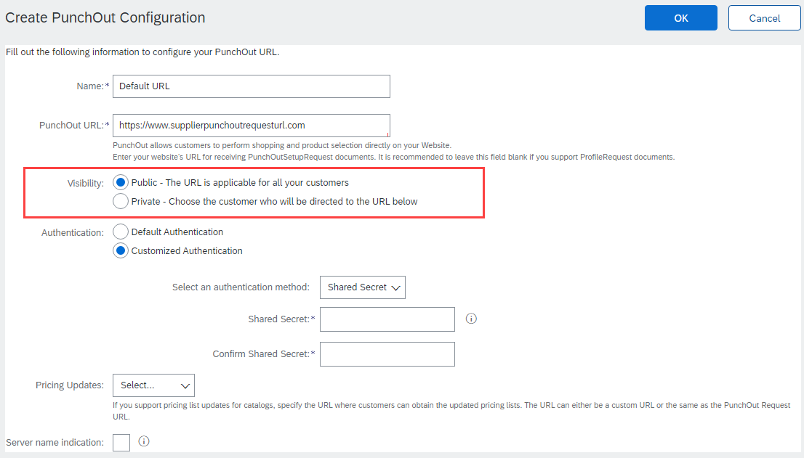
Configuring a SAP Business Network Account for PunchOut
Select Public visibility as this default URL will be used to received the PunchOutSetUpRequest.
This link can be used to connect with all customers.
    Note 1: This setting will not impact which customers can access the punchout site.
    Note 2: To configure a customer specific punchout connection, using a specific URL link, please refer to Configuring your Customer Specific PunchOut URL connection..

Slide 9
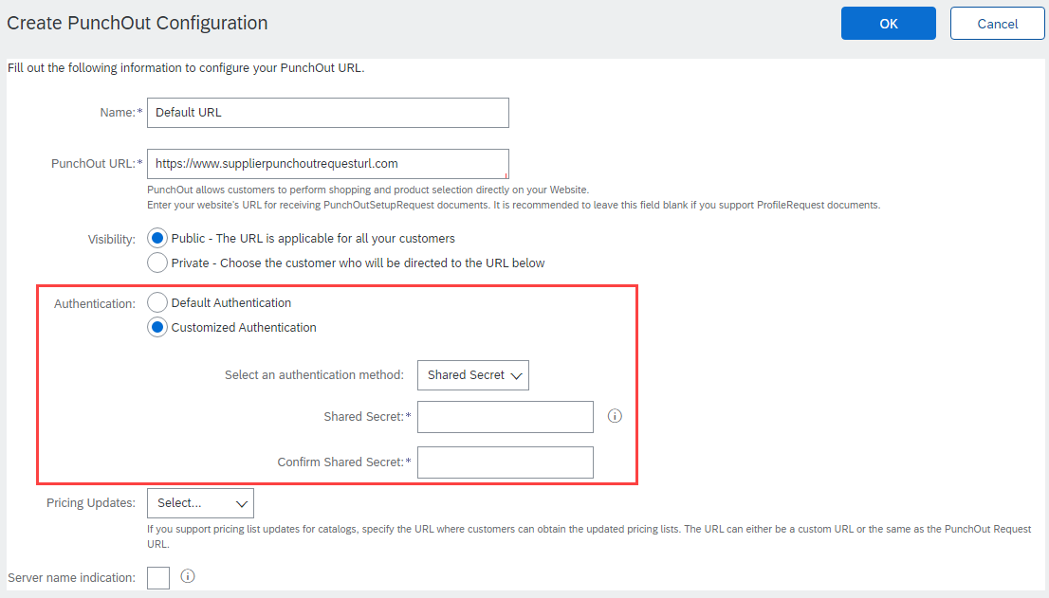
Configuring a SAP Business Network Account for PunchOut
Next, select an Authentication option. The Preferred method is Shared Secret.
  Customized Authentication: This shared secret is used purely for PunchOut catalog connectivity. These credentials will be sent to your PunchOut site to authenticate requests from ALL Buyers.
  Default Authentication: This Account Level authentication is used for all cXML transactional documents and is maintained in another section of your Supplier account. More detail regarding this topic and setup is covered in section Native cXML transaction setup PunchOut Index File Template.
If using the customized option, type in your Shared Secret, and confirm it.

Slide 10
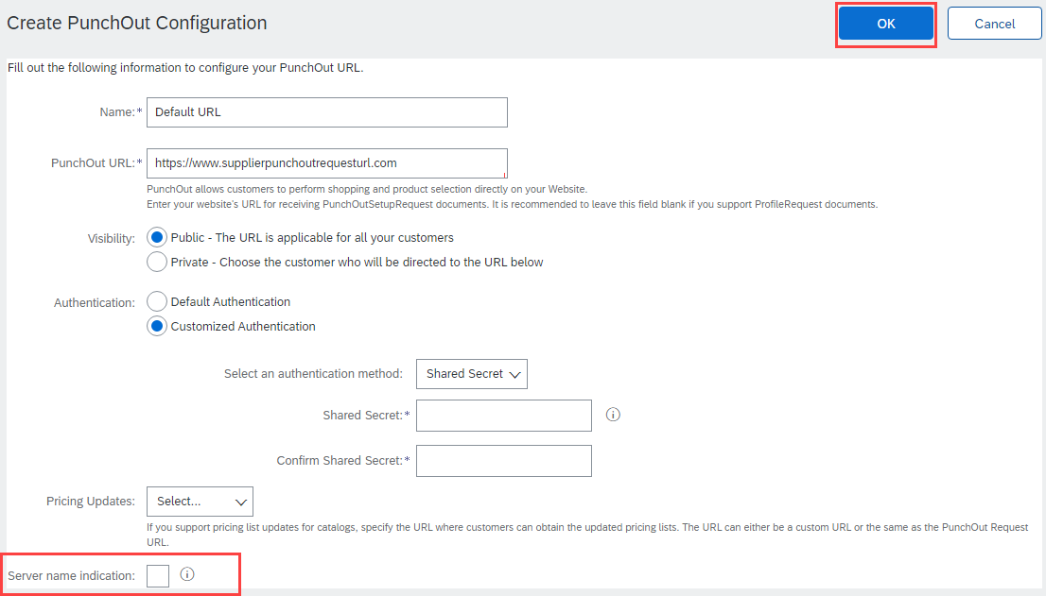
Configuring a SAP Business Network Account for PunchOut
  Uncheck if your URL is not Server Name Indication (SNI) enabled.
Click OK

Slide 11
Native cXML transaction setup

Slide 12
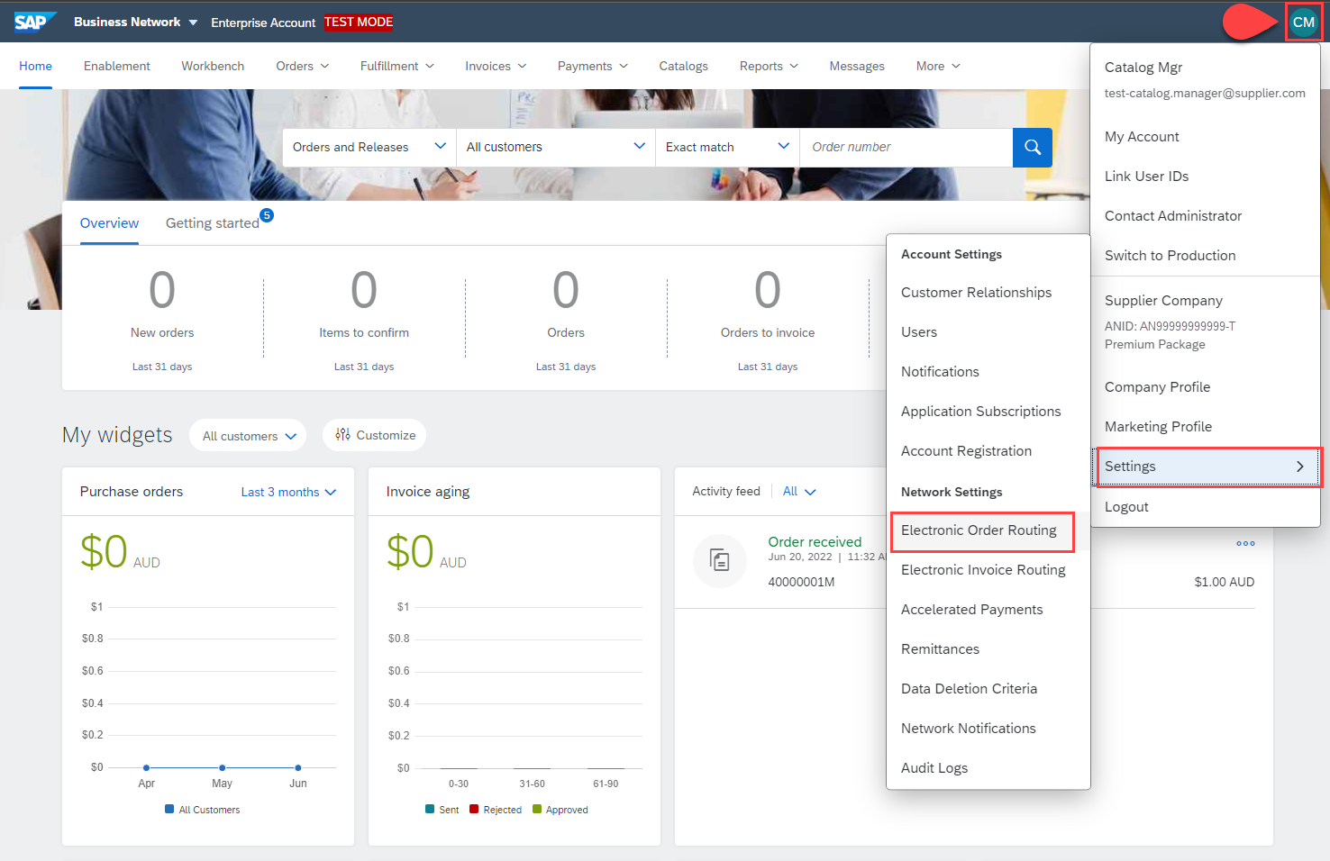
Native cXML transaction setup
This option refers to the account level Default Authentication. This option would be used for all cXML transactional documents across all customers.
To access this authentication setup:
  Click your initials
  Select Settings
  Click Electronic Order Routing

Slide 13
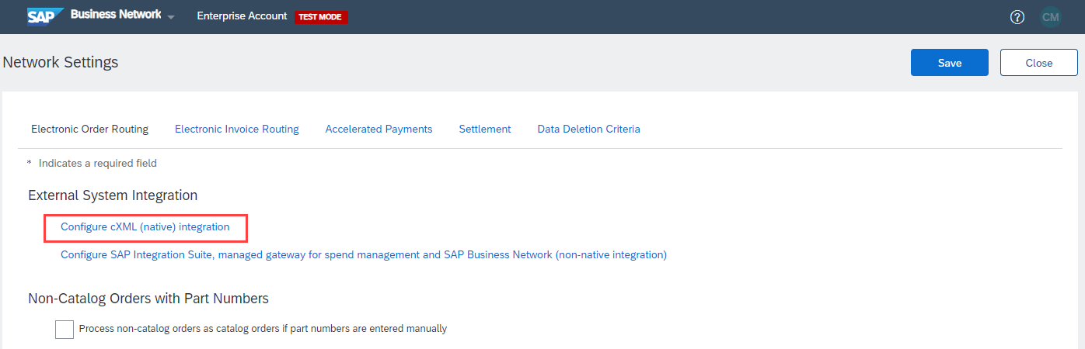
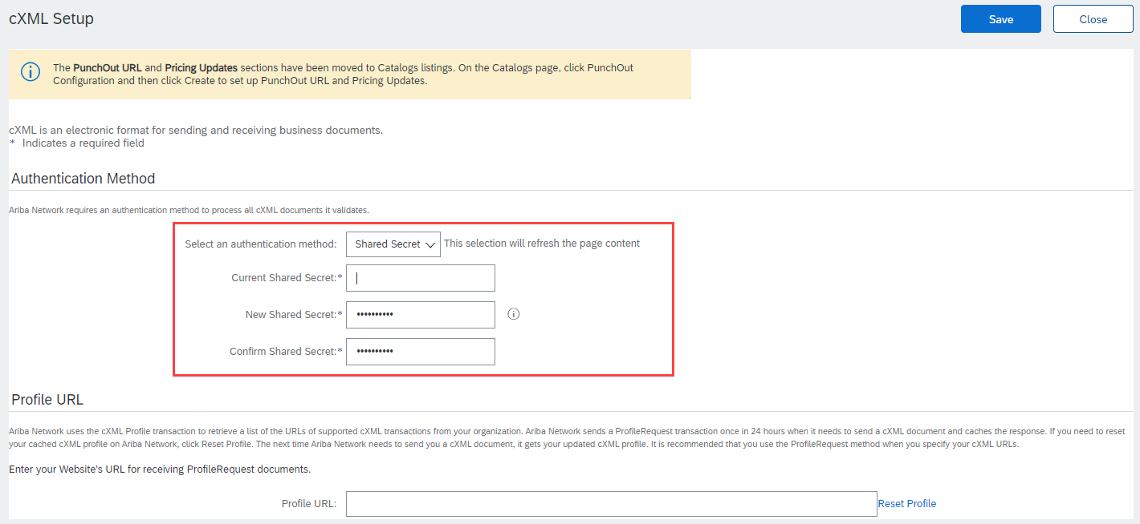
Native cXML transaction setup
  Click Configure cXML (native) Integration
Select your Authentication Method. The Preferred method is Shared Secret.
Type in your Shared Secret credentials.
  This Shared Secret will be sent to your systems to authenticate requests.
Click OK

Slide 14
Configuring your Customer Specific PunchOut URL connection

Slide 15
Configuring your Customer Specific PunchOut URL connection
In some cases, you may wish to use a unique PunchOut URL, that is different to your Default URL, for a specific customer.
To configure your customer specific PunchOut URL connection, please follow these steps.
Login to your SAP Business Network Supplier Account (https://supplier.ariba.com)
Assistance from your IT Manager may be needed for the following slides.

Slide 16
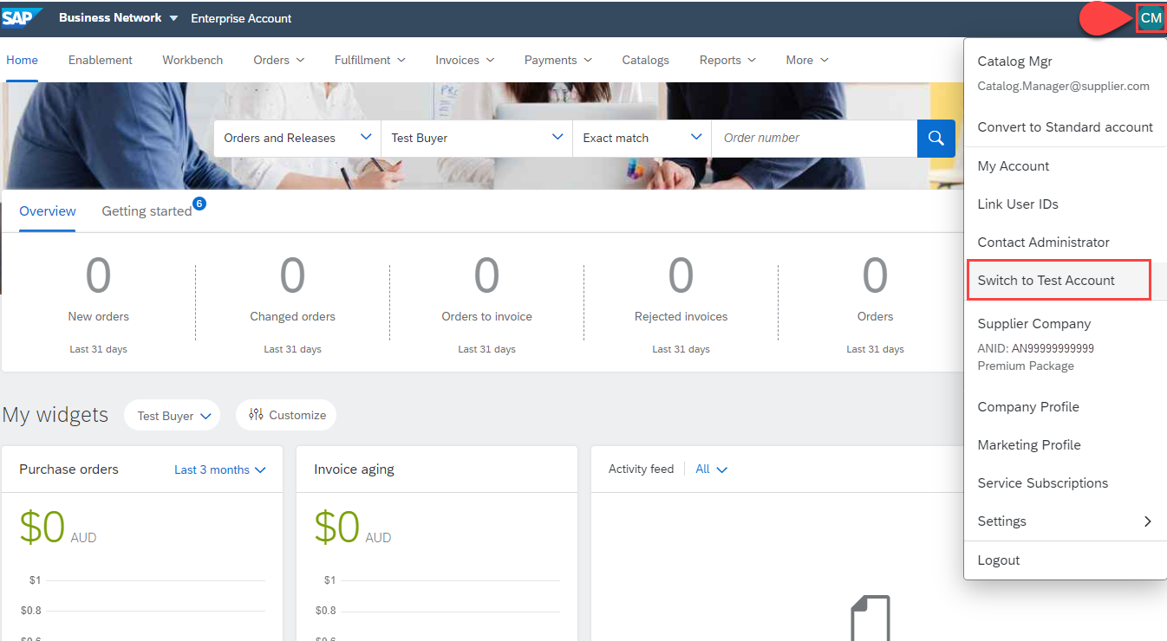
Configuring your Customer Specific PunchOut URL connection
Switch to your Test Account
  Your Network Account needs to be set up in both your Test and Production environments
  Find your initials in the upper right corner and click for the pull down menu, then click “Switch To Test Account”
  If you don’t see a “Switch to Test Account” link,
  your Test account has not yet been set up.
  Contact your SAP Business Network
  Administrator
  You will get a warning.
  “You are about to switch to Test Mode.”
  Click “OK”

Slide 17
Configuring your Customer Specific PunchOut URL connection
Go to Catalog tab, choose Customer Catalogs, and click PunchOut Configuration.
Please note the next steps need to be completed in your Test and Production environments.

Slide 18
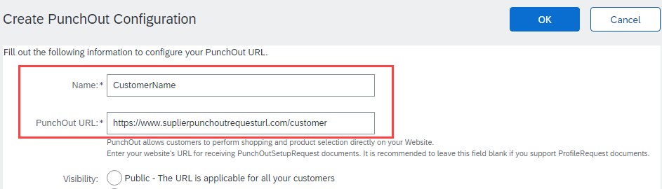
Configuring your Customer Specific PunchOut URL connection
To create your customer specific PunchOut Catalog connection:
Click on Create
In the Name field, write your customer’s company name.
Add your company’s complete unique PunchOut Request URL within the PunchOut URL field. This is the
location where your customer’s specific PunchOut requests will be sent to. This field is checked,
and its value used each time your customer punches out to your site.

Slide 19
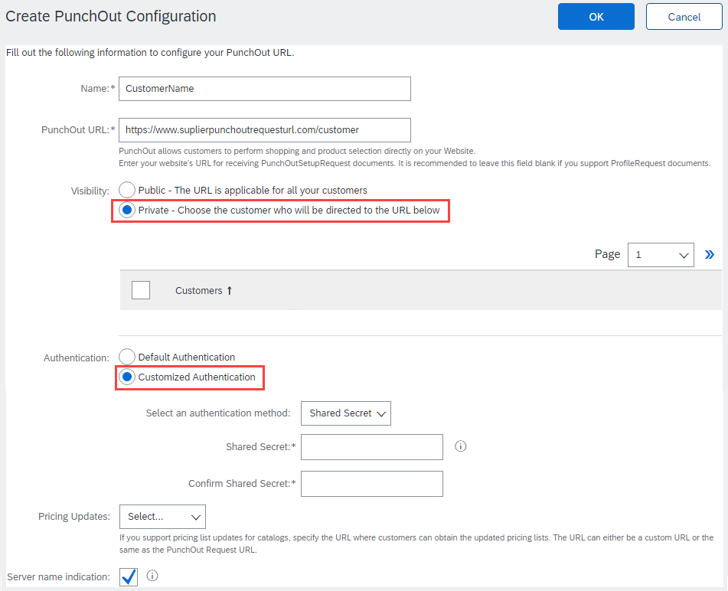
Configuring your Customer Specific PunchOut URL connection
Select Private visibility as this URL is applicable to only your specific customer.
    Note: A table will appear and show all existing customer relationships.
Next, select Customized Authentication option. The Preferred method is Shared Secret. This Shared Secret will be sent to you to authenticate requests from your Buyers. Type in your Shared Secret, and confirm it.

Slide 20
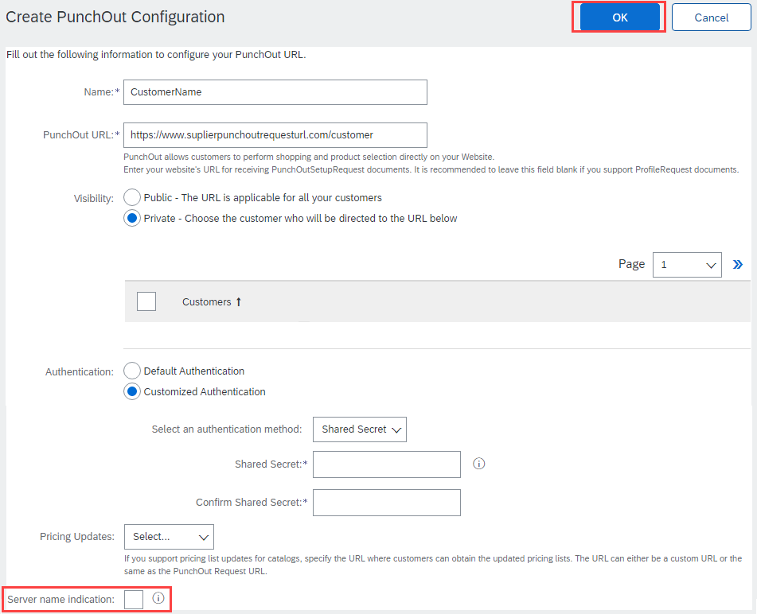
Configuring your Customer Specific PunchOut URL connection
  Uncheck if your URL is not Server Name Indication (SNI) enabled.
Click OK

Slide 21
Setting up Default Level 1
Index File Template Details

Slide 22
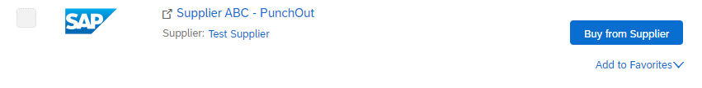
Setting up Default Level 1 Index File Template Details
In Level 1 PunchOut, the catalog file is a simple, one line Index file. This is because a Level 1 Catalog appears on the catalog interface just as a link to the Supplier’s website.
The PunchOut icon tells the User that this is an external catalog, as well as the “Buy From Supplier” button.

Slide 23
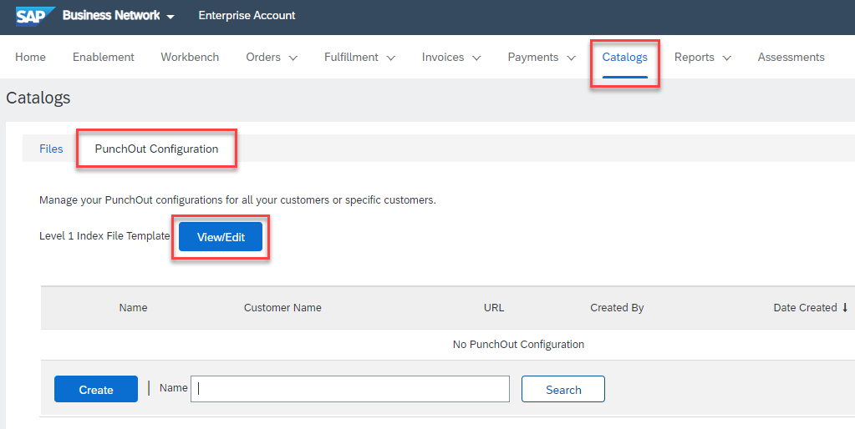
Setting up Default Level 1 Index File Template Details
Enter default PunchOut details by specifying standard information and company logos to be applied to all future PunchOut Level 1 catalog templates.
Go to Catalogs tab, choose Customer Catalogs, and then click the PunchOut Configuration tab.
Click View/Edit to start populating your default Level 1 Index File Template Form details.

Slide 24
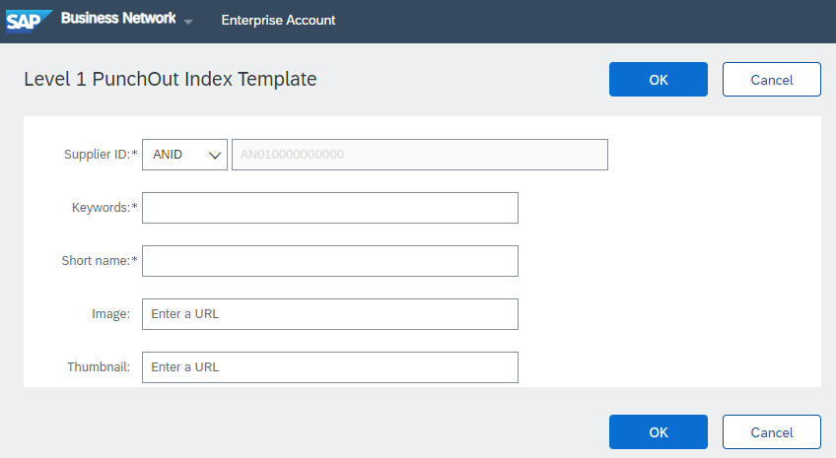
Setting up Default Level 1 Index File Template Details
This is where default information can be specified.
This information will be visible to any customers when you use the PunchOut Level 1 Template.
Information about each field is captured on the next page.
Once populated you can click the OK button to save your changes.

Slide 25
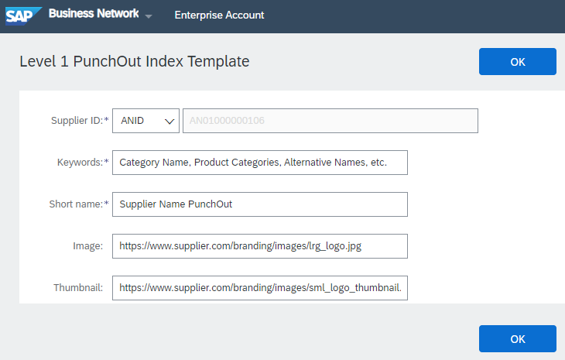
Setting up Default Level 1 Index File Template Details
Supplier ID - Required
Description: This will default to your ANID or can be changed to your DUNS, if it is maintained in your supplier profile.
Note: If you publish the Catalog in your test account, add a suffix –T to your ANID or DUNS number like this: AN99999999999-T
Keywords - Required
Description: Additional keywords to help users find items, this information will also populate the Item Description field when creating a customer catalog online.
Type of data: String
Maximum length: 255
Example: Pens, Pencils, Paper, Copier
Short Name - Required
Description: In L1 PunchOut, this is what will actually display to the User on the UI
Type of data: String
Example: <SupplierName> PunchOut
Maximum length: 50 characters
Image – Optional but Preferred
Description: In L1 PunchOut, this can be your company logo that will display to the User on the UI
Type of data: URL that begins with https://, as required by SAP.
Example: https://www.supplier.com/branding/images/lrg_logo.jpg
Thumbnail - Optional
Description: In L1 PunchOut, this can be your company logo that will display to the User on the UI
Type of data: URL that begins with https://, as required by SAP
Example: https://www.supplier.com/branding/images/sml_logo_thumbnail.jpg

Slide 26
Creating and Publishing
PunchOut Level 1 Catalogs Online
*Within your SAP Business Network Account, not using the Excel file.

Slide 27
Creating and Publishing PunchOut Level 1 Catalogs Online
Login to Ariba Network
    Go to: https://supplier.ariba.com
    Log in with your Username and Password

Slide 28
Creating and Publishing PunchOut Level 1 Catalogs Online
Switch to your Test Account
  Your Catalog should be loaded and tested in your Test Account prior to loading the catalog in Production. (Note: If you are instructed to load a Catalog to a Production account, just skip this step)
  Find your initials in the upper right corner and click for the pull-down menu, then click “Switch To Test Account”
  If you don’t see a “Switch to Test Account” link, your Test account has not yet been set up. Contact your SAP Business Network Administrator
  You will get a warning.
  “You are about to switch to Test Mode.”
  Click “OK”

Slide 29
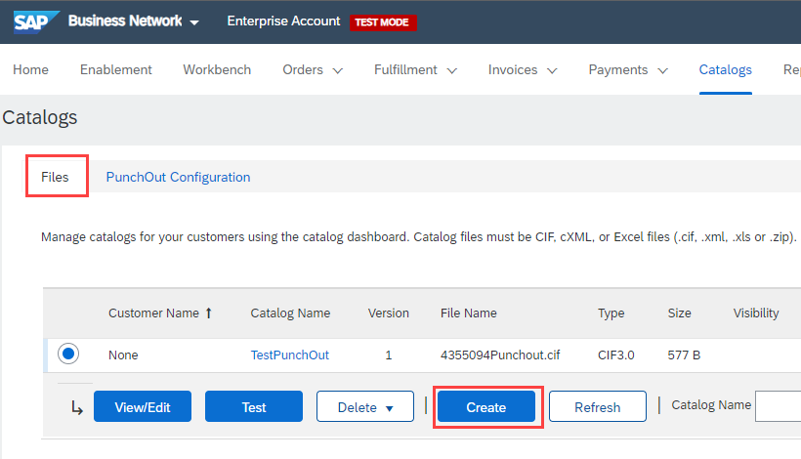
Creating and Publishing PunchOut Level 1 Catalogs Online
Navigate to the Catalogs Tab and click “Customer Catalogs” tab.
Click “Files” tab.
On the Catalogs screen, click the
“Create” button.

Slide 30
Creating and Publishing PunchOut Level 1 Catalogs Online
When creating a Catalog within your SAP Business Network account, there are four steps you will follow:
  Populate—During this step, you enter specific information related to your catalog, such as the Catalog name (this becomes the “Subscription Name” in the Buyer’s local Catalog) descriptive text, and classify it so that buying organizations that are looking for specific products and services can find your Catalog.
  Setting Visibility—Allows you to specify whether the Catalog version is “Public” or “Private” and determines which of your Customers can access it
  Validating—The Network checks the Catalog for errors, checks for zero price values and does a high-level validation of UNSPSC codes and Units of Measure
    (Note: Customer-specific validation rules for UNSPSC and UOM codes, and zero price values can be more detailed and much more strict than the high-level Network validations, therefore your Catalog may pass the Network validations but fail the Customer-specific validations for these same items)
  Publishing—Freezes the current version and notifies your Customer of the Catalog’s availability

Slide 31
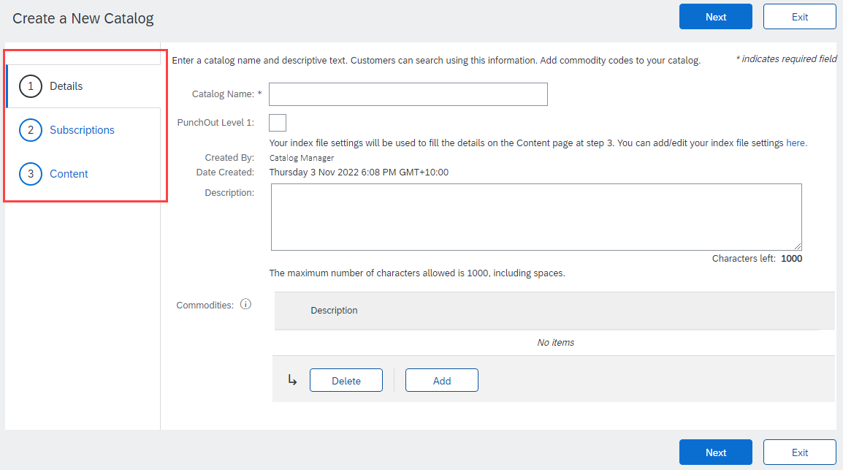
Creating and Publishing PunchOut Level 1 Catalogs Online
You are now on the Create a New Catalog screen
To create the Catalog, there is a 3-step Wizard:
  Details—General information about the Catalog
  Subscriptions—Who you are publishing the Catalog to
  Content—Uploading the actual Catalog file

Slide 32
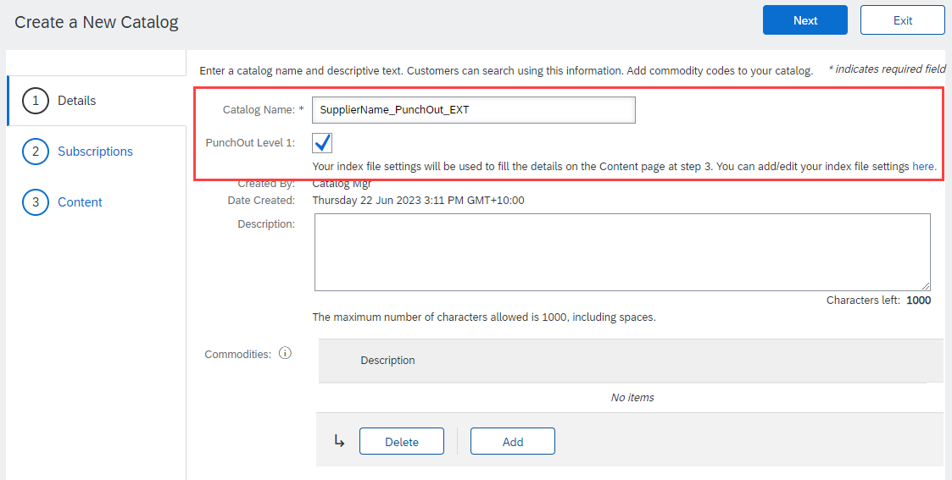
Creating and Publishing PunchOut Level 1 Catalogs Online
Details
  Catalog Name: This becomes the “Subscription Name” for this Catalog that will not change. The format for this Name is set by your customer. Use this format (no special characters are allowed, you can use a dash (-) or underscore(_)):
  SupplierName_UnionPacific_Region_CatalogType, for example: MySupplier_UnionPacific_US_Punchout (or L1)
  PunchOut Level 1: Check this box to apply the default template details.
  Description: (Optional) Brief description of the content of your Catalog
  Commodities: (Optional) The UNSPSC code(s)
  that corresponds to the items family/ group of your Catalog. Use the “Add” button to find the code
  When you complete this screen, click “Next”
Notes:
.

Slide 33
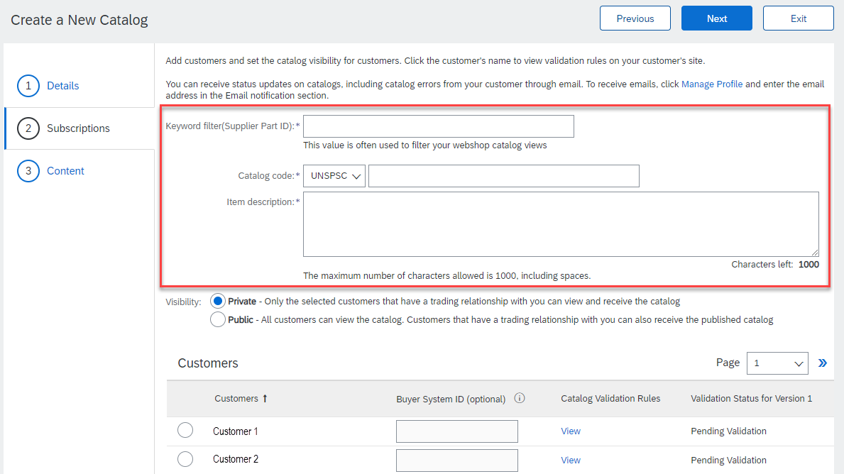
Creating and Publishing PunchOut Level 1 Catalogs Online
Subscriptions
  Populate the fields which will be used to help generate the catalog index file.
Supplier Part ID - Required
Description: This can be a default value such as AAA, or a customer specific value if your PunchOut solution validates on additional information.
Note: If you provide more than one catalog for the same customer, please see the Appendix – Template and Catalog File Creation section.
Maximum length: 255
Catalog Code - Required
Description: Classification of the main product or service you sell. It is recommended to use a high level commodity code that best represents the overall category of products/services sold to your customer. This will determine where your Supplier link appears in the catalog hierarchy—not what the actual items are.
Note: The domain can be changed to; UNSPSC, ECLASS, and Custom. Consult with your customer specific materials for their accepted commodity codes.
Item Description - Required
Description: In L1 PunchOut, use keywords from product categories and services available on the Supplier’s site. These keywords are searched and display the Supplier’s PunchOut link when matched.
Along with the prepropulated keywords, you will have an additional 745 characters to add additional information about the content you provide.
Maximum length: 1000

Slide 34
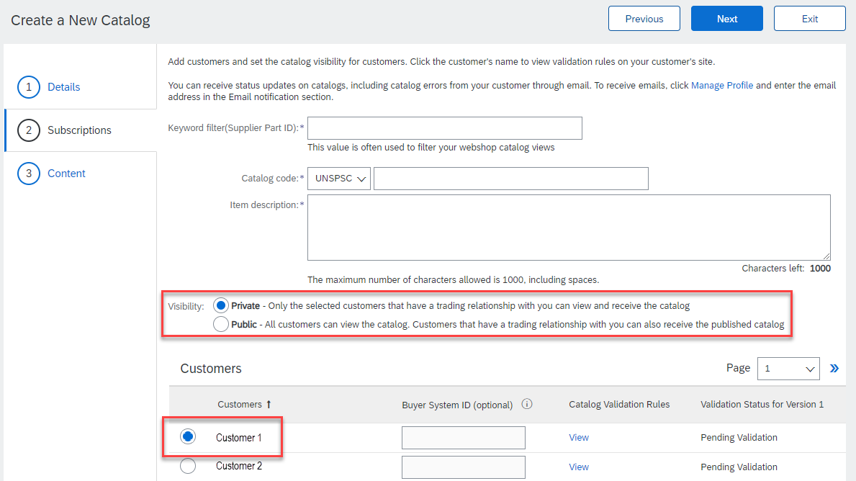
Creating and Publishing PunchOut Level 1 Catalogs Online
Subscriptions
  You determine which Customers subscribe to your Catalog—specific Customer(s) or to all Customers on the Network
  Set the Visibility to “Private”. You can select a single customer.
  To select your Customer, click the radio button next to their name in the "Customers" list.
  If the Customer does not appear, it means
  that your company has not established a
  relationship with your Customer yet.
  This is required prior to publishing a
  Catalog to them.
  When you complete this screen, click “Next”.

Slide 35
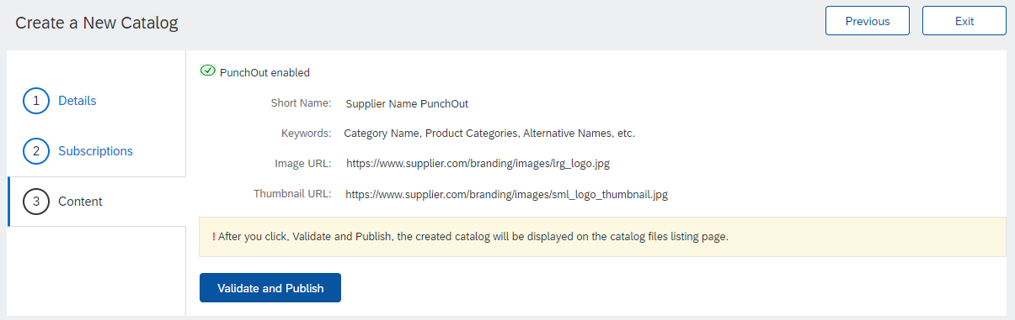
Creating and Publishing PunchOut Level 1 Catalogs Online
Content
  The system will display a brief summary of the contents.
  If everything is correct click the “Validate and Publish” button.
  The catalog will then be validated by the system, and then published to selected customers.
  You will be able to see the catalog subscription under the Catalog Files tab.

Slide 36
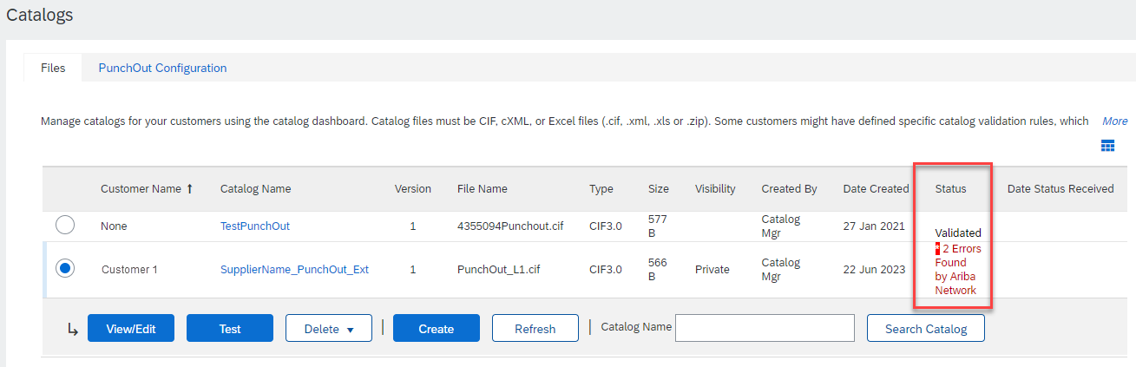
Creating and Publishing PunchOut Level 1 Catalogs Online
Network Catalog Validation
  After the Network completes validation, it changes the Catalog status from “Validating” to one of the following statuses:
    Validated, Published or Pending Buyer Validation—your Catalog is error-free.
    Errors Found by SAP Business Network—the Network detected Catalog content that violates validation rules.
    Bad Format—your Catalog failed the file validation check. Audit the file for problems in format.
  A Catalog with an error status means you need to review the error results and correct them before going on.

Slide 37
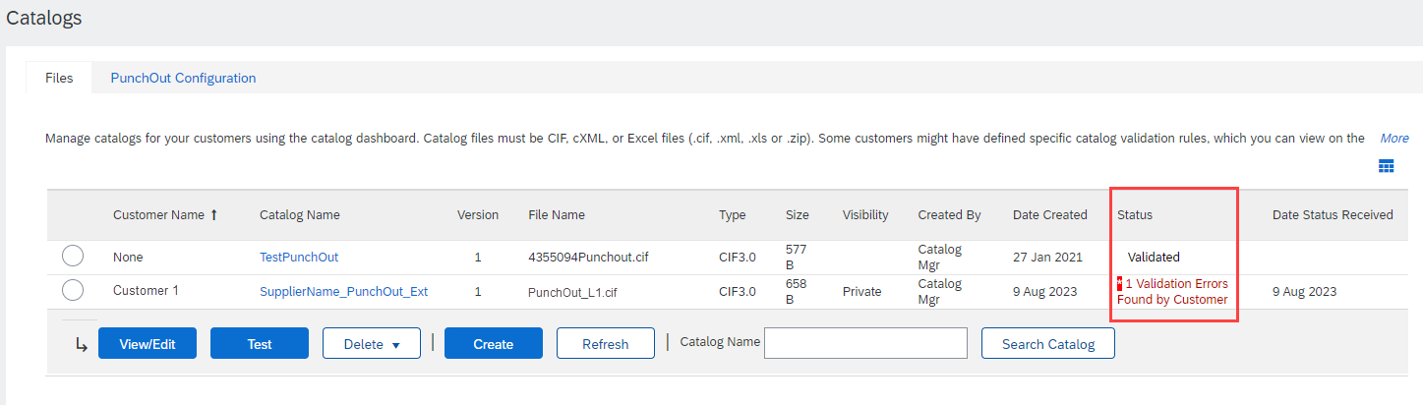
Creating and Publishing PunchOut Level 1 Catalogs Online
Correcting Validation Errors
  To see the error detail, click on the “Errors Found” hyperlink:

Slide 38
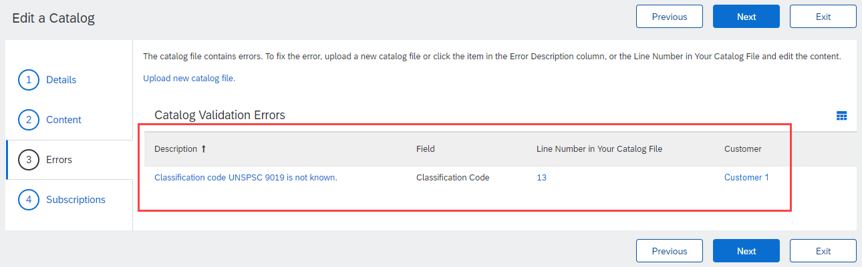
Creating and Publishing PunchOut Level 1 Catalogs Online
Viewing Validation Errors
  The Network displays Description, Field and Line Number for each error
  In this case, the Network is telling us that the Commodity Code is not found.
  To correct any issues that didn’t pop up during the process described in slides 51-54, a new version of the catalog will need to be created either online or through a catalog template.

Slide 39
Creating and Publishing PunchOut Level 1 Catalogs Online
Customer Approval
  When your Catalog passes the Network upload validation, your Customer is then notified to audit, validate and approve your Catalog. The Network may show any of these statuses: “Published”, “Validated by Customer” or “Pending Buyer Validation”—note that these are all valid statuses
  Each Customer may have specific validation rules—and these rules may be more strict than the standard Network rules. This means that your Catalog could pass the Network validation, but fail the Customer-specific rules and be returned to you
  If your Customer finds anything in your Catalog file that requires your attention, you will be notified by e-Mail
    Each Catalog must pass both the Network validation, and the Customer audit before it can be loaded into the Customer’s buying application and be available for their Users.

Slide 40
Template and Catalog File Creation for a Level 1 PunchOut Catalog

Slide 41
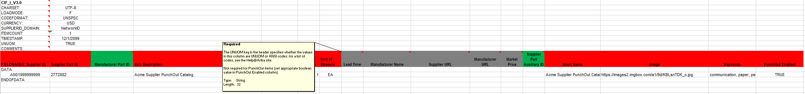
PunchOut L1 Template
A PunchOut Template is a special CIF Template that creates a PunchOut Index file. There is an addition field which changes a CIF file to a PunchOut Index file called PunchOut Enabled.
Here is a sample L1 PunchOut Template in Excel format.
The Template is color coded and has Tool Tips that provide information about how to treat each field.
Each Template includes specific instructions, including custom fields or other requirements set by your Customer.

Slide 42
Templates and Catalog Creation – L1 PunchOut
In Level 1 PunchOut, the catalog file is a simple, one line Index file. This is because a L1 Catalog appears on the catalog interface just as a link to the Supplier’s website.
The PunchOut icon tells the User that this is an external catalog, as well as the “Buy From Supplier” button.

Slide 43
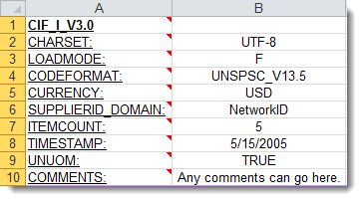
Creating a L1 PunchOut Catalog
The Header Section
CIF_I_V3.0—Specifies the Catalog format (CIF 3.0). Do not change this value
CHARSET—UTF-8 Specifies the data coding type. Do not change this value, unless instructed by your Catalog Expert
LOADMODE—F (Full) or I (Incremental)
CODEFORMAT—Specifies the commodity coding (UNSPSC: United Nations Standard Products and Services Code) in the field “SPSC Code”
CURRENCY—Specifies the currency used for the prices. The value “USD” (United States Dollar) is here by default and can be changed to a difference currency
SUPPLIERID_DOMAIN—Specifies the Domain used. The preferred value is the Supplier’s Business Network ID Number—“NetworkID”. Other values include “DUNS”, “internalsupplierid” or other custom values
ITEMCOUNT—Specifies the number of items of the Catalog. Enter the total number of all items between the DATA and ENDOFDATA markers
TIMESTAMP—Enter the date you created your Catalog.
UNUOM—If set to “TRUE”, the Unit Of Measure is set to UNUOM (United Nations Unit of Measure); if set to “FALSE”, the value is set to ANSI. (Ariba recommends UNUOM)
  COMMENTS—This field is optional, but can be used for comments related to your Catalog. It is a good place to enter the Supplier Name, the Customer Name and Catalog Name
Note: The only fields that Suppliers should modify in the Template are indicated in red: CURRENCY, ITEMCOUNT, TIMESTAMP and COMMENTS. All the other fields are predefined in the Template for the Customer and should not be modified, unless instructed by a Catalog Expert.

Slide 44
Creating a L1 PunchOut Catalog
The Data Section
Supplier ID | Supplier Part ID | Manufacturer Part ID
AN99999999999 | PurchGrp500
Supplier ID - Required
Description: If the Header is set to “NetworkID”, then enter the Supplier’s Business Network ID, otherwise the appropriate value for the Domain used—DUNS, internalsystem, etc. Ask your Catalog Expert if you have questions. For PunchOut, be sure the Supplier can accept the Domain and value in their system for authentication
Type of data: String
Maximum length: 255
Example: AN99999999999
Note: If you publish the Catalog in your test account, add a suffix –T to your ANID or DUNS number like this: AN99999999999-T
Supplier Part ID - Required
Description: In L1 PunchOut this can be any value. It is required to be populated. You could set a keyword for your PunchOut system to evaluate here if you wish
NOTE: If you provide more than one catalog for the same customer, make sure the items across these catalogs do not share the same Part ID + Part Auxiliary ID as this duplicates will cause erratic behavior in the application.
Type of data: String
Maximum length: 255
Example: 2772882
Manufacturer Part ID - Optional
Description: In L1 PunchOut this can be any value. It is not required to be populated, but the field must remain. You could set a keyword for the Supplier to evaluate here if you wish
Type of data: String
Maximum length: 255
Example: TTSIBM412CID
F I E L D C O L O R C O D E S
 | Required
 | Optional
 | Optional, but preferred
 | Do not use

Slide 45
Creating a L1 PunchOut Catalog
Item Description | SPSC Code | Unit Price
Pen, Sharpie, staple, tape, folder, post-it, scissors, mouse | 4412 | 1.00
Item Description - Required
Description: In L1 PunchOut, use keywords from product categories and services available on the Supplier’s site. These keywords are searched and display the Supplier’s PunchOut link when matched
Note: To use a special character as a literal value, you need to “escape” it by putting a backslash (\) in front of it. For example, \" lets a double quote be seen as a quote instead of a delimiter for an entry. To escape a quote (") within a quoted field, use two quotes ("")
Type of data: String
Maximum length: 2000
Example: Printer, Laser, Inkjet, laptop, tablet, mouse, HP, Apple, Microsoft, Software
SPSC Code - Required
Description: Classification of the main product or service you sell. It is recommended to use a high level (Level 1 or 2) commodity code that best represents the overall category of products/services sold to your customer. For L1 PunchOut, this commodity code will only determine where the Supplier link appears in the catalog hierarchy—not what the actual items are.
Type of data: String
Maximum length: 40
Example: 440000 (level 1) and 44120000 (level 2)
Note: Ariba supports UNSPSC Version 13.5. A code list is available in your Customer’s Supplier Information Portal
Unit Price - Required
Description: In Level 1 PunchOut, the price is not used, but must be populated. It is suggested that you set the value to 1.00
Type of data: Decimal
Example: 1.00
Note: To separate the integer from the decimal, you must use a ‘dot’ and not a comma. Also, do not use a comma to indicate ‘thousands’. Do not include any currency symbols such as $, £ or ¥.

Slide 46
Creating a L1 PunchOut Catalog
Unit of Measure | Lead Time | Manufacturer Name
EA
Unit of Measure - Required
Description: For L1 PunchOut, this is just populated to meet the system requirement—UOM is not used. It is suggested that you use EA
Type of data: String
Maximum length: 32
Example: EA
Lead Time - Do Not Use
Description: For L1 PunchOut, this is not used, but the field must remain
Type of data: Integer
Maximum length: 40
Example: 1
Manufacturer Name - Do Not Use
Description: For L1 PunchOut, this is not used, but the field must remain
Type of data: String
Maximum length: 255
Example: Epson

Slide 47
Creating a L1 PunchOut Catalog
Supplier URL | Manufacturer URL | Market Price
Supplier URL - Do Not Use
Description: For L1 PunchOut, this is not used, but the field must remain
Type of data: String
Maximum length: 255
Example: https://www.supply.com/Catalog/product18.htm
Manufacturer URL - Do Not Use
Description: For L1 PunchOut, this is not used, but the field must remain
Type of data: String
Maximum length: 255
Example: https://www.manu.com/Catalog/product18.htm
Market Price - Do Not Use
Description: For L1 PunchOut, this is not used, but the field must remain
Type of data: Decimal
Example: 4.32 or 1234.78

Slide 48
Creating a L1 PunchOut Catalog
Supplier Part Auxiliary ID | Short Name
Seattle | SupplierABC PunchOut
Supplier Part Auxiliary ID - Optional
Description: In L1 PunchOut, this can be used to convey a value for the Supplier to process, and send back the appropriate catalog URL
NOTE: If you provide more than one catalog for the same customer, make sure the items across these catalogs do not share the same Part ID + Part Auxiliary ID as this duplicates will cause erratic behavior in the application.
Type of data: String
Maximum length: 255
Example: 1234 French
Note: If any items have the same reference (Supplier Part ID column), this column allows you to differentiate them
Short Name - Required
Description: In L1 PunchOut, this is what will actually display to the User on the UI
Type of data: String
Example: <SupplierName> PunchOut
Maximum length: 50 characters

Slide 49
Creating a L1 PunchOut Catalog
Image | Keywords | PunchOut Enabled
https://www.mylogo12354.jpg | IT, communication, paper, pens | TRUE
Image - Required
Description: URL of the item’s image (preferred and in https: format as required by SAP), or filename of the image (sent in a zip file)
Supported image formats: JPG, JPEG, GIF, PNG, BMP—(JPG preferred)
Type of data: String
Maximum length: 255
Recommended Size: 250 x 250 pixels
Keywords - Required
Description: Additional keywords to help users find items
Type of data: String
Maximum length: 255
Example: Pens, Pencils, Paper, Copier
PunchOut Enabled - Required
Description: Tells the system that this file is a PunchOut Index file. Must be set to TRUE for the system to see this as a PunchOut item
Type of data: Boolean

Slide 50
Creating a L1 PunchOut Catalog
Special Notes for Images
In the Catalog file, you can refer to a Remote Image—using a URL—or you can refer to a Local Image, and send that image to your Customer to store
Using Remote Images is preferred
  Be sure the URL in the Template is complete (including https:// as required by SAP)
  Example: https://server/directory/imagefilename.jpg
Point to the image itself—not a program that serves up images
If you use Local Images
  Be sure the filename in the Template is exact—including upper and lower case
  Example: FileName.jpg -or- lowercasename.jpg
Load images in a zip file format with the Customer Name and Supplier Name on the SBN Account

Slide 51
Template and Catalog File Creation for a Level 2 PunchOut Catalog

Slide 52
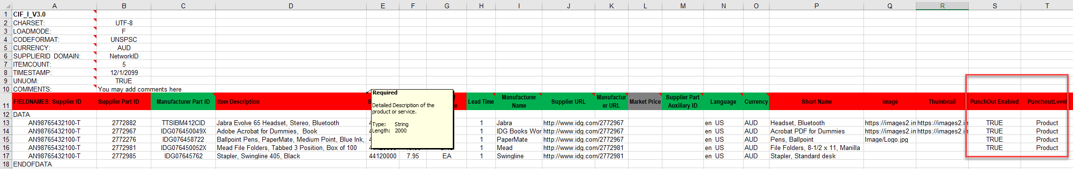
PunchOut L2 Template
A PunchOut L2 Template is a special CIF Template that creates a PunchOut Index file. The addition of two fields changes a CIF file to a PunchOut Index file. The fields are:
PunchOut Enabled and
PunchOutLevel
Here is a sample L2 PunchOut Template in Excel format.
The Template is color coded and has Tool Tips that provide information about how to treat each field.
Each Template includes specific instructions, including custom fields or other requirements set by your Customer.

Slide 53
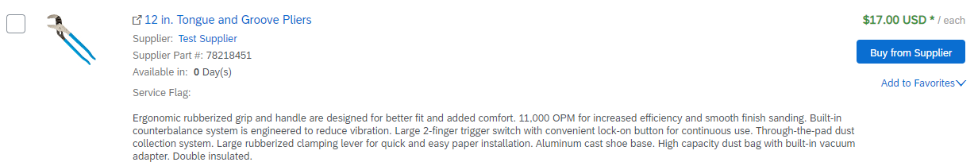
Creating a L2 PunchOut Catalog
In Level 2 PunchOut, the catalog file is a combination of static catalog information (this is used to search) and it also contains the PunchOut Enabled and PunchOut Level fields, to tell the system that this is a PunchOut catalog, and the User will be taken to the Supplier’s website to add items to their cart as they shop.
L2 PunchOut items appear on the Catalog interface just as a static item does, but has the “Buy from Supplier” button instead of “Add to Cart”.
The PunchOut icon tells you that this is an external catalog, as well as the “Buy From Supplier” button.

Slide 54
Creating a L2 PunchOut Catalog
The Header Section
CIF_I_V3.0—Specifies the Catalog format (CIF 3.0). Do not change this value
CHARSET—UTF-8 Specifies the data coding type. Do not change this value, unless instructed by your Catalog Expert
LOADMODE—F (Full) or I (Incremental)
CODEFORMAT—Specifies the commodity coding (UNSPSC: United Nations Standard Products and Services Code) in the field “SPSC Code”
CURRENCY—Specifies the currency used for the prices. The value “USD” (United States Dollar) is here by default and can be changed to a difference currency
SUPPLIERID_DOMAIN—Specifies the Domain used. The preferred value is the Supplier’s Business Network ID Number—“NetworkID”. Other values include “DUNS”, “internalsupplierid” or other custom values
ITEMCOUNT—Specifies the number of items of the Catalog. Enter the total number of all items between the DATA and ENDOFDATA markers
TIMESTAMP—Enter the date you created your Catalog.
UNUOM—If set to “TRUE”, the Unit Of Measure is set to UNUOM (United Nations Unit of Measure); if set to “FALSE”, the value is set to ANSI. (Ariba recommends UNUOM)
  COMMENTS—This field is optional, but can be used for comments related to your Catalog. It is a good place to enter the Supplier Name, the Customer Name and Catalog Name
Note: The only fields that Suppliers should modify in the Template are indicated in red: CURRENCY, ITEMCOUNT, TIMESTAMP and COMMENTS. All the other fields are predefined in the Template for the Customer and should not be modified, unless instructed by a Catalog Expert.
F I E L D C O L O R C O D E S
 | Required
 | Optional
 | Optional, but preferred
 | Do not use

Slide 55
Business Network – File Size Limits
CIF Format : When using the catalog wizard, the catalog file can't exceed 95 MB or 400,000 lines.
Excel Format : The maximum size of zipped Excel file that you can upload is 1 MB (uncompressed). If your Excel files exceed these size, you can convert them to CIF manually and upload the CIF files. Business Network uploads the file, unzips it if necessary, converts it to CIF format, and starts validation. Conversion from Excel to CIF can take several minutes depending on the catalog size. As Excel files convert, their status is Validating.
cXML Format: If you use the cXML CatalogUploadRequest transaction, the zipped catalog file cannot exceed 10 MB, and the unzipped CIF file cannot exceed 95 MB (approximately 400,000 line items). To have this default size limit increased to 200 MB, contact SAP Ariba Customer Support.

Slide 56
Creating a L2 PunchOut Catalog
The Data Section
Supplier ID | Supplier Part ID | Manufacturer Part ID
AN99999999999 | 12345 | CFG 11562
AN99999999999 | 87690 | 87690-12
AN99999999999 | 479-56 | A100-BLK
Supplier ID - Required
Description: If the Header is set to “NetworkID”, then enter the Supplier’s Business Network ID, otherwise the appropriate value for the Domain used—DUNS, internalsystem, etc. Ask your Catalog Expert if you have questions. For PunchOut, be sure the Supplier can accept the Domain and value in their system for authentication
Type of data: String
Maximum length: 255
Example: AN99999999999
Note: If you publish the Catalog in your test account, add a suffix –T to your ANID or DUNS number like this: AN99999999999-T
Supplier Part ID - Required
Description: Part Number used by the Supplier. The Part Number must be unique for each item in the Catalog.
NOTE: If you provide more than one catalog for the same customer, make sure the items across these catalogs do not share the same Part ID + Part Auxiliary ID as this duplicates will cause erratic behavior in the application.
Type of data: String
Maximum length: 255
Example: 2772882
Manufacturer Part ID - Optional
Description: A Part Number that a Manufacturer uses
Type of data: String
Maximum length: 255
Example: TTSIBM412CID

Slide 57
Creating a L2 PunchOut Catalog
Item Description | SPSC Code | Unit Price
Pens, Bic, Ballpoint, Blue, 1 dozen | 43191504 | 3.48
Stapler, Swingline, Black | 55010125 | 18.72
Post-It, Yellow, 1”x2”, pad of 100 | 15874236 | 6.49
Folders, Letter, Manilla, 100 | 89745125 | 12.98
Item Description - Required
Description: Description of the product or service. Make your descriptions as clear and complete as possible (Item type, brand, model, color, etc.)
Note: To use a special character as a literal value, you need to “escape” it by putting a backslash (\) in front of it. For example, \" lets a double quote be seen as a quote instead of a delimiter for an entry. To escape a quote (") within a quoted field, use two quotes ("")
Type of data: String
Maximum length: 2000
Example: Printer, Laser, A4, Epson Stylus Color 740
SPSC Code - Required
Description: Classification of the product or service. Use a UNSPSC code if the Header specifies “UNSPSC” as the CODEFORMAT
Type of data: String
Maximum length: 40
Example: 45678900 (level 3) and 45678923 (level 4)
Note: Ariba supports UNSPSC Version 13.5. A code list is available in your Customer’s Supplier Information Portal
Unit Price - Optional
Description: Customer-specific price. For L2 PunchOuts the price can be left blank if the Buyer agrees
Type of data: Decimal
Example: 4.32 or 1234.78
Note: To separate the integer from the decimal, you must use a ‘dot’ and not a comma. Also, do not use a comma to indicate ‘thousands’. Do not include any currency symbols such as $, £ or ¥.

Slide 58
Creating a L2 PunchOut Catalog
Unit of Measure | Lead Time | Manufacturer Name
EA | 1 | Intelidata
EA | 1 | IDG Book
DZN | 3 | Bic
EA | 1 | Swingline
Unit of Measure - Required
Description: Unit of measure related to the Unit Price. Use a United Nations UOM if the UNUOM in the Header is set to “True”
Type of data: String
Maximum length: 32
Example: BX
Note: A file containing the Units of Measure is available in your Customer’s Supplier Information Portal
Lead Time - Optional
Description: Number of working days for the product to be shipped from the date you receive the Purchase Order
Type of data: Integer
Maximum length: 40
Example: 1
Manufacturer Name - Optional
Description: Name of the manufacturer
Type of data: String
Maximum length: 255
Example: Epson

Slide 59
Creating a L2 PunchOut Catalog
Supplier URL | Manufacturer URL | Market Price
https://www.supplier.com | https://www.manu.com | 12.95
https://www.supplier.com |  | 2296.56
https://www.supplier.com |  | 4.86
https://www.supplier.com |  | 12.86
Supplier URL - Optional
Description: A URL that links to a Supplier static page about the item (could be a MSDS, construction info, packaging info, etc.), in https: format as required by SAP.
Type of data: String
Maximum length: 255
Example: https://www.supply.com/Catalog/product18.htm
Manufacturer URL - Optional
Description: A URL that links to a Manufacturer’s static page about the item (could be a MSDS, construction info, packaging info, etc.), in https: format as required by SAP.
Type of data: String
Maximum length: 255
Example: https://www.manu.com/Catalog/product18.htm
Market Price - Do Not Use
Description: List or retail price.
Note: Does not show on the Ariba UI—this is an informational-only field for Suppliers
Type of data: Decimal
Example: 4.32 or 1234.78
Note: To separate the integer from the decimal, you must use a ‘dot’ and not a comma. Also, do not use a comma to indicate ‘thousands’. Do not include any currency symbols such as $, £ or ¥.

Slide 60
Creating a L2 PunchOut Catalog
Supplier Part Auxiliary ID | Language | Currency
1234-75 | en_US | USD
 | en_US | USD
 | en_US | USD
 | en_US | USD
Supplier Part Auxiliary ID - Optional
Description: Uniquely identifies a single item. For example, items in multiple languages or available in multiple units of measure
NOTE: If you provide more than one catalog for the same customer, make sure the items across these catalogs do not share the same Part ID + Part Auxiliary ID as this duplicates will cause erratic behavior in the application.
Type of data: String
Maximum length: 255
Example: 1234 French
Note: If any items have the same reference (Supplier Part ID column), this column allows you to differentiate them
Language - Optional (If blank, defaults to ‘en_US’)
Description: Specifies the language used to describe the item.
Type of data: String
Maximum length: 255
Example: en_US
Note: A listing of language codes is in your Customer’s Supplier Information Portal
Currency - Optional (Set in Header)
Description: Specifies the currency used for the prices
Type of data: String
Maximum length: 32
Example: USD, CAD (Canadian Dollar)
Note: A listing of currency codes is in your Customer’s Supplier Information Portal

Slide 61
Creating a L2 PunchOut Catalog
Short Name | Image
Soft Drink, Soda, Dr Pepper | 12354.jpg
Dairy, Milk, 1% milkfat | https://www.1.com/34.jpg
Coffee, Dark Roast, Starbucks | 587.Jpg
Soft Drink, Juice, Minute Maid | https://www.1.36.jpg
Short Name – Optional
Description: Short description of the item. The Short Name is displayed first in the UI, and is in a larger type face and blue color. You can use the Short Name to describe a category or Item type, then give the specifics in the Item Description.
Type of data: String
Example: Nylon Glove, Blue
Maximum length: 50 characters
Note: If the “Short Name” field is left blank, the first 50 characters of the Item Description column will automatically fill the “Short Name” field.
Image - Optional but Preferred
Description: URL of the item’s image (preferred), or filename of the image (sent in a zip file)
Supported image formats: JPG, JPEG, GIF, PNG, BMP—(JPG preferred)
Type of data: String
Maximum length: 255
Recommended Size: 250 x 250 pixels

Slide 62
Creating a L2 PunchOut Catalog
Special Notes for Images
In the Catalog file, you can refer to a Remote Image—using a URL—or you can refer to a Local Image, and send that image to your Customer to store
Using Remote Images is preferred
  Be sure the URL in the Template is complete (including https:// as required by SAP)
  Example: https://server/directory/imagefilename.jpg
Point to the image itself—not a program that serves up images
If you use Local Images
  Be sure the filename in the Template is exact—including upper and lower case
  Example: FileName.jpg -or- lowercasename.jpg
Load images in a zip file format with the Customer Name and Supplier Name on the SBN Account

Slide 63
Creating a L2 PunchOut Catalog
PunchOut Enabled | PunchOutLevel
TRUE | Product
PunchOut Enabled - Required
Description: Tells the system that this file is a PunchOut Index file. Must be set to TRUE for the system to see this as a PunchOut item
Type of data: Boolean
PunchOutLevel - Required
Description: Tells the system that this item is a L2 PunchOut item that will take the User to the Supplier’s site at the Store Level (like a L1), the Aisle level (a category, that requires then to further refine the search on the Supplier’s site), the Shelf level (a refined category that results in only a few items that will all be displayed in the PunchOut) or the Product level (this takes the User to the exact item on the Supplier’s site that they searched for in Ariba). Product is the most common level
Values: Store, Aisle, Shelf, Product
Type of data: Boolean

