Slide 1

Understanding, Creating and Publishing PunchOut® Catalogs

Slide 2
Agenda
  Configuring a SAP Business Network (SBN) Account for PunchOut
  Creating the default PunchOut Connection
  Native cXML Transaction Setup
  Configuring your Customer Specific PunchOut URL connection
  Creating a customer-specific PunchOut connection
  Setting up Default Level 1 Index File Template Details
  Creating and Publishing PunchOut Level 1 Catalogs Online
Templates and Catalog File Creation
  For Level 1 and Level 2 PunchOut Catalogs
Uploading and Publishing PunchOut Catalogs
  Replacing Existing Catalogs
  Appendix
  Creating a CIF from an Excel Catalog File

Slide 3
Uploading and Publishing
PunchOut Catalogs

Slide 4
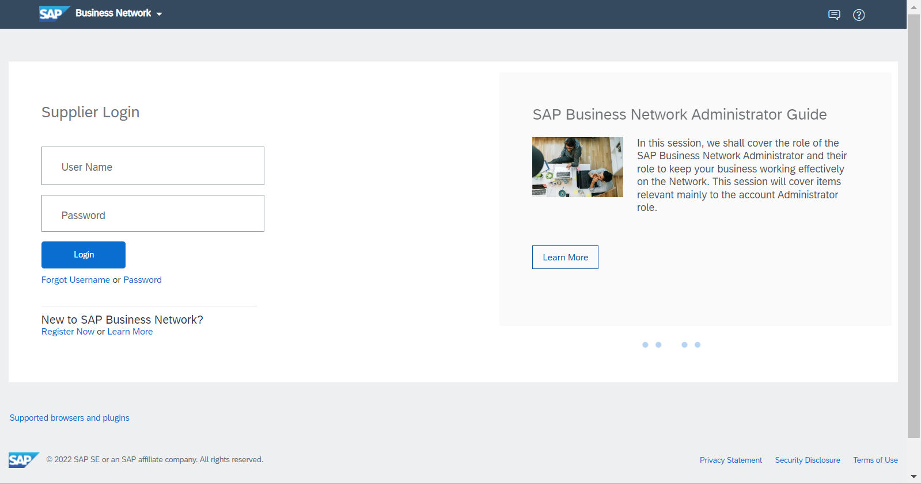
Uploading and Publishing PunchOut Catalogs
Login to Ariba Network
    Go to: https://supplier.ariba.com
    Log in with your Username and Password

Slide 5
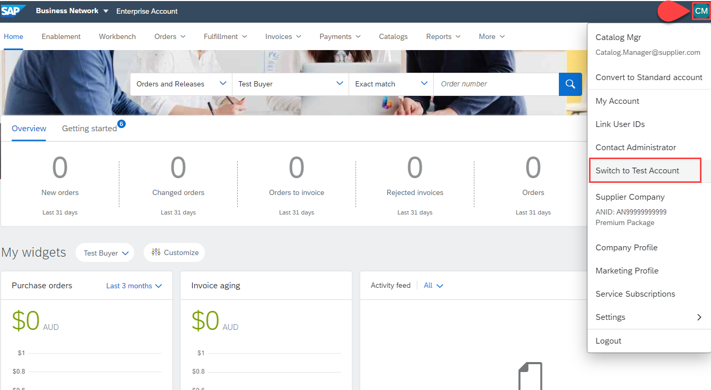
Uploading and Publishing PunchOut Catalogs
Switch to your Test Account
  Your Catalog should be loaded and tested in your Test Account. (Note: If you are instructed to load a Catalog to a Production account, just skip this step)
  Find your initials in the upper right corner and click for the pull down menu, then click “Switch To Test Account”
  If you don’t see a “Switch to Test Account” link, your Test account has not yet been set up. Contact your SAP Business Network Administrator
  You will get a warning. “You are about to switch to Test Mode.” Click “OK”

Slide 6
Uploading and Publishing PunchOut Catalogs
When uploading a Catalog on SAP Business Network, there are four steps you will follow:
  Uploading—Transfers the Catalog file from your local drive to the SAP Business Network. During the upload process, you enter the Catalog name (this becomes the “Subscription Name” in the Buyer’s local Catalog) descriptive text, and classify it so that buying organizations that are looking for specific products and services can find your Catalog
  Setting Visibility—Allows you to specify whether the Catalog version is “Public” or “Private” and determines which of your Customers can access it
  Validating—The Network checks the Catalog for errors, checks for zero price values and does a high-level validation of UNSPSC codes and Units of Measure
    (Note: Customer-specific validation rules for UNSPSC and UOM codes, and zero price values can be more detailed and much more strict than the high-level Network validations, therefore your Catalog may pass the Network validations but fail the Customer-specific validations for these same items)
  Publishing—Freezes the current version and notifies your Customer of the Catalog’s availability

Slide 7
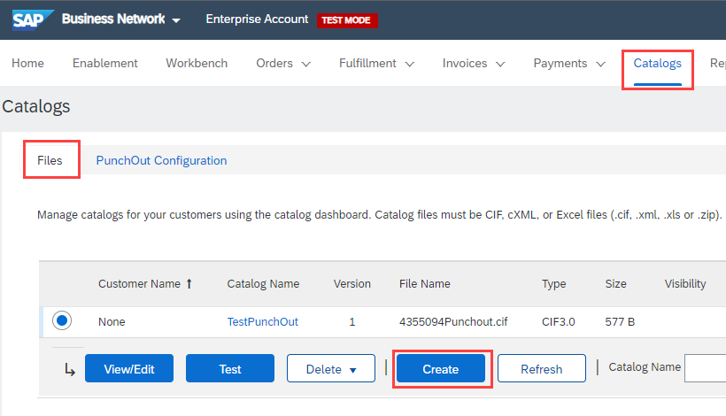
Uploading and Publishing PunchOut Catalogs
Navigate to the Catalogs Tab and click “Files” tab.
On the Catalogs screen, click the
“Create” button.

Slide 8
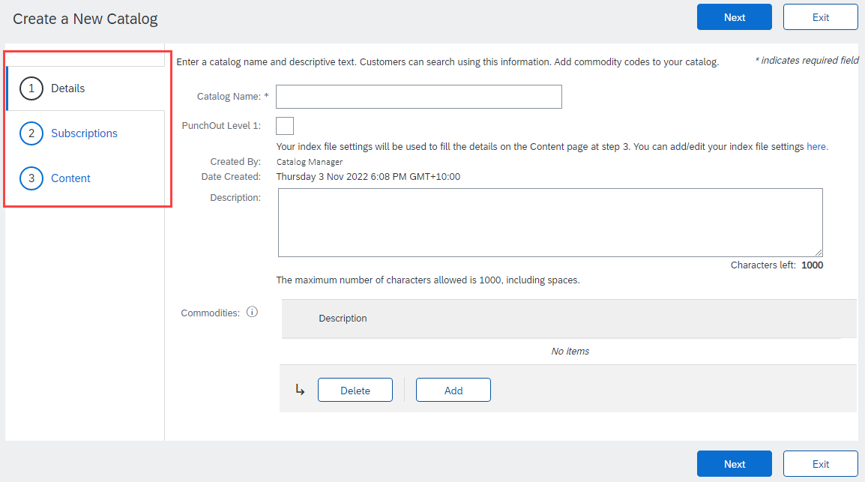
Uploading and Publishing PunchOut Catalogs
You are now on the Create a New Catalog Screen
To create the Catalog, there is a 3-step Wizard:
  Details—General information about the Catalog
  Subscriptions—Who you are publishing the Catalog to
  Content—Uploading the actual Catalog file

Slide 9
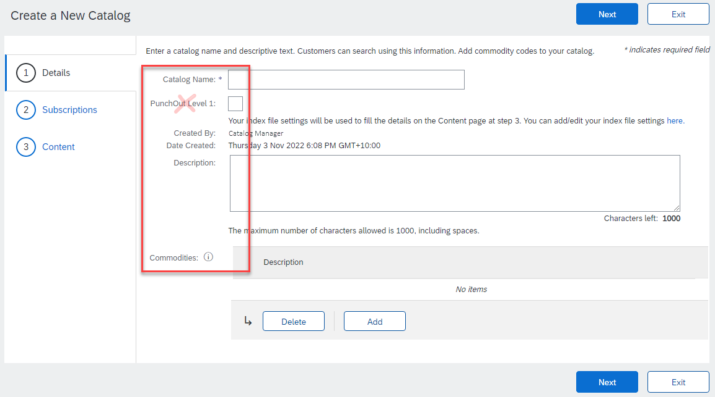
Uploading and Publishing PunchOut Catalogs
Details
  Catalog Name: This becomes the “Subscription Name” for this Catalog that will not change. The format for this Name is set by your Customer. Use this format (no special characters are allowed, you can use a dash (-) or underscore(_)): SupplierName_UnionPacific_Region_CatalogType, for example: MySupplier_UnionPacific_US_Punchout (or L2)
  Description: (Optional) Brief description of the content of your Catalog
  Commodities: (Optional) The UNSPSC code(s)
  that corresponds to the items family/ group of your Catalog. Use the “Add” button to find the code
  Do not select PunchOut Level 1 unless requested by your SAP Ariba Catalog Specialist.
  When you complete this screen, click “Next”

Slide 10
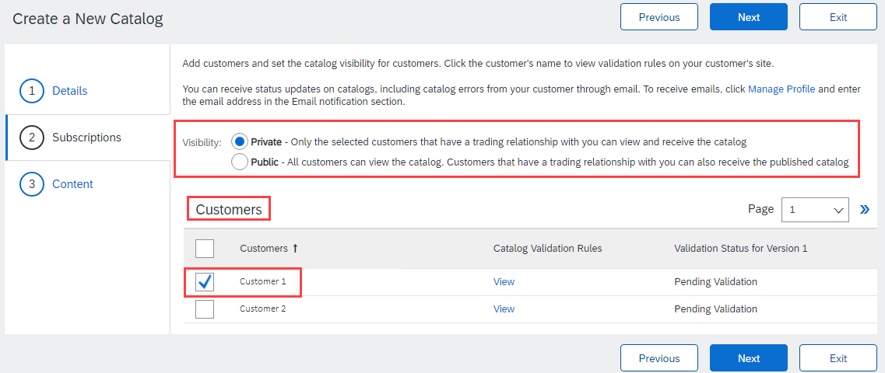
Uploading and Publishing PunchOut Catalogs
Subscriptions
  You determine which Customers subscribe to your Catalog—specific Customer(s) or to all Customers on the Network
  Set the Visibility to “Private”. You can select a single customer.
  To select your Customer, check the box next to their name in the “Customers” list.
  If the Customer does not appear, it means
  that your company has not established a
  relationship with your Customer yet.
  This is required prior to uploading a
  Catalog to them.
  When you complete this screen,
  click “Next”

Slide 11
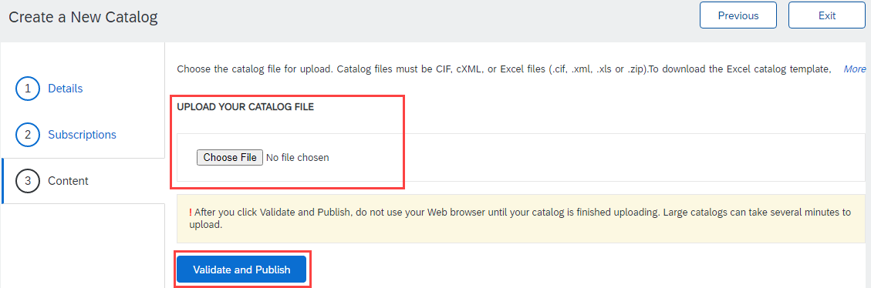
Uploading and Publishing PunchOut Catalogs
Content
  Select your Catalog File, by clicking “Choose File” and navigating to where your file is saved.
    Your Excel file must not exceed 1 Mb, however you can use zip compression.
    If your Excel file is too large, you will need to convert it to a CIF. See the Appendix—“How to convert an Excel file to CIF”
  After you have selected your Catalog file, click the “Validate and Publish” button.
  As your Catalog loads, the
  status will read “Validating”.
  Click the “Refresh” button
  at the bottom of the screen
  to see the status change.

Slide 12
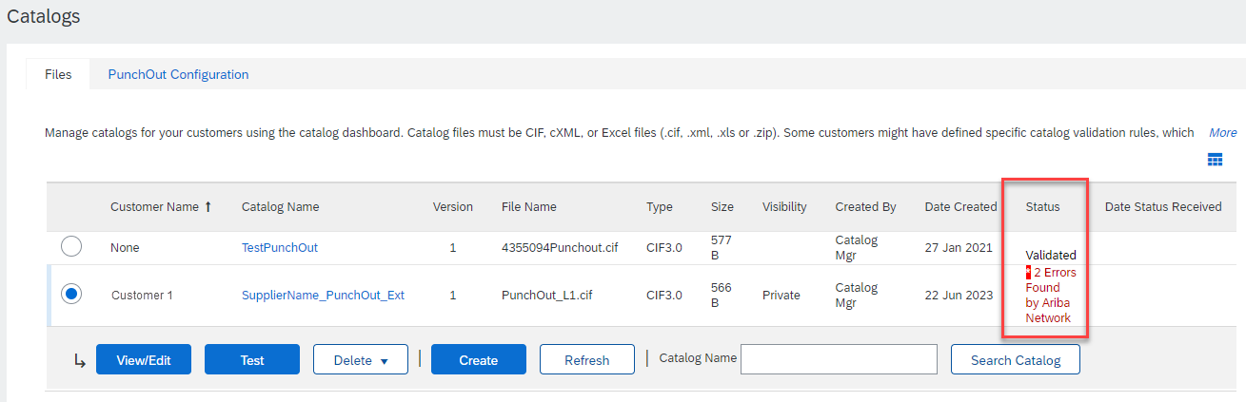
Uploading and Publishing PunchOut Catalogs
Network Catalog Validation
  After the Network completes validation, it changes the Catalog status from “Validating” to one of the following statuses:
    Validated, Published or Pending Buyer Validation—your Catalog is error-free.
    Errors Found by SAP Business Network—the Network detected Catalog content that violates validation rules.
    Bad Format—your Catalog failed the file validation check. Audit the file for problems in format
  A Catalog with an error status means you need to review the error results and correct them before going on

Slide 13
Uploading and Publishing PunchOut Catalogs
Correcting Validation Errors
  To see the error detail, click on the “Errors Found” hyperlink:

Slide 14
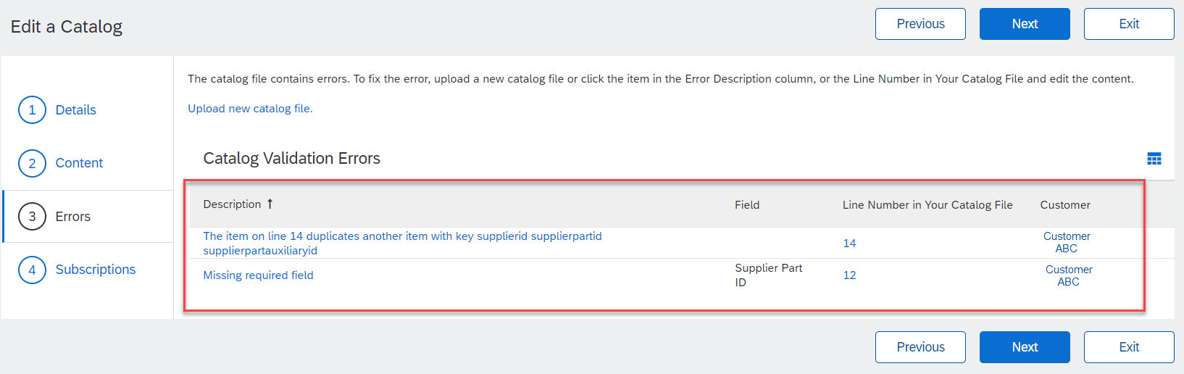
Uploading and Publishing PunchOut Catalogs
Viewing Validation Errors
  The Network displays Description, Field and Line Number for each error
  In this case, the Network is telling us that the Supplier Part ID / Supplier Part Auxiliary ID combination is not unique on line 14 and line 12 is missing a Supplier Part ID.
  To correct any issues, go back to the original Excel Catalog file, make the corrections, then update the Catalog file, and upload the new version to replace the existing Catalog

Slide 15
Uploading and Publishing PunchOut Catalogs
Customer Approval
  When your Catalog passes the Network upload validation, your Customer is then notified to audit, validate and approve your Catalog. The Network may show any of these statuses: “Published”, “Validated by Customer” or “Pending Buyer Validation”—note that these are all valid statuses
  Each Customer may have specific validation rules—and these rules may be more strict than the standard Network rules. This means that your Catalog could pass the Network validation, but fail the Customer-specific rules and be returned to you
  If your Customer finds anything in your Catalog file that requires your attention, you will be notified by e-Mail
    Corrections should be made to the original Excel file, then the corrected Catalog file needs to be uploaded to the Network
    Each Catalog must pass both the Network validation, and the Customer audit before it can be loaded into the Customer’s buying application and be available for their Users

Slide 16
Replacing Existing Catalogs

Slide 17
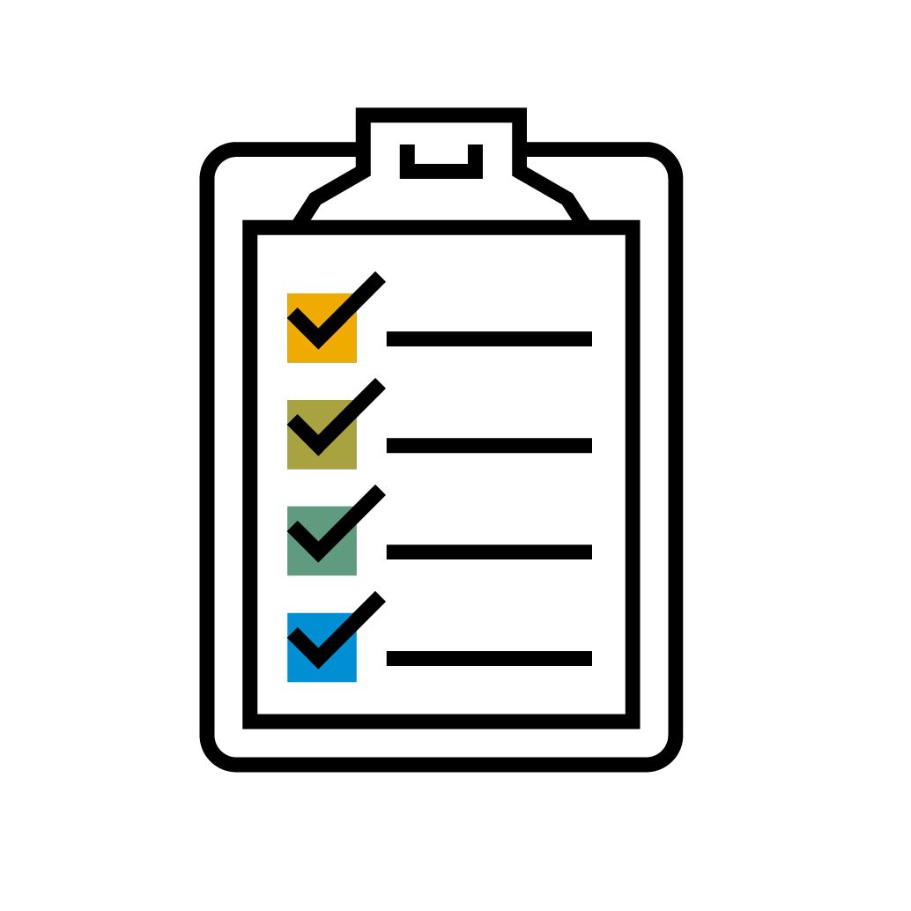
Replacing Existing PunchOut Catalogs
Due to the nature of L1 PunchOut Index files, it is rare that you would need to update them. Only a change to the logo, the Description to appear on the UI or additional keywords would require an update to a L1 Catalog.
For L2, updating will occur much like a static catalog. Since the Index file is used for searching the items in the Supplier’s catalog, before punching the User out to their website, it is important that the data in the L2 Index files be kept current.

Slide 18
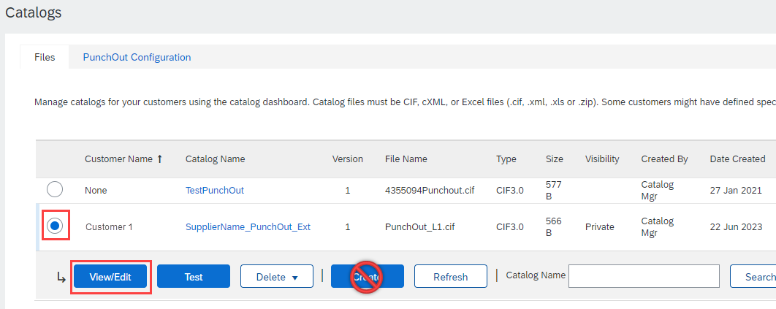
Replacing Existing PunchOut Catalogs
To replace an existing Catalog, the steps are almost the same as uploading a new Catalog for the Customer.
Log into your SAP Business Network account
Navigate to Catalogs
Update the Catalog—using “View/Edit”
  When replacing an existing Catalog, do not use the “Create” button—it is important to keep the same Catalog Name. The file name can be different:

Slide 19

Replacing Existing PunchOut Catalogs
Find the existing Catalog you wish to replace with a new version
  Click on the radio button to select the existing Catalog
Click “View/Edit”

Slide 20
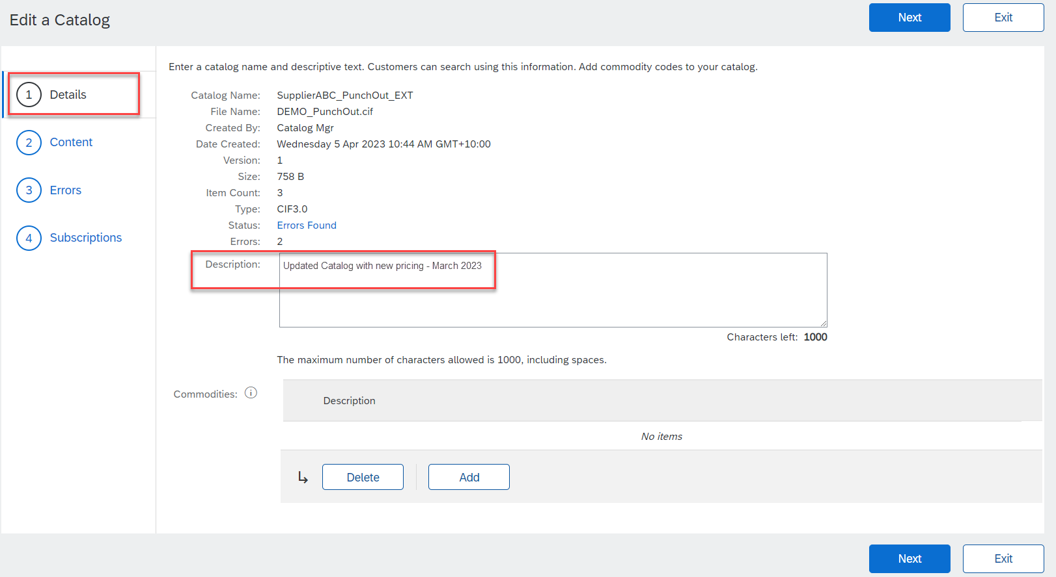
Replacing Existing PunchOut Catalogs
You are now taken to the Edit a Catalog Screen
You see the same 3 steps as a New Catalog
  Details—Most of the fields are pre-populated with the existing information, but you can add a new Description for the updated Catalog
  Click “Next”

Slide 21
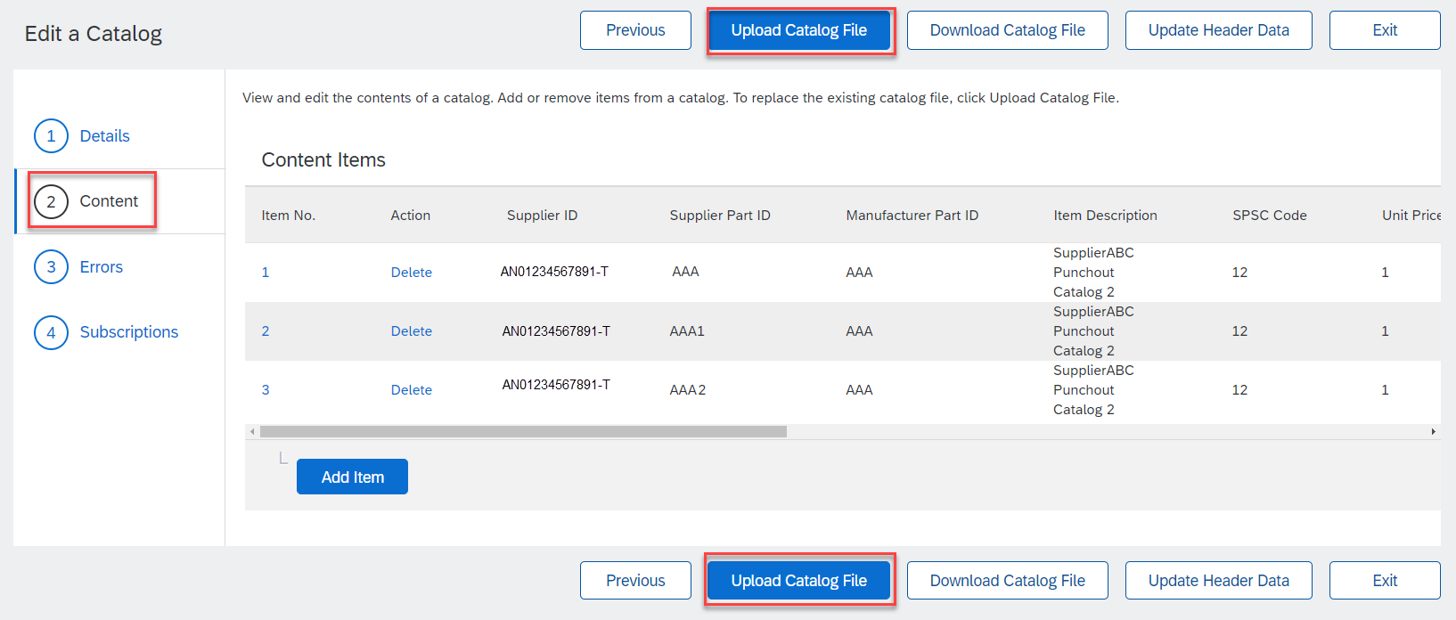
Replacing Existing PunchOut Catalogs
  Content—The Network will display the current Catalog (if it is under 4Mb)
  Click the Upload Catalog File button. This will replace the existing Catalog File with our updated Catalog

Slide 22
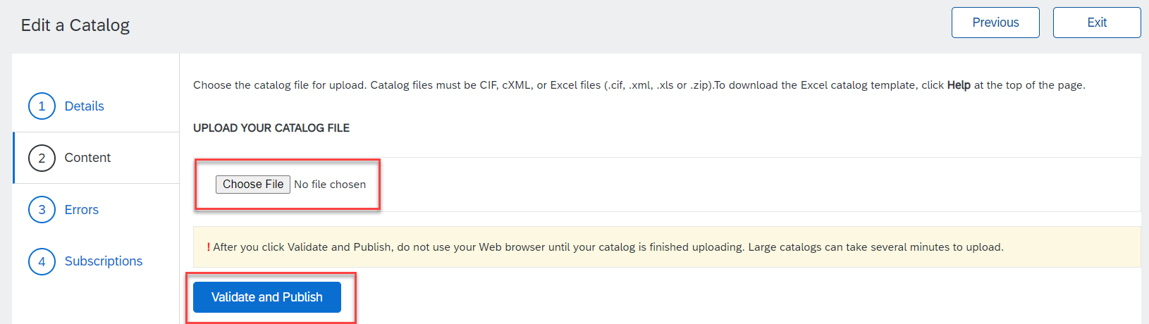
Replacing Existing PunchOut Catalogs
  Select your Catalog file, by clicking the Choose File button and navigating to where your file is saved.
    Your Excel file must not exceed 1 Mb, however you can use zip compression
    If your Excel file is too large, you will need to convert it to a CIF. See the Appendix—“How to convert an Excel file to CIF”
  After you have selected your Catalog file, click “Validate and Publish”
  As your Catalog loads, you will be returned to the Catalog Home screen and the status will read “Validating”. Click the “Refresh” button at the bottom of the screen to see the status change. Be sure to wait for the validation to finish

Slide 23
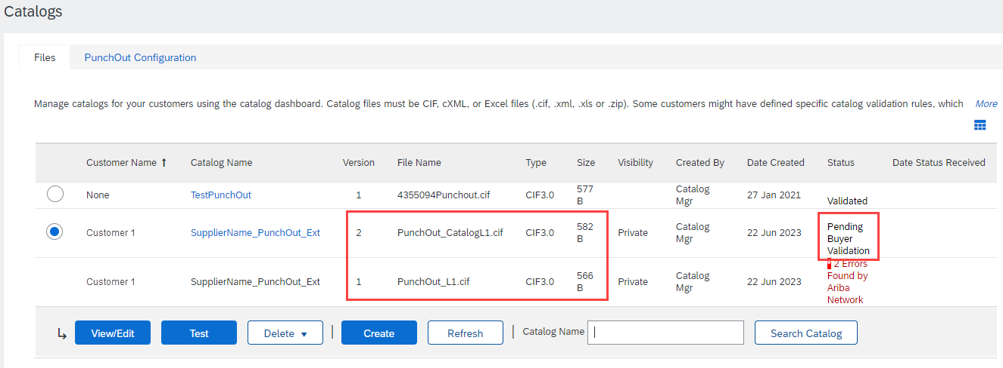
Replacing Existing PunchOut Catalogs
  When your Catalog passes the Network upload validation, the Network may show any of these statuses: “Published”, “Validated by Customer” or “Pending Buyer Validation”—note that these are all valid statuses. The upload is complete.
  Notice that the Catalog Name stayed the same, but the new File Name we loaded is reflected on the Network.
  The Network does Catalog version control for you. See that our replacement Catalog is now Version 2, and is active. Note that the radio button has moved up to our new active version.

Slide 24
Replacing Existing PunchOut Catalogs
Customer Approval
  When your Catalog passes the Network upload validation, your Customer is then notified to audit, validate and approve your Catalog.
  Each Customer may have specific validation rules—and these rules may be more strict than the standard Network rules. This means that your Catalog could pass the Network validation, but fail the Customer-specific rules and be returned to you.
  If your Customer finds anything in your Catalog file that requires your attention, you will be notified by e-Mail.
    Corrections should be made to the original Excel file, then the corrected Catalog file needs to be uploaded to the Network.
    Each Catalog must pass both the Network validation, and the Customer audit before it can be loaded into the Customer’s buying application and be available for their Users.

Slide 25
Appendix

Slide 26
Creating a CIF from an Excel Catalog File

Slide 27
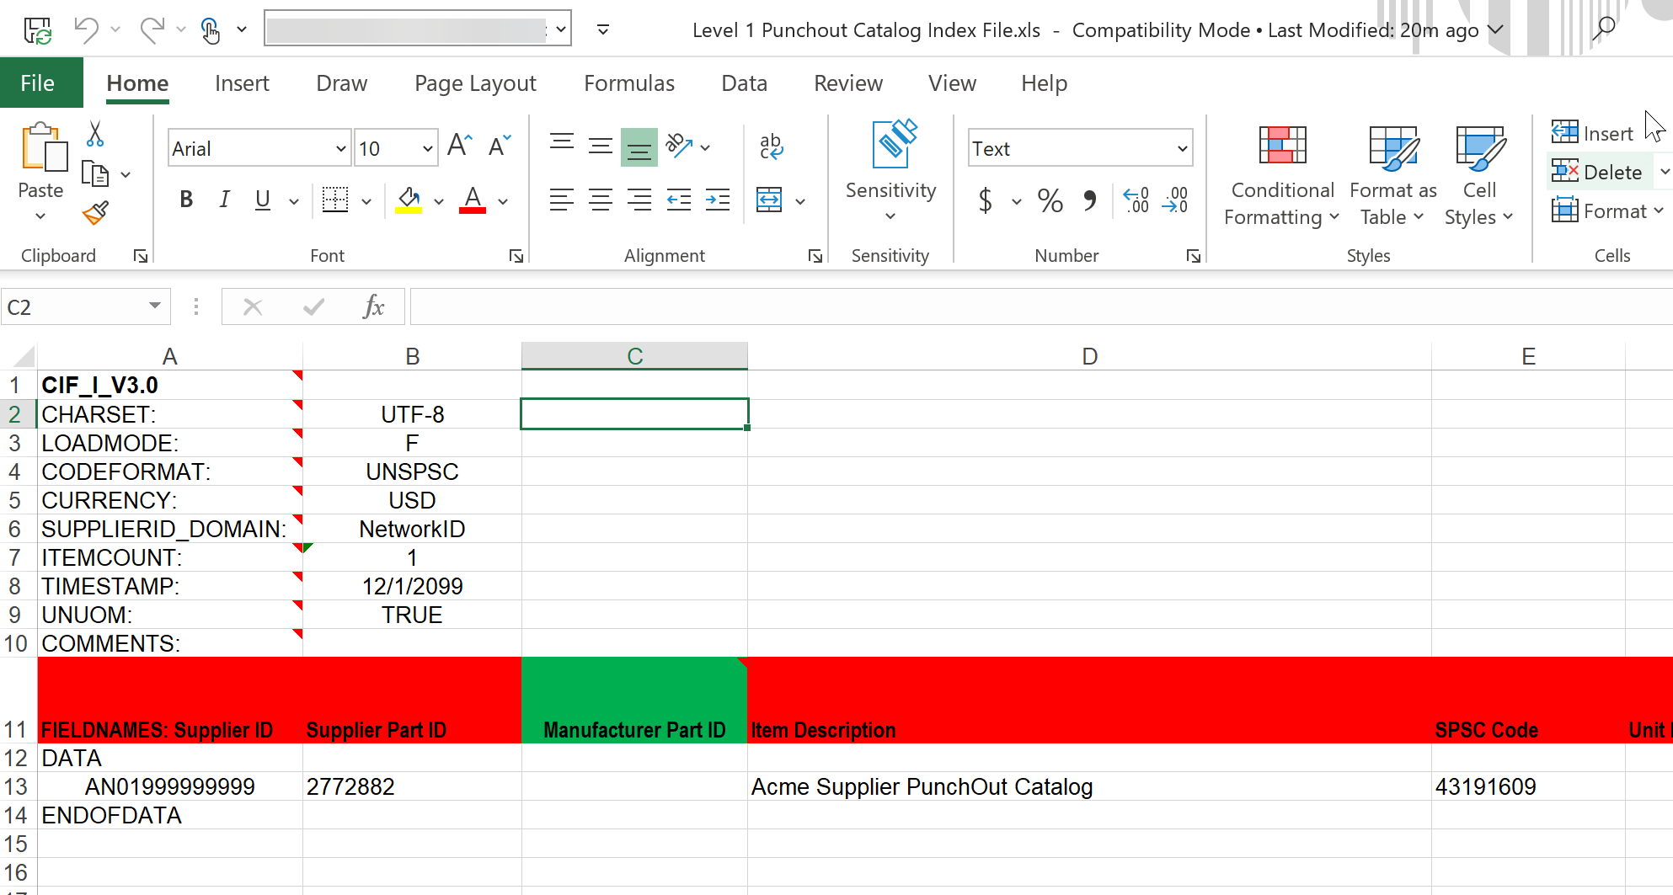
Creating a CIF from an Excel File
Open your Excel Catalog file.

Slide 28
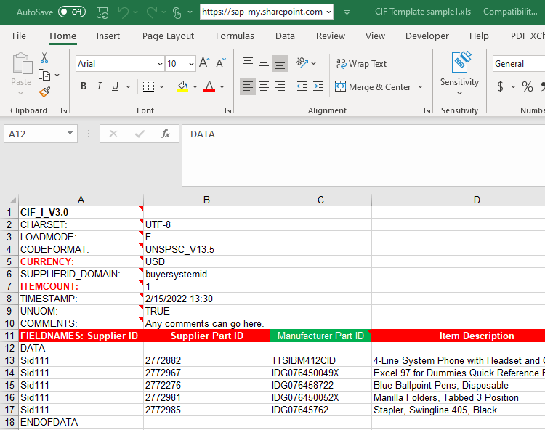
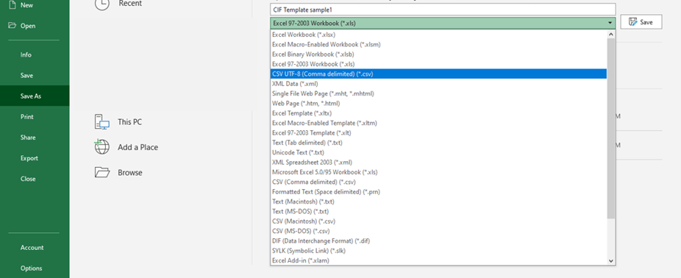
Creating a CIF from an Excel File
Click on the drop down menu and save it as a “.csv” file.

Slide 29
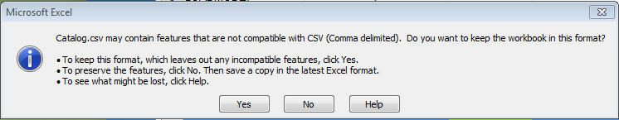


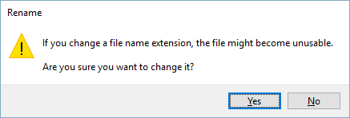
Creating a CIF from an Excel File
You will get a system warning about saving it as a .csv—click “Yes” to continue.
Rename your saved file, by changing the extension to “.cif”.
The system will warn you about changing the
extension. Click “Yes” to continue.

Slide 30
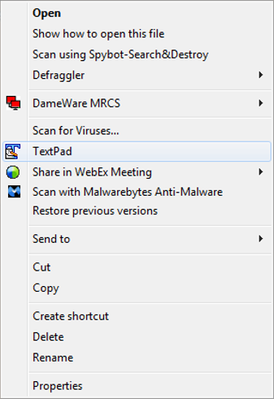
Creating a CIF from an Excel File
Open your CIF Catalog file with Notepad, or your favorite text editor.

Slide 31
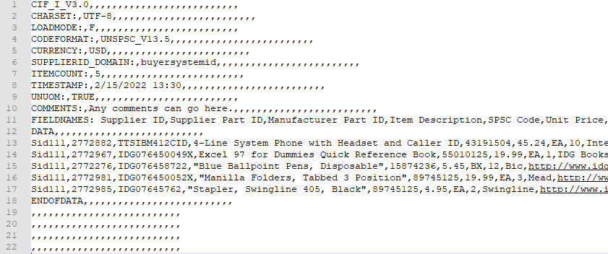
Creating a CIF from an Excel File
Notice that the file has new, added commas in the Header, and after the DATA and ENDOFDATA markers.

Slide 32
Creating a CIF from an Excel File
Remove these extra commas after the Header values and the DATA and ENDOFDATA markers. Be sure to remove any commas in front of the data in the Header as well.
Be careful if you use the “Replace” function—you don’t want to replace any of the commas in the actual Catalog data.

Slide 33
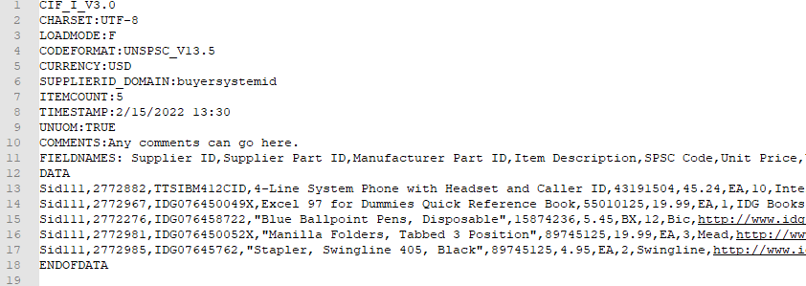
Creating a CIF from an Excel File
Once the commas are deleted, save the CIF Catalog file. It is now ready to be loaded.
Your completed file should look like this.

