Slide 1


Creating Multiple Roles and users

Slide 2
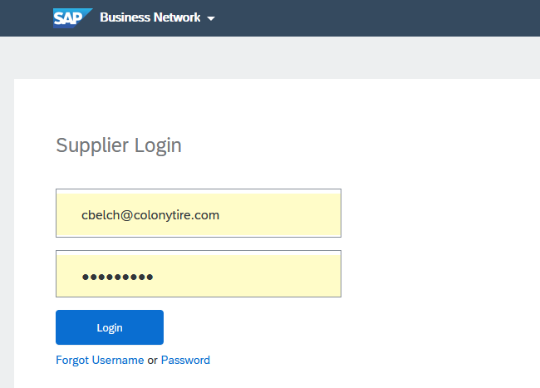
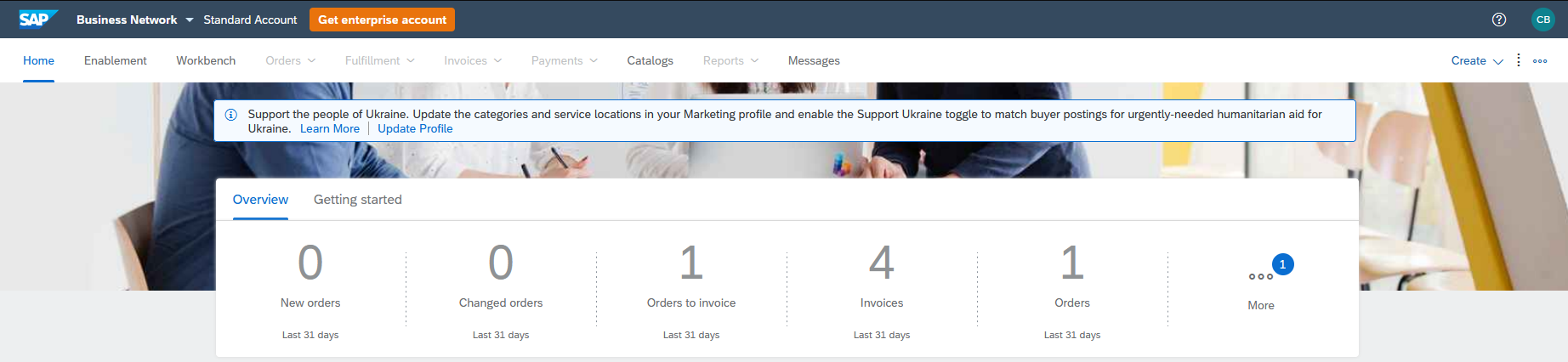
Ariba Log-IN
Gerdau - Ariba - SAP (hyperlink)
Log-in: USER ID
Password: XXXXXXX
Home screen

Slide 3
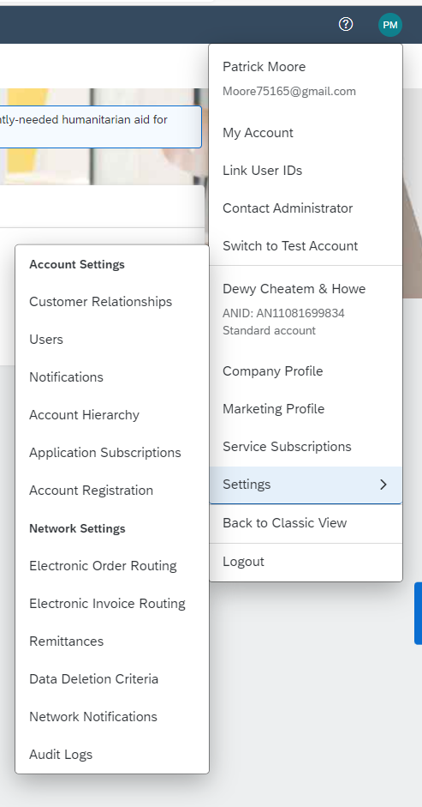
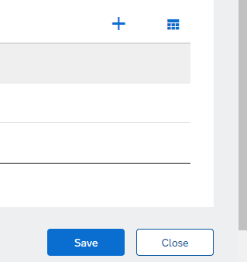
Manage roles
In the upper-right corner of the application, click [User Initials] > Settings and select Users.
Under the Manage Roles tab, click +

Slide 4
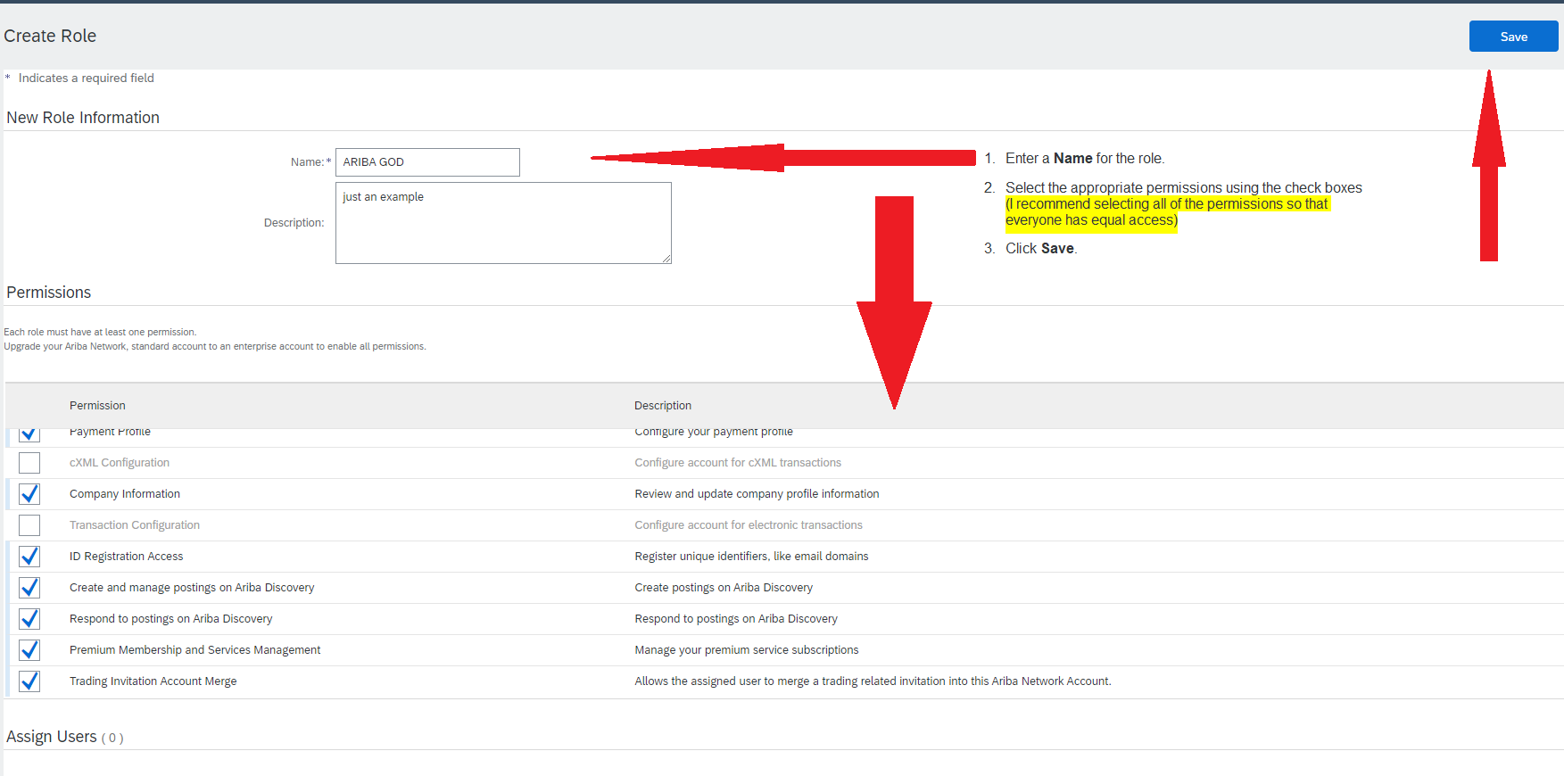
Manage roles cont.

Slide 5
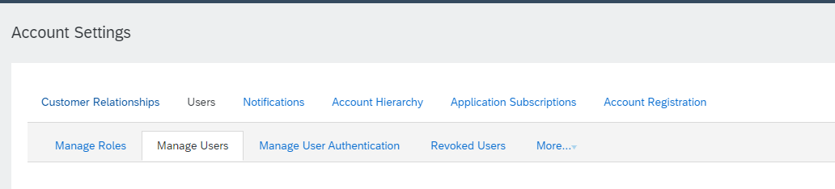
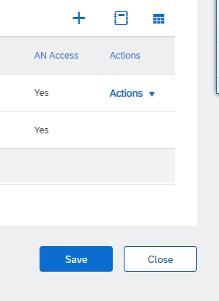
Create users
In the upper-right corner of the application, click [User Initials] > Settings and select Users.
Click the Manage Users tab.
Click on the + on the bottom right

Slide 6
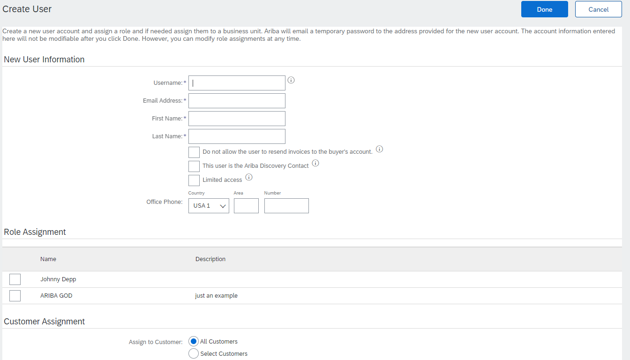
Create users cont.
Enter the user's information (Username, Email Address, First Name, Last Name and Phone). (If you get an error that mentions a username is unavailable, you can make the username have a 1 in it. The username is not the same as the Email Address. In the Email Address box, make sure there is a REAL Email Address).
Select a role in the Role Assignment section.
Assign a customer (All customers or Select Customers).
Click Save.

Slide 7
Review
Create Roles
Create User

