Slide 1
Reaching support without logging in to account
If you are unable to log in to your SAP Business Network account due to being locked out, or not remembering password, or even an admin change – these directions will show you step by step how to reach SAP Business Network Customer Support and file a ticket.

Slide 2
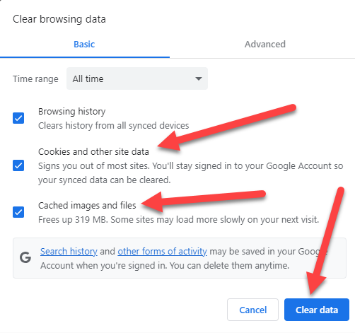
Navigate to:
Supplier.Ariba.com
Please note: it’s best to use Google Chrome; however, other web browsers are supported as well. If your web browser is not loading after clicking on entering this hyperlink in, you will need to clear your cache/cookies. You can do this through the settings within your browser, or by simultaneously clicking ‘ctrl+shift+delete’
In the picture to the right, this is the window that will be displayed
when you click ‘ctrl+shift+delete’ – make sure that the bottom two
blue boxes (cookies and other site data/cached images and files)
are selected, and then click ‘clear data.’

Slide 3
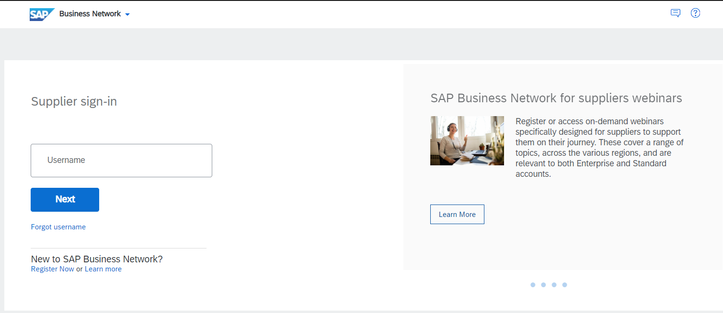
Whenever you site loads, it will look like this:

Slide 4
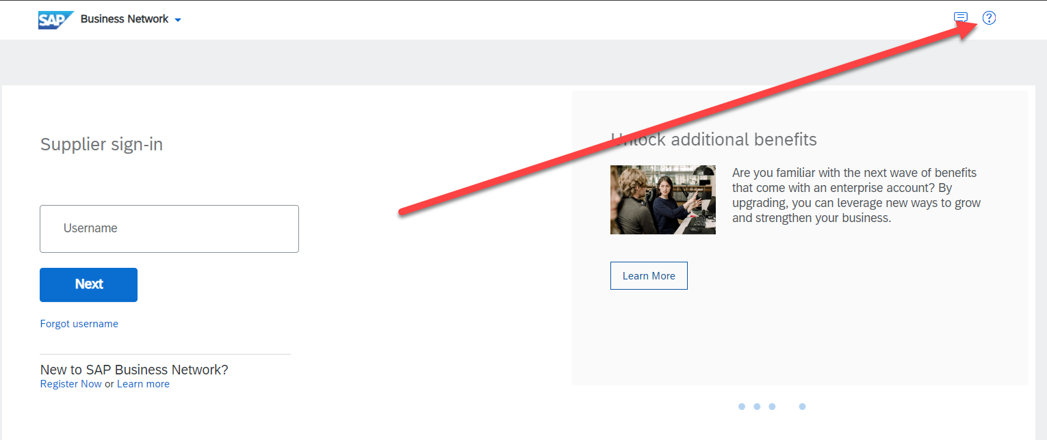
Click the question mark in the top right:

Slide 5
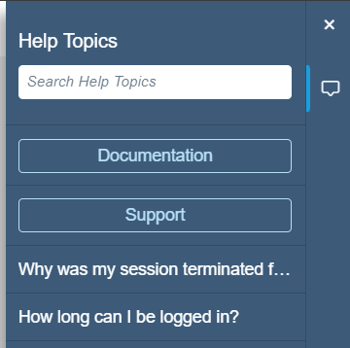
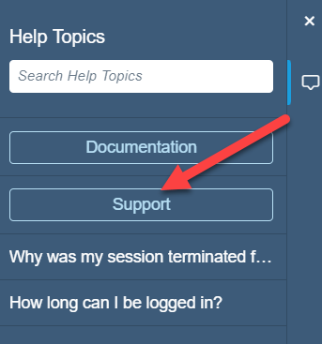
After clicking the question mark, you’ll see this:
A little blue box (pictured on the right) will appear on the right side of
the screen after clicking the question mark. Please click ‘support’ after you
see this little blue box:

Slide 6
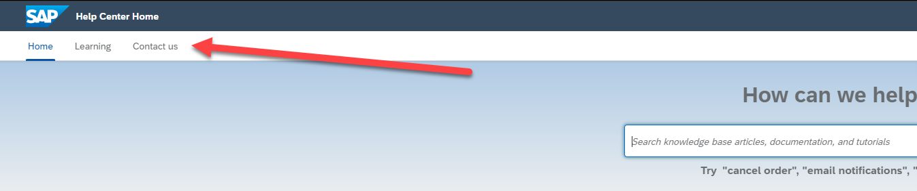
The next page will populate with a search bar at the top
You’ll see a search bar in the middle of the screen. Notice on the top left you will see ‘home,’ ‘learning,’ and ‘contact us.’ Click the ‘contact us’ button:

Slide 7
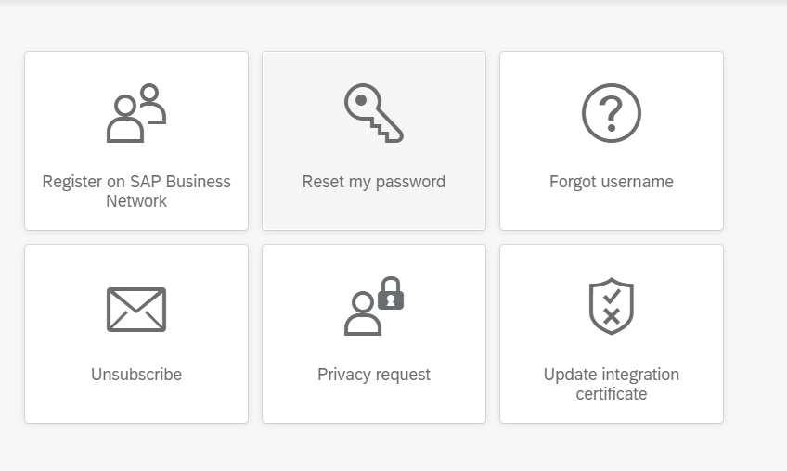
The next page will have six tiles of general topics to choose from:
Please select one of these options for the screen to move you on to the next page:
For example, if you click ‘reset my password’ you will be taken to option 2 (see next slide):

Slide 8
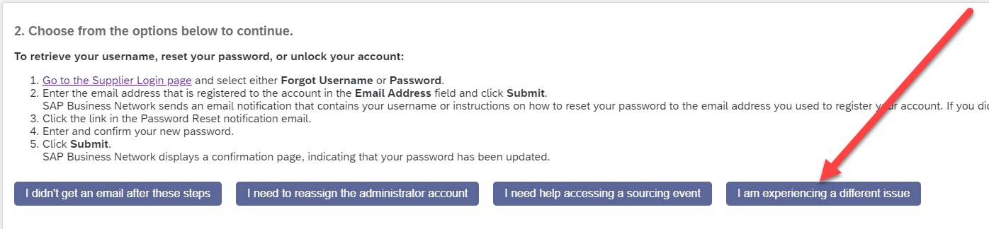
Option 2 will provide you with some options
There will be different options to choose from, but if you would like to contact support directly, please click ‘I am experiencing a different issue’

Slide 9

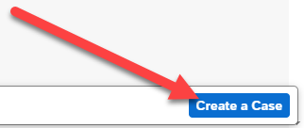
After clicking ‘I am experiencing a different issue’
On the bottom left side of the screen you will see ‘Can’t find what you’re looking for?’:
On the bottom right of the screen you will see ‘Create a Case.’
Please click on ‘Create A Case’

Slide 10
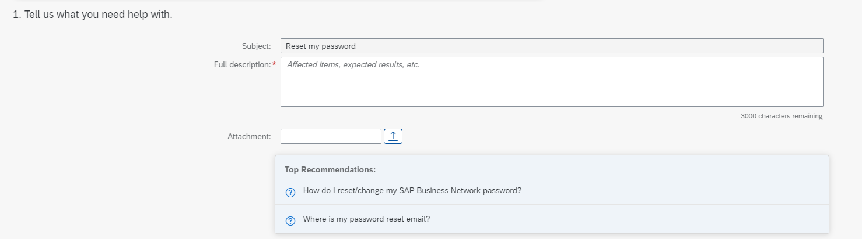
After clicking ‘Create a case,’ you will be taken to the questionnaire
On the top portion, number 1 part of the questionnaire asks what the issue is (please be as detailed and provide as much information as possible as this will prepare the technician better),
and also include any and all attachments regarding your issue.

Slide 11
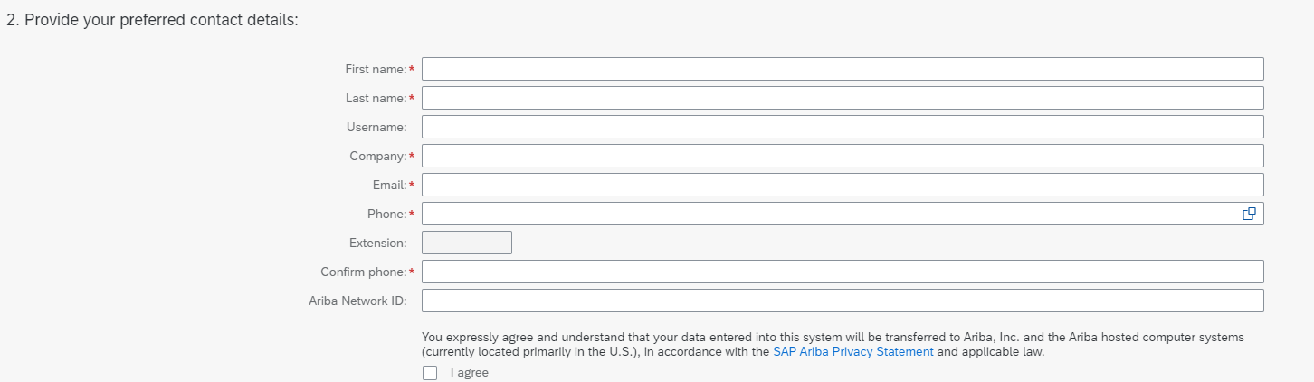
Part 2 of the questionnaire
Part 2 asks for your contact information, and your preferred method of contact. Also, if you have your ANID, that will be very beneficial to the service technician. If you don’t have your ANID, don’t worry, they will be able to find it, it’ll just take a little bit of digging on their side.
Please fill out all of the fields and then click the ‘I agree’ button on the button of the screen.
Once you do this, you will be either called or emailed back depending on your preference.

