Slide 1


FAQ for Vendors – Common Issues

Slide 2
Common Issues
  Home Screen and Navigation – pages 3-5
  I can’t see my POs – Am I connected to Gerdau? – pages 6-7
  I can’t see my POs - Setting up the Workbench Tab –page 8
  I can’t see my POs - Change a Workbench criteria – page 9
  How do I create an Order Confirmation? – page 10
  How do I create a Service Sheet? – page 11
  How can I find what my invoice’s status is? – page 12
  Ariba adds Tax to the invoice, but I don’t charge tax - page 13
  AP invoice Submission rejected my invoice – page 14
  I’ve received invoice rejection email from Ariba – pages 15-16
  I need to reset my password – page 17
  Ariba is charging me for an Enterprise account – Downgrade to Free – pages 18-27

Slide 3
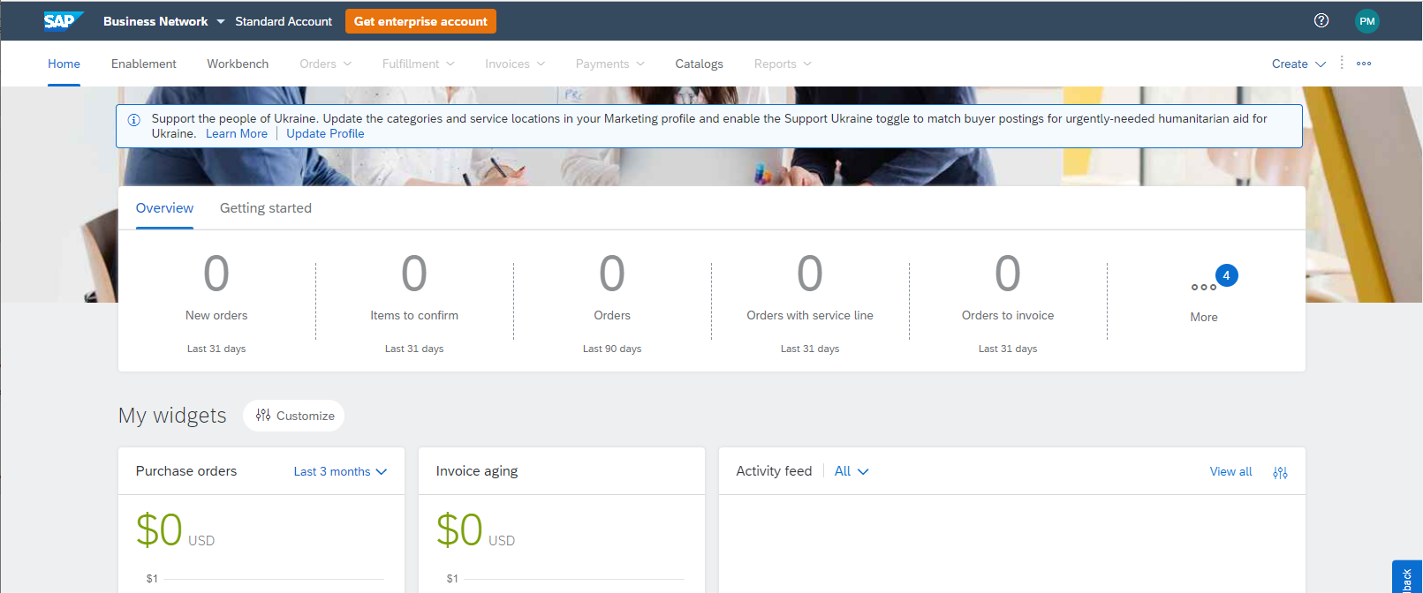
Home Screen and Navigation
Top right the Circle with a ? is for Support
Top right Circle with your initials gets you to the User menu.

Slide 4

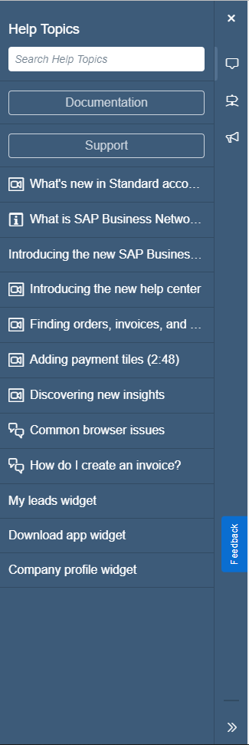
Support
Click the Question Mark button then click on the “Support” button.
This will open a second browser tab and you can then search for process documents by keywords.

Slide 5

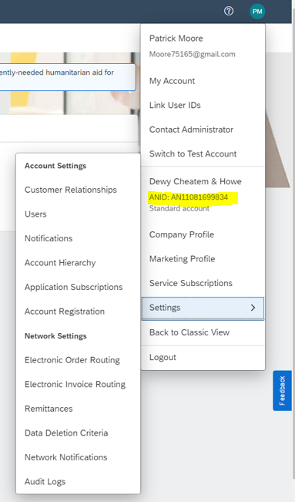
User menu / ANID number
Click the blue circle with your initials in it.
Mid-way down you can see your ANID number and other options for your company’s profile and other Settings.

Slide 6
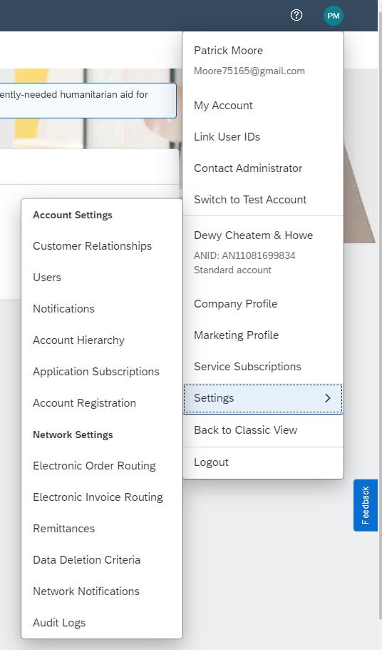
I can’t see my POs – Am I connected to Gerdau?
Open user menu by clicking on your initials
Click “Settings >” to expand the menu
Select “Customer Relationships”

Slide 7
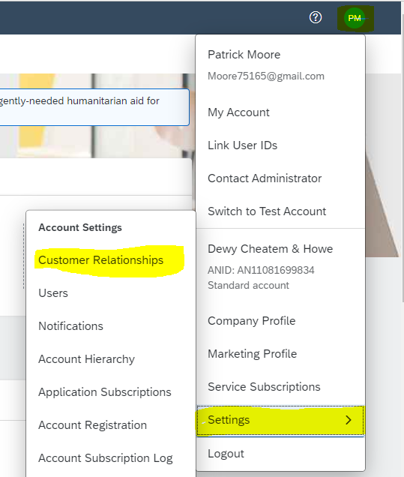
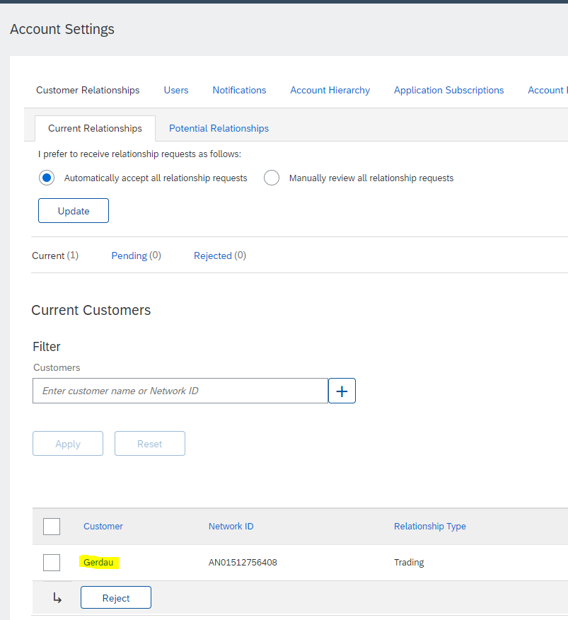
I can’t see my POs – Am I connected to Gerdau?
Click user menu, Click on Settings, Click on Customer Relationships
Here you should see Gerdau listed along with other customers you may be using Ariba with.
If you do not see Gerdau, please click on the “Potential Relationships” tab and see if Gerdau is listed there. If it is, create the customer relationship by selecting it.
If you do not see Gerdau in either tab, please reach out to your Gerdau Buyer for assistance to get connected.

Slide 8
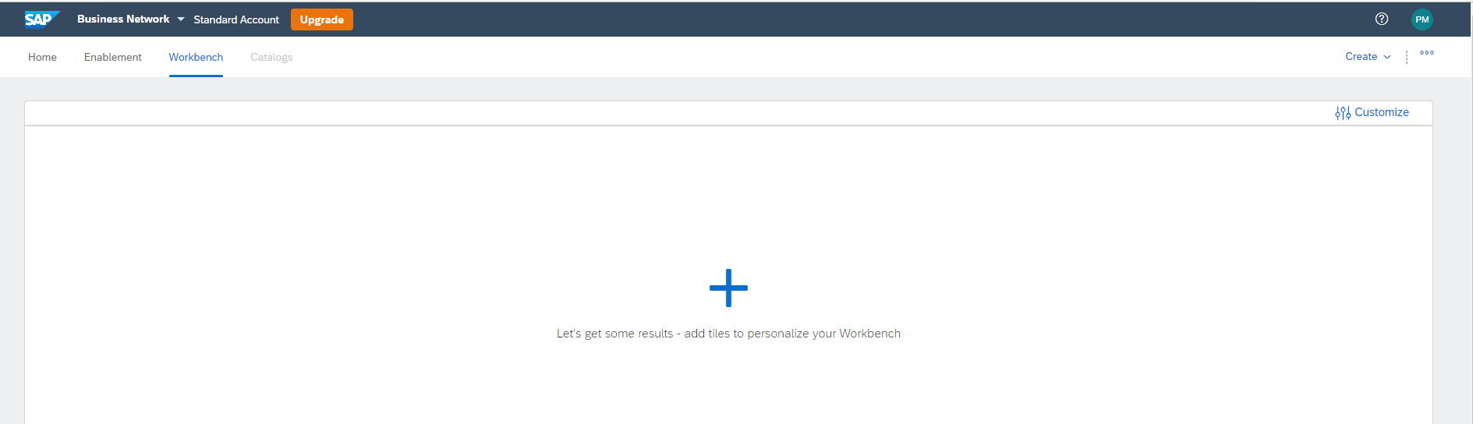
I can't see my POs – Workbench Tab
Click on Menu tab titled “Workbench.” If this is the first time you open it, you’ll see a white screen with a large blue plus in the middle of it. Here, you can configure the tab to view and your work with orders, confirmations, service sheets, and invoices. Using the Workbench tab can replace the Home page. If you don’t have a blue plus showing, you may not be connected to Gerdau.
To add tiles, click the blue “+” . A list of tile selections will appear. Click on the information type that you want to access. Click the blue plus again to add another tile. Repeat until you have all the tiles you want to see (limit 10), then click Apply and Save.
Go here when you need to see a PO, create a Confirmation, Service Sheet, or Invoice.

Slide 9
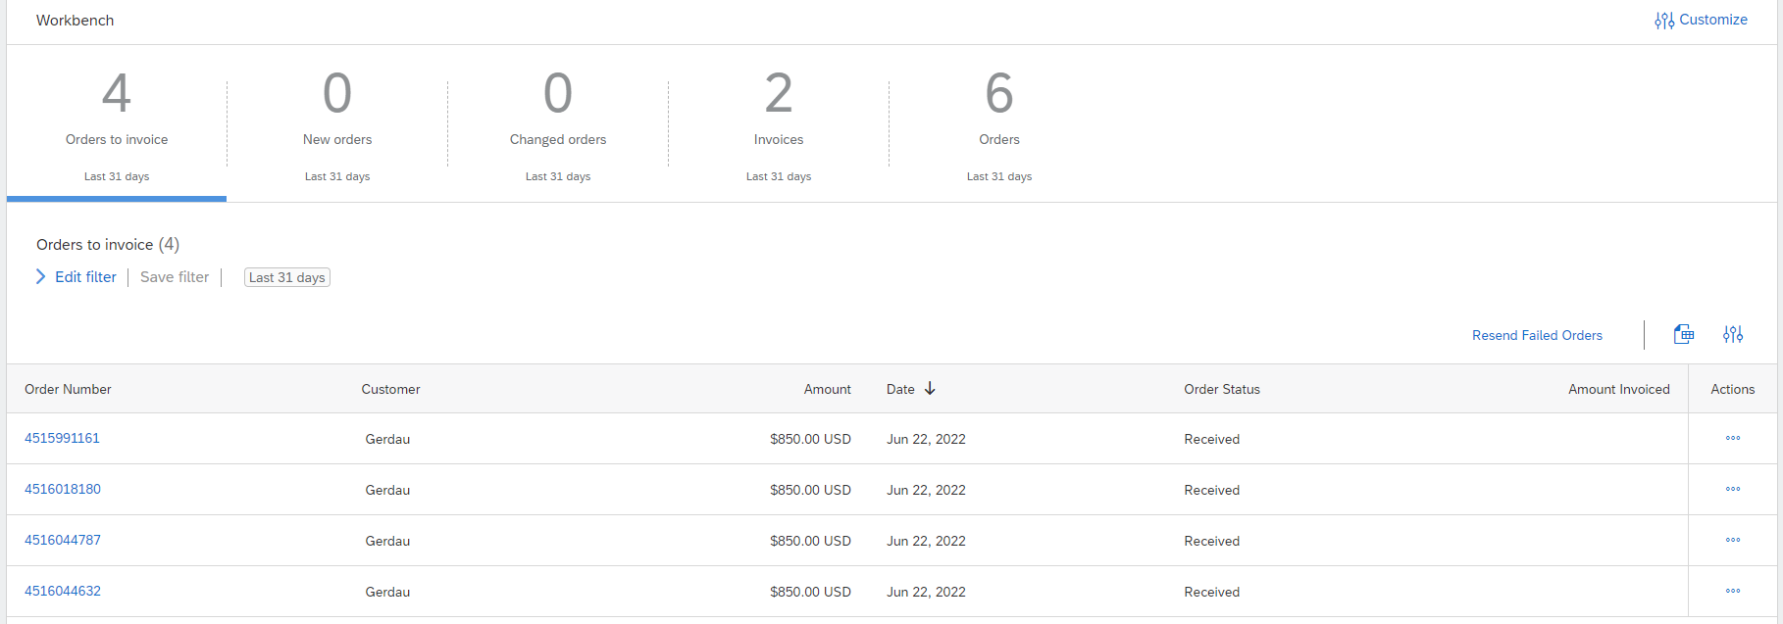
I can't see my POs – Change Workbench Criteria
Some POs may be hidden due to a default filter in your Workbench.
Select a tile shows as underlined. Then click Edit filter (middle section) and choose 365 days and apply. Save filter for each tile. Your list of documents will be below the selected tile
If you don’t have any POs showing even after you have modified your filter dates, please contact your Gerdau Buyer for further assistance.

Slide 10
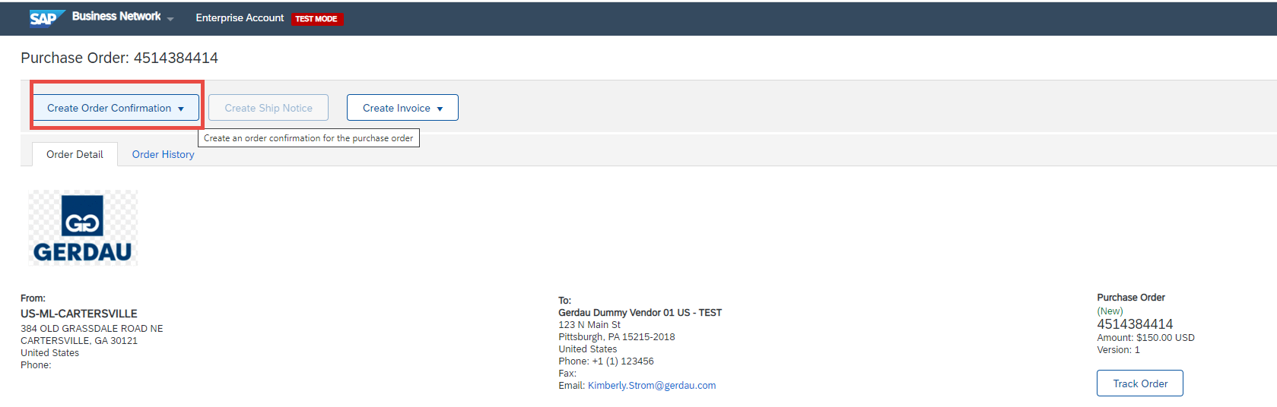
How do I create an Order Confirmation?
Go to your Workbench tab and click on the “Orders” tile and select the PO that you want to confirm. (You can also access a new order by clicking on it from the Home tab.)
To create the Order Confirmation, click on the “Create Order Confirmation” button. Choose “Confirm Entire Order” – the Reject order is option is disabled.
Enter the Confirmation number (limited to 16 characters, usually your invoice or internal order number or sometimes people use the Gerdau PO number). Then enter the ESTIMATED shipping date. Then click “Next”, then “Submit”. The buyer at Gerdau will now be notified that you have received their PO and are processing their order.

Slide 11
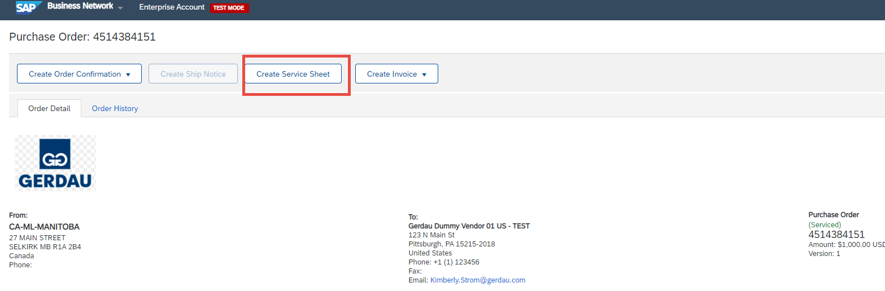
How do I create a Service Sheet?
Go to your Workbench tab and click on the “Orders” tile and select the Service-type PO that you want to create a Service Sheet for.
Enter the number that you want to use for your Service Sheet (limit 16 characters) as with the Order Confirmation, you can use your invoice or internal order number or even the Gerdau PO number.
Leave the Service Sheet Date alone – do not back date it as it is the date on which you’re creating the sheet, not the days the service was done. You can fill in the actual service dates in the start and end date fields, but the Service Sheet’s date must always be today’s date. You cannot change the pricing, but you can change the quantities as necessary. If you are not going to be servicing a line at all, please don’t put a zero in it or delete it. Instead, click on the green toggle switch under the “Include” header and it will go gray, excluding the line from the Service Sheet you are currently creating. Then click “Next” and then “Submit”.
NOTE: Gerdau must approve the Service Sheet before you will be able to use the “Create Invoice” button – it will most likely be gray/inactivated. Once Gerdau does the approval on our end, it will enable the Create Invoice button again.

Slide 12
Invoice status updates
Direct all status update requests to:
APInquiries@gerdau.com

Slide 13
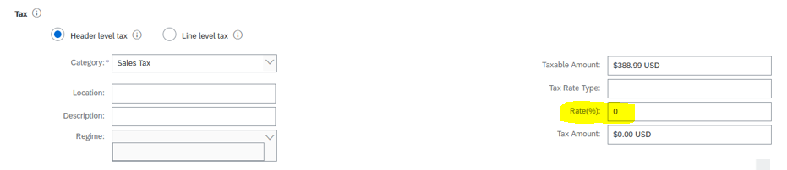
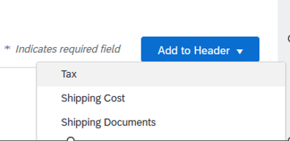
Ariba adds Tax to my invoice, but I don’t charge Tax
Ariba requires that you enter a Tax amount, regardless of value. There are two ways to enter a $0 tax amount. The best way is to configure a tax value for 0% tax that you can one-click select every time you create an invoice. Please contact the Mill’s AP Processor for instructions.
The other option is as follows:
Choose the Header level Tax button. Then enter 0.0 for the rate and hit tab. The tax amount goes to $0.00. Proceed with the rest of your invoice creation.
If you do not have the above Tax grid look for “Add to Header” in the top right and choose Tax. Then enter 0.0 for the rate and hit tab.

Slide 14
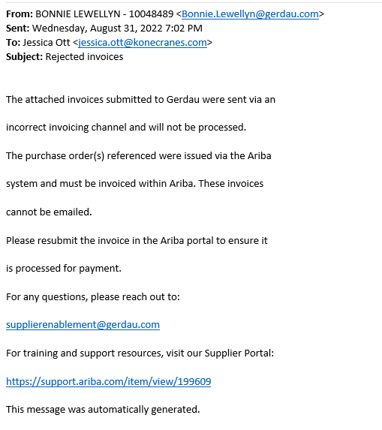
AP rejected my invoice
You may receive an email like this one →
This happens when an invoice is submitted by an incorrect method.
In this case, it would mean that you have emailed the invoice for an Ariba PO to an old email address, APInvoiceSubmission@Gerdau.com.
This email cannot be used for invoicing Ariba POs.
You must create the invoice in your Ariba portal by going through the PO document.

Slide 15
Rejected invoice email from Ariba
You may receive an email from the Ariba system saying that your invoice has been rejected by Gerdau.
When this happens, please open the email and look for the notes/comments section.
Most often, you will see a note that will say that the invoice is being corrected or that there is no action to be taken by the vendor. Occasionally, there may be an action you need to take, so checking into the emails is important.
When an invoice encounters an error on the Gerdau side of the Ariba, we sometimes have to reject it and then reprocess it with no action required from you, the Vendor.
Please don’t get discouraged if you receive these emails or see the rejected status on your invoice in Ariba! It means we are working to pay that invoice. Note that the rejection/reprocessing could happen multiple times for the same invoice.
If you have any questions about the rejections, please reach out to your Accounts Payable contact at the mill location and they will be able to explain the situation for that invoice.

Slide 16
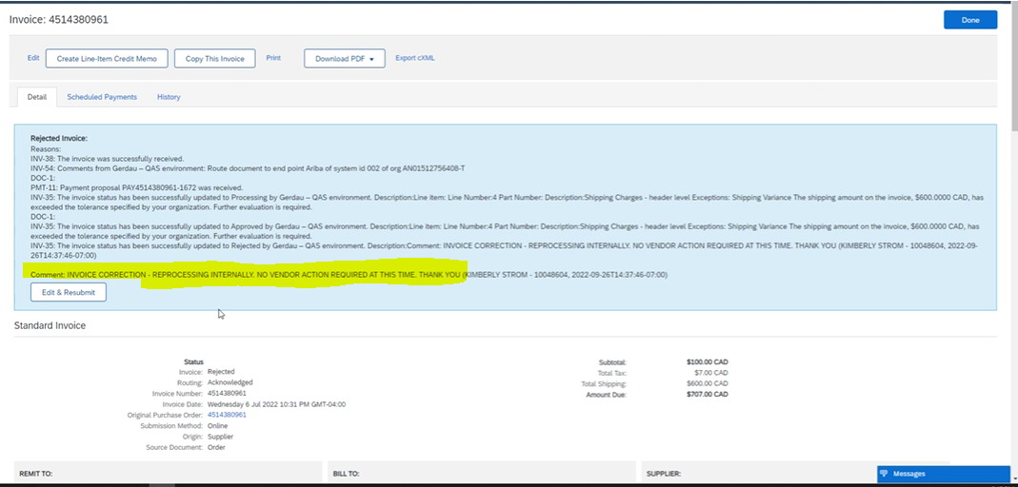
Ariba rejected my invoice - Why ?
There is an alternative way to see if an invoice has been rejected as well as by getting an email from the Ariba system.
If you go to the Workbench tab and into the “Invoices” tile, you will see invoice status labels.
For an invoice with a rejected status, you can drill into the document to see what has happened.
You can see there is a “Comment” section and if Gerdau has rejected the invoice from our end, there will be the same comments you would see in the Ariba rejection email.
If the notes request it, here is where you can edit the invoice and resubmit it back to Gerdau with the requested changes.

Slide 17
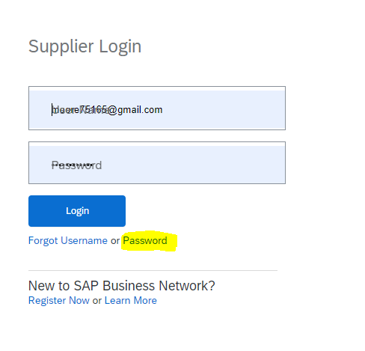
Password Reset
The quickest way is to use the Forgot password below the log in.
Or this link below
Help Center Contact us (ariba.com)
https://helpcenter.ariba.com/

Slide 18
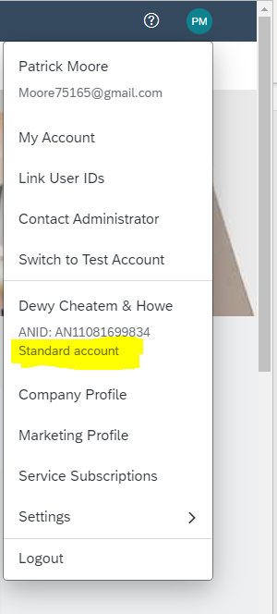
Accidental Account upgrade
The easiest way to tell if you are using the upgraded account is all menu option tabs at the top will be available.
Your Account version is also listed on user menu
If you wish to downgrade, please do the following steps or, if you are viewing this document digitally, click on the PowerPoint link here:

Slide 19
Ariba Enterprise Account Downgrade Steps

Slide 20
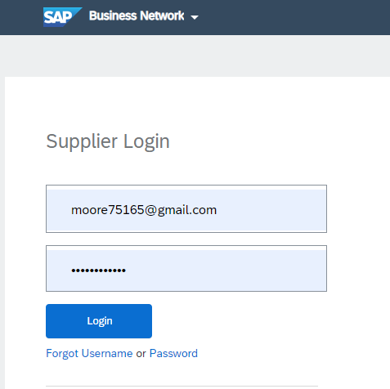
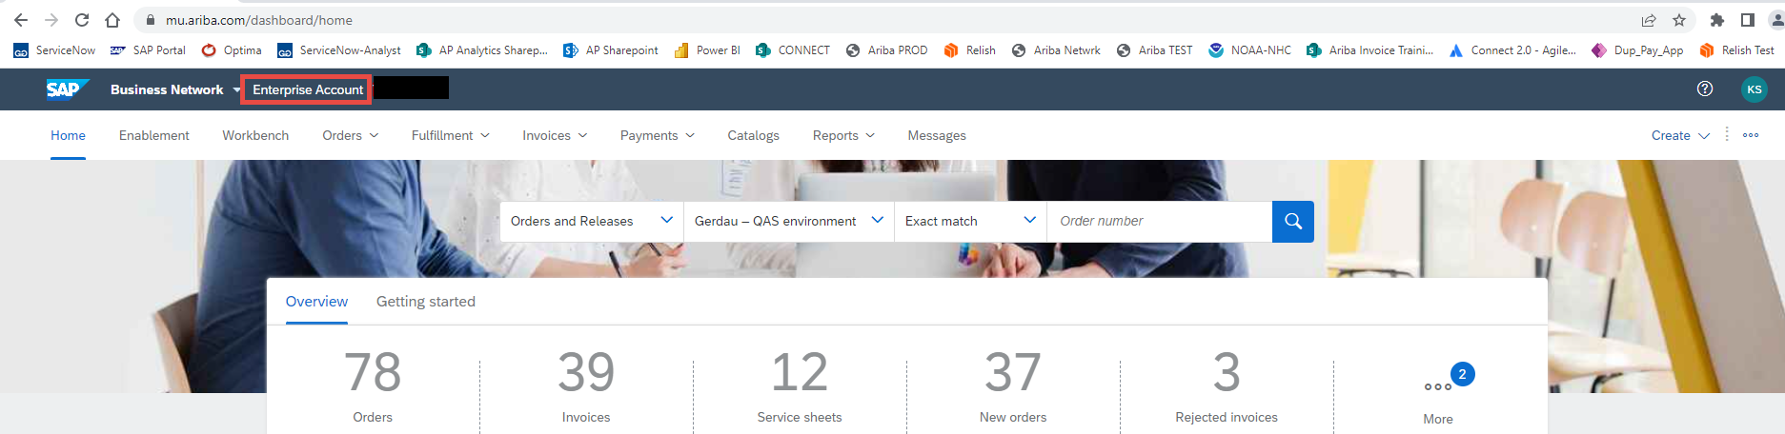
Ariba Log-in
Gerdau - Ariba - SAP (hyperlink) or https://service.ariba.com/ and click on “Supplier”
User Name/Log-in: email@yourcompany.com
Password: XXXXXXXX
This will take you to your Ariba Home page – at the top of the screen, you will either see the words “Enterprise Account” or a note in orange asking if you want to Upgrade to an Enterprise account. If you see the words “Enterprise Account”, you are in the paid version and will be billed. If this is not correct, please take the following steps.

Slide 21
Create a ticket with Ariba Support
Clicking on the Question mark button in the upper right-hand side of the screen will take you to the Ariba Support options.

Slide 22
Support
Click the [Support] button on the menu.
This will open a new tab in your browser.

Slide 23
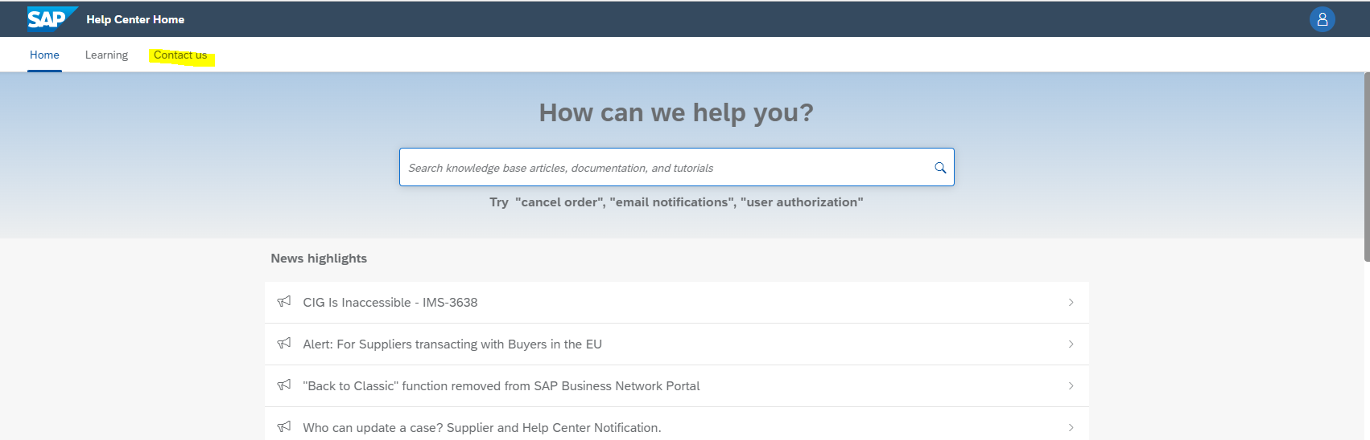
Help center
On the new tab click on “Contact us”

Slide 24
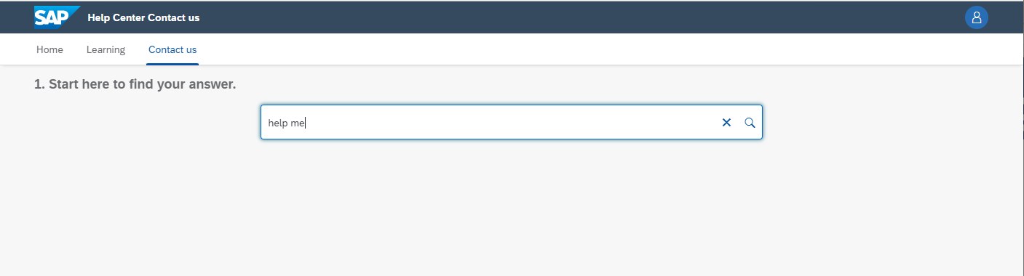
Contact us search
In the search type “help me” click magnifying glass

Slide 25

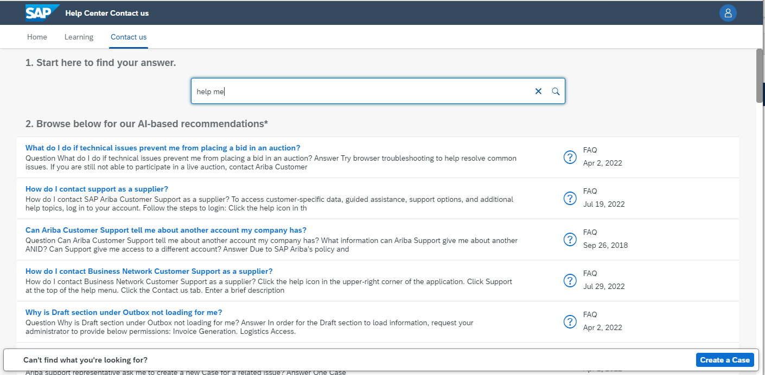
Create a Case
Click on the blue button that has appeared in the bottom right:

Slide 26
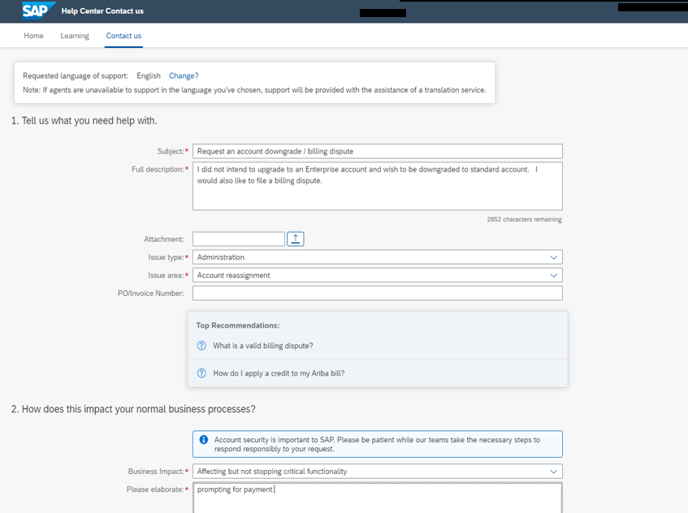

Case creation
Fill out required fields.
Subject: “Request an Account Upgrade Dispute”
Full Description: “I did not intend to upgrade to an Enterprise Account and wish to be downgraded to a Standard Account. I would also like to file a billing dispute.”
Business Impact: “Affecting but not stopping critical functionality”
Please Elaborate: “Prompting for Payment”
Then click “One Last Step”

Slide 27
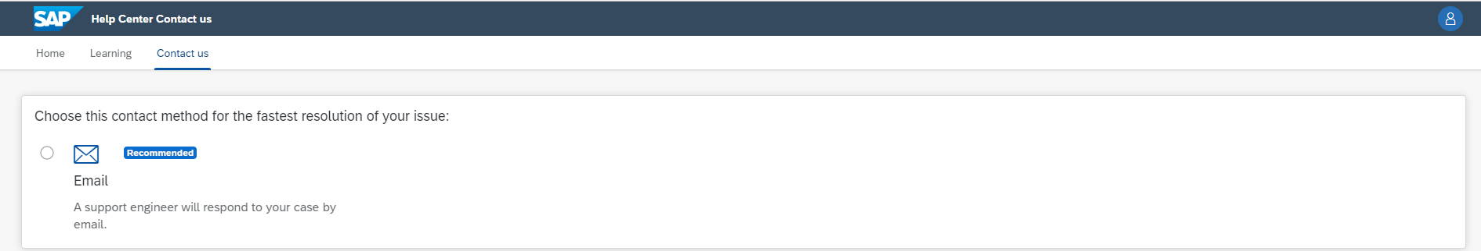

Submit Case
Here you choose method of contact. The Enterprise Account may have a phone options as well.
After selection click “Submit” and record the case number for future reference.

