Slide 1

Notification Settings
How to add change notification settings in Ariba account

Slide 2
Open Google Chrome or Microsoft Edge
Start off by navigating to supplier.ariba.com
If your web browser is giving you errors, please clear your cookies.
  This can be done through your settings within your web browser; or,
  Simultaneously hold down ‘Ctrl + Shift + Delete’ and your browser will prompt you with some options with a pop-up window.

Slide 3
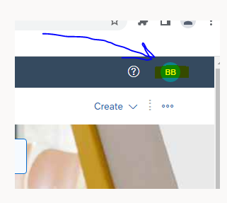
Once you’re in your account, click the initials in the top right

Slide 4
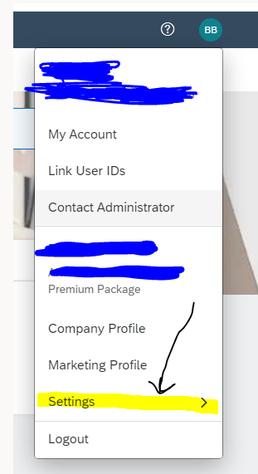
A new window will pop up
Drag cursor down and click on ‘settings’

Slide 5
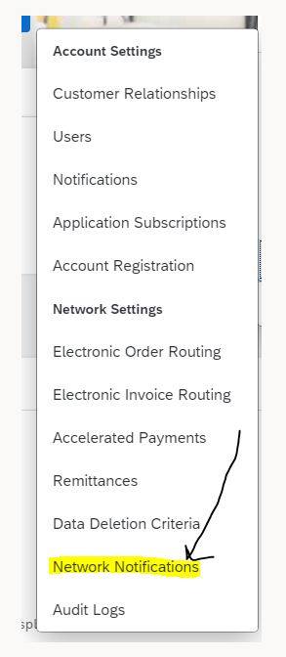
Another menu will appear to the left
Drag your cursor down to select
  ‘Network Notifications’

Slide 6
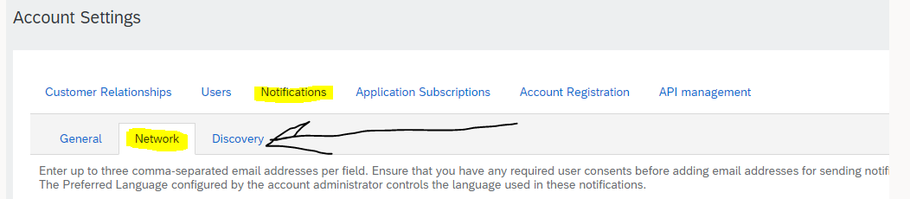
Once you’ve made it through these steps, account settings will appear at the top of your screen
At the top you will see some tabs to click on that will contain all of the notification settings within each grouping.

Slide 7
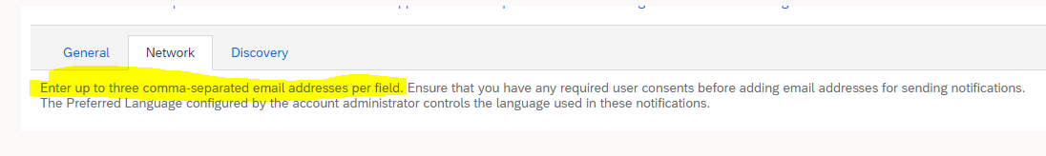
Adding emails to the notifications
Please keep in mind on the right side of the screen is where you will enter the email addresses to be notified. You can enter up to the emails for each notification, separated by a comma.

Slide 8
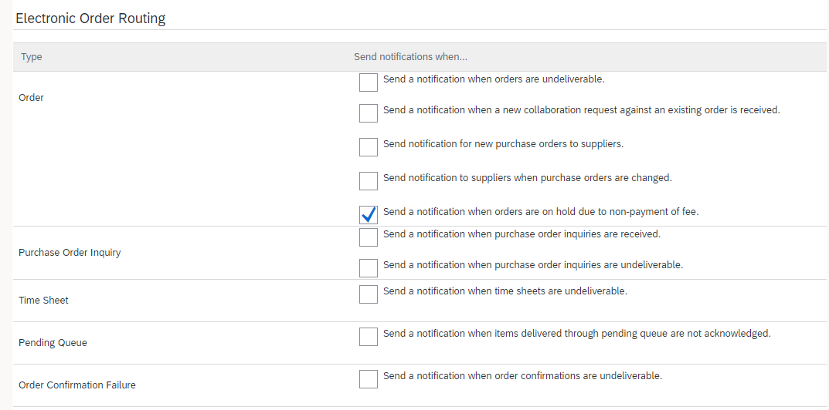
Electronic Order Routing Notifications:
(select all notifications that will apply)

Slide 9
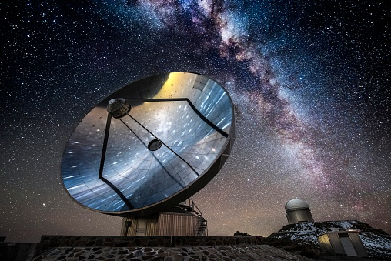
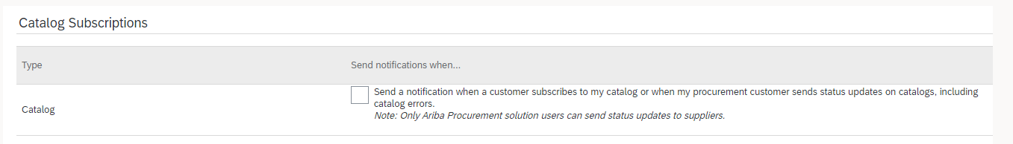
Catalog Subscriptions:
Depending on your account type(standard, enterprise, enterprise with enabled catalog, integration) will determine how many catalog notifications can be enabled. In this example, this is a standard account.

Slide 10
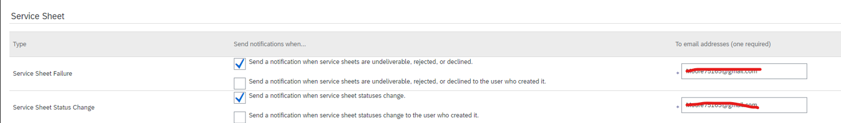
Service Entry Sheet notifications
As you can see below, none of the notifications for service entry sheets are enabled. Please make sure that if you want to enable notifications, click the little block and a blue checkmark will indicate it’s enabled.

Slide 11
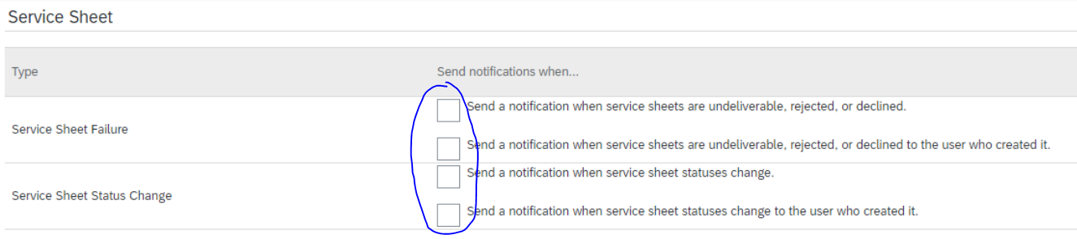
Service Sheet notifications (cont.)
If you want to enable notifications for service sheets if they fail, please click the top two notification buttons.
If you want to enable notifications to be sent any time there is a change, please click the bottom two.

Slide 12


Up to three emails can be added :
As stated earlier, up to three emails can be added to receive notifications. If more than one is added, please use a comma to separate them.

Slide 13
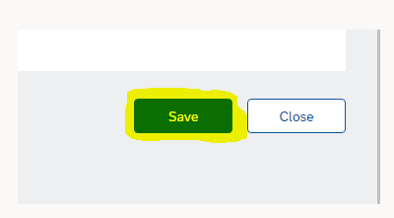
When you’re finished, be sure to hit Save!
On the top and bottom of the screen, there will be an option to save. Please be sure to save your changes before you ‘x’ out of the screen, or your edits will not go into effect!

Slide 14

Thank you!
Thank you for taking the time to view this Powerpoint demo in regard to notifications. I hope you’ve found this information beneficial.
Have a great rest of your day!

