Slide 1


Purchase Order Confirmations and Service Entry Sheets
Miles Sieminski, SAP
Updated: 11/26/2022 by Kimberly Strom, AP Gerdau

Slide 2
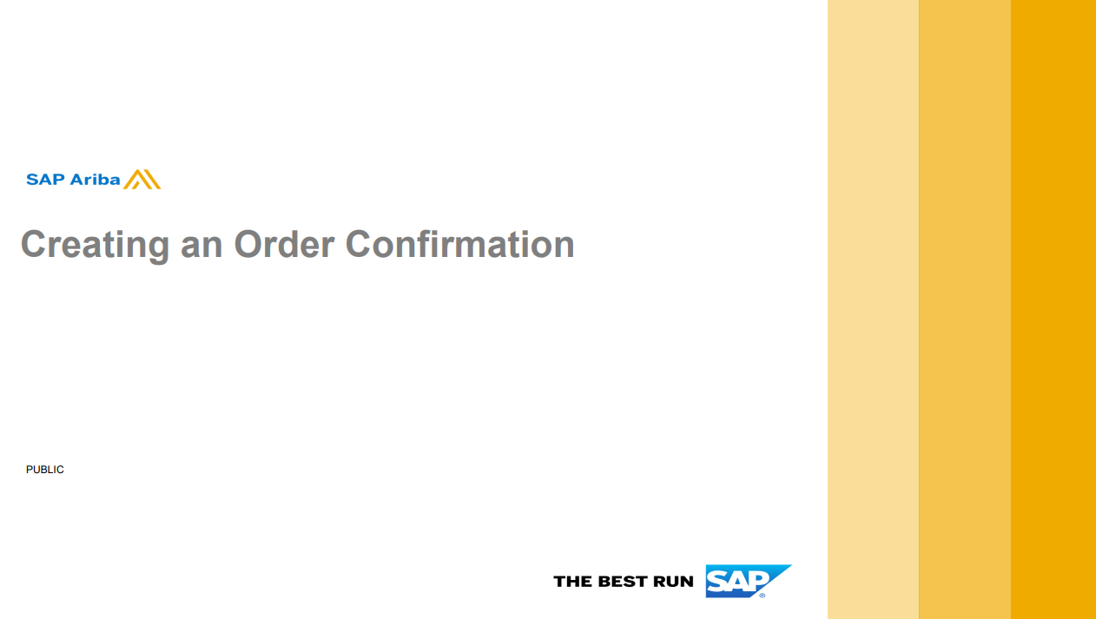

Slide 3
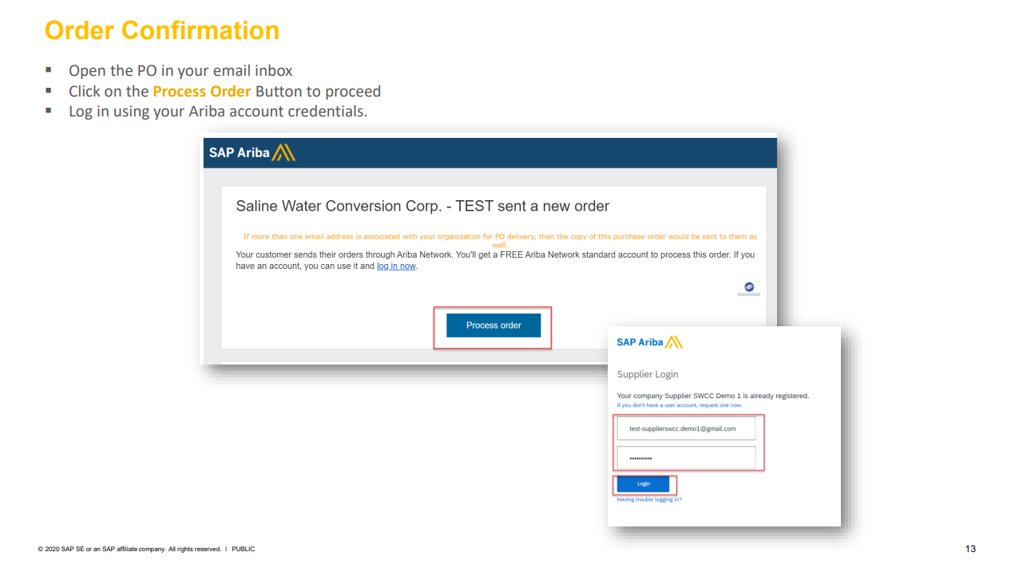


Slide 4
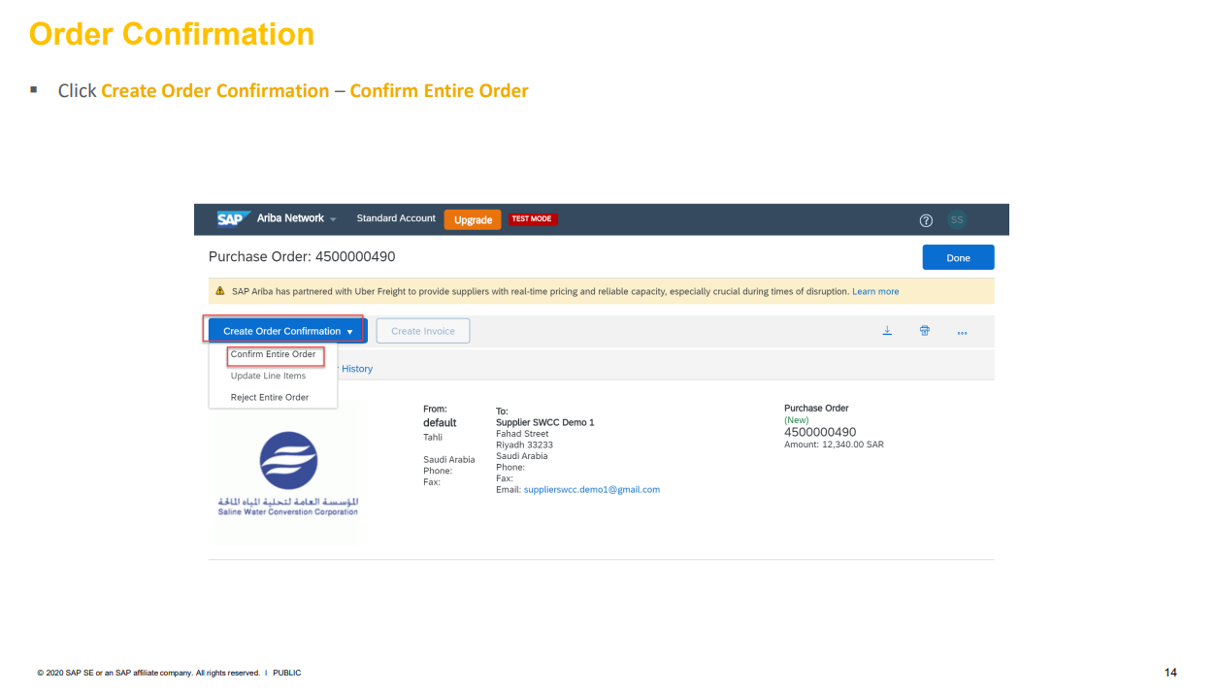
The Confirmation Sheet step is your chance to check the pricing and quantities on the purchase order to see if it agrees with what you expect it to be or have quoted.
If it is NOT correct, please reach out to your Gerdau Buyer to work with them on getting the information corrected and the PO resubmitted.

Slide 5
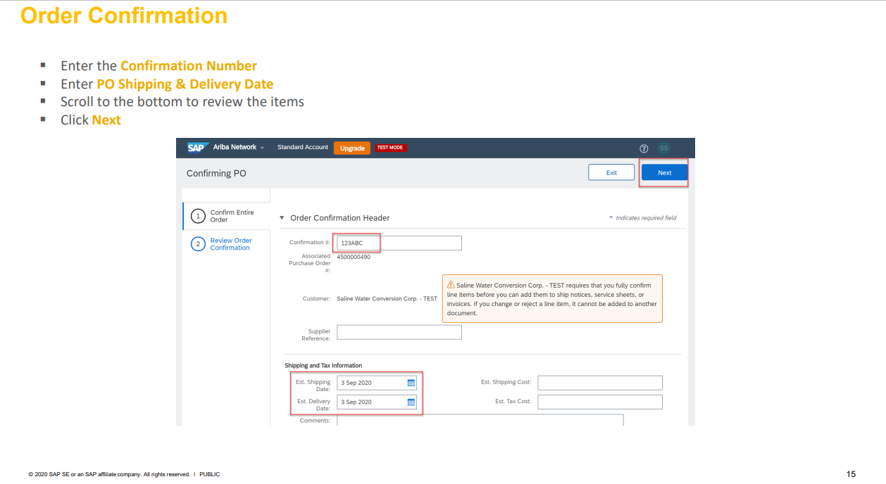

Slide 6
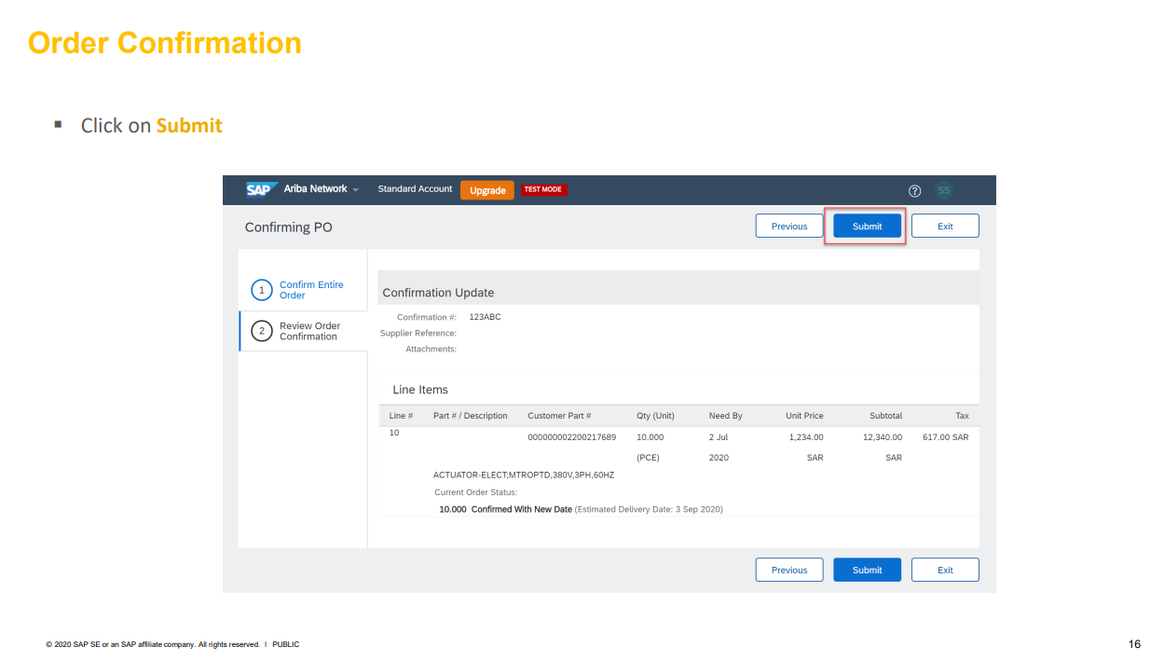

Slide 7
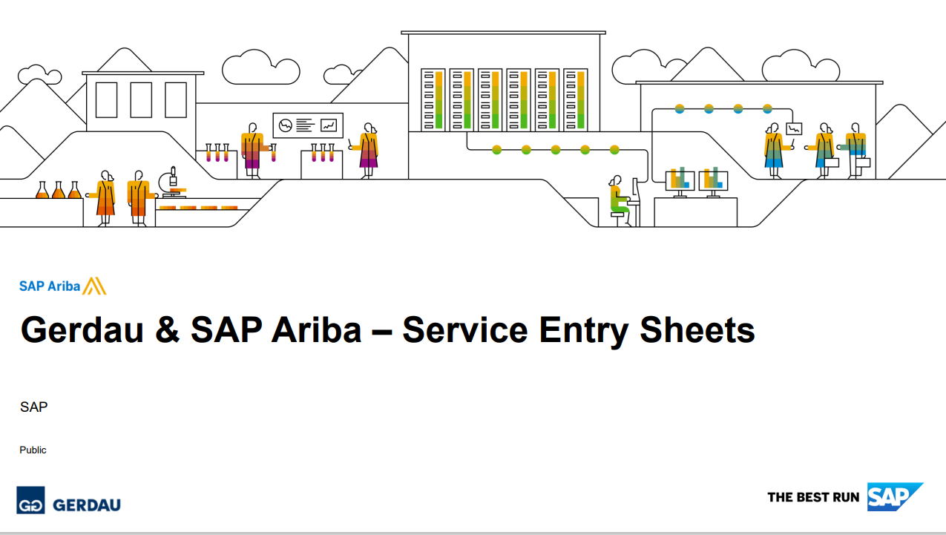

Slide 8
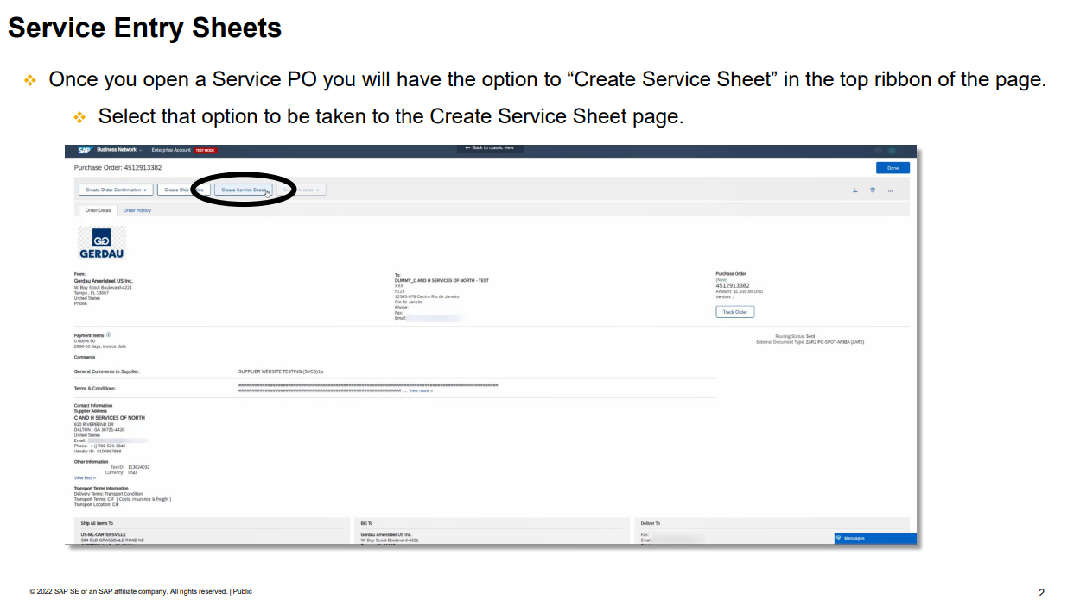

Slide 9
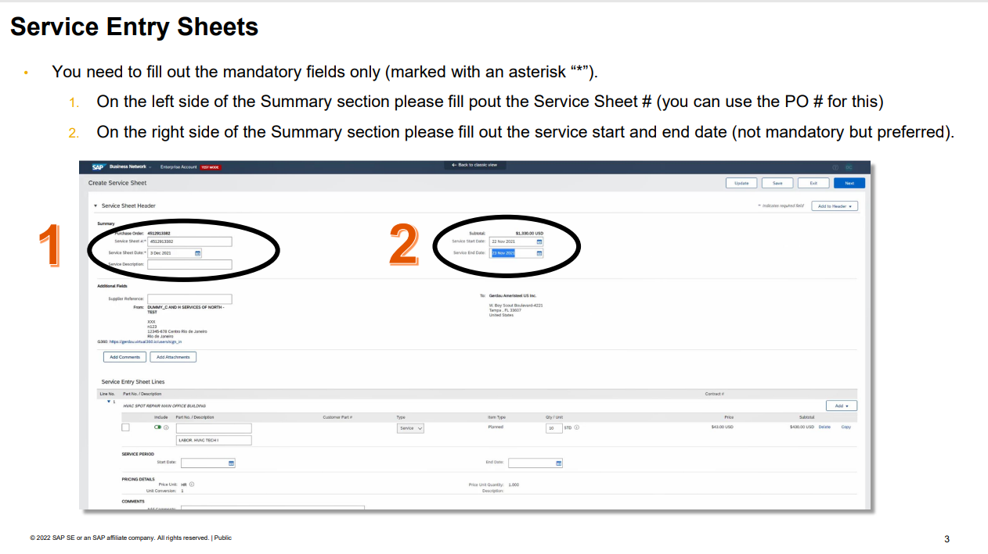




NOTE: Do not change the Service Sheet Date field. It will default to the date of when you are creating the SS. To avoid processing issues, please do NOT backdate here.

Slide 10
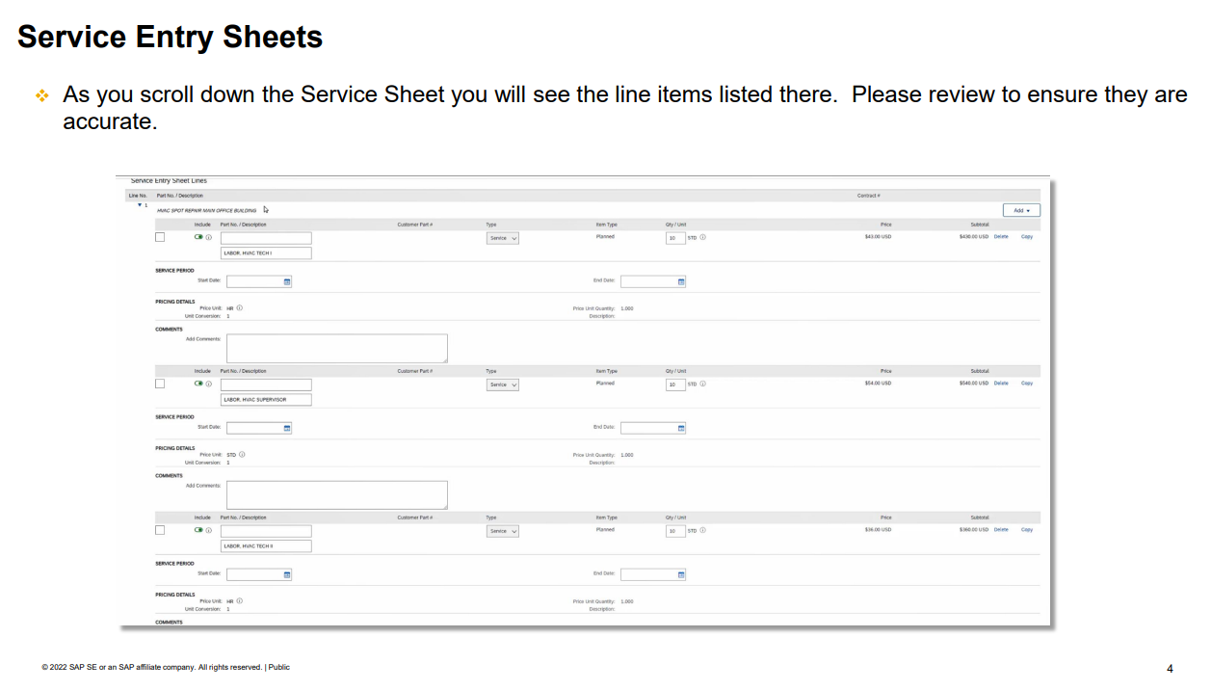
To do a PARTIAL Service Sheet, a line can be excluded simply by clicking on the GREEN sliding toggle button to the left of the item description, under “Include”.
Do NOT put a zero in the “Quantity” field; click the toggle button instead.

Slide 11
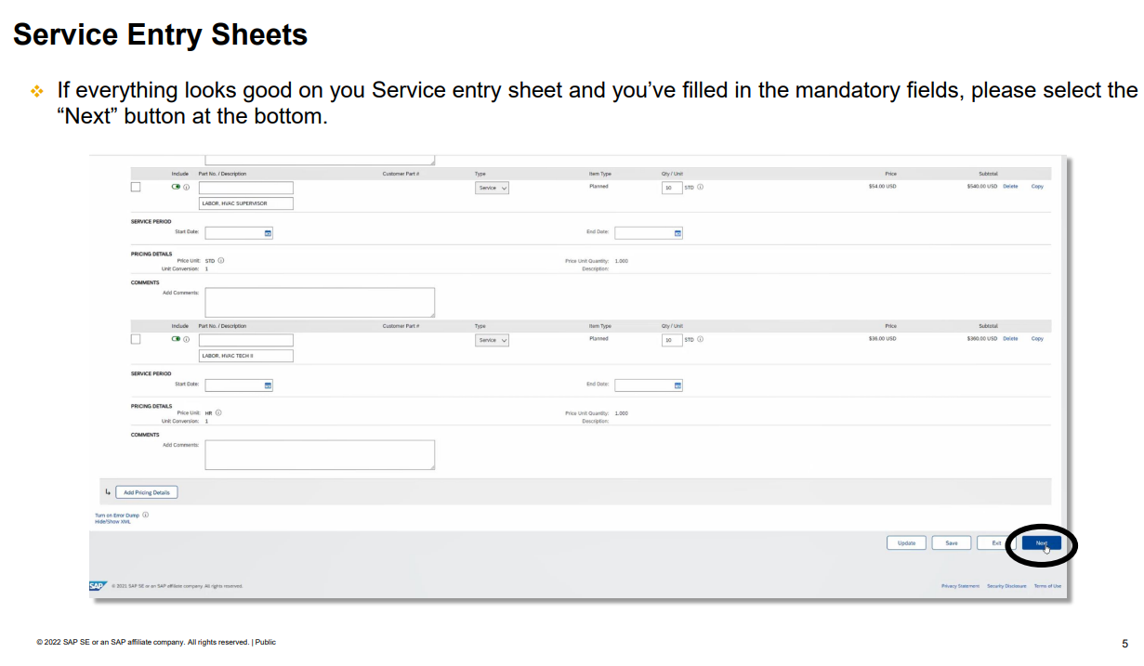

Slide 12
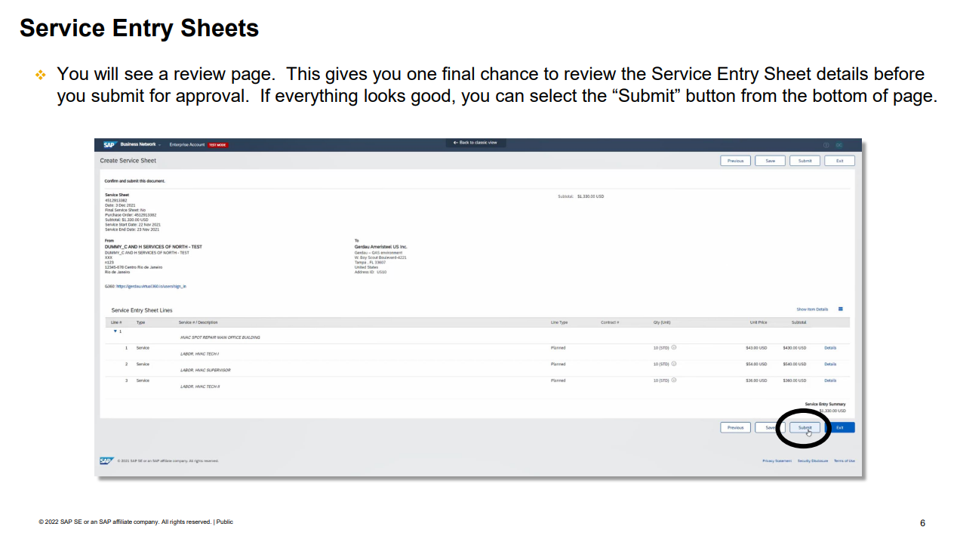

Slide 13
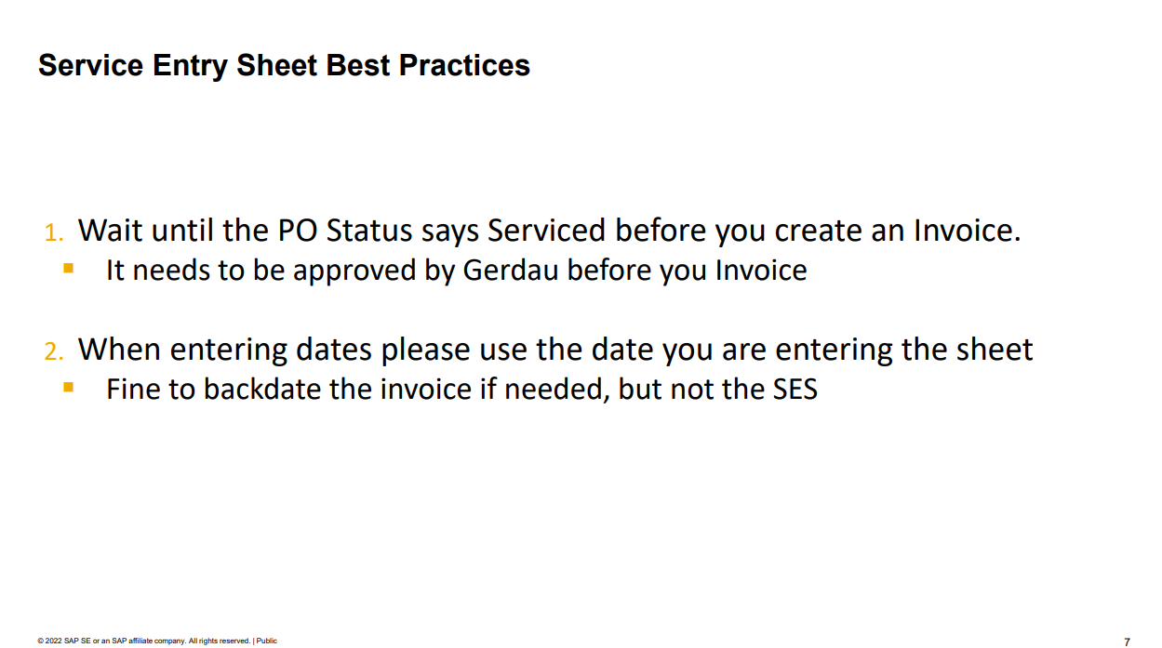

Slide 14
Service Sheet Statuses
Activity | Service Sheet Status | Ariba Network Routing Status/Service Sheet Status
A buyer has created a service sheet but not submitted it for approval. | Composing | n/a
A buyer has submitted a service sheet for approval | Composing -> Submitted | n/a
A supplier has tried to send a service sheet from Ariba Network but the transmission did not complete | n/a | Failed/Failed
A supplier has sent a service sheet from Ariba Network but your invoicing solution could not receive it due to a data error | Composing -> Rejected | Sent/Failed
A supplier has sent a service sheet and your SAP Ariba solution has received it | Composing -> Submitted | Sent/Acknowledged
(Supplier submitted Service Sheet) Your SAP Ariba solution has rejected the service sheet because it did not pass validation | Composing -> Rejected | Acknowledged/Rejected
A supplier on Ariba Network submitted a service sheet, but the ERP system could not receive the service sheet due to a data error or a validation error | Composing -> Failed in External System | Sent/Acknowledged
A supplier on Ariba Network has canceled a service sheet | Approved -> Canceled | Sent/Obsoleted
A supplier on Ariba Network has canceled a service sheet | Approved -> Canceled | Failed/Obsoleted
In sites configured to require external approval, all approvers have approved the service sheet and it has been sent to the external ERP system for approval | Approved -> Awaiting External Approval | Acknowledged/Sent
An approver has force-rejected an approved service sheet | Approved -> Rejected | Acknowledged/Rejected
In sites configured to require external approval, the service sheet fails in the external system after it is fully approved. | Submitted -> Awaiting External Approval -> Failed in External System | n/a
In sites configured to require external approval, a user edits a failed service sheet and submits it for approval | Failed in External System -> Submitted | n/a
A user has rejected a failed service sheet | Failed in External System -> Rejected | Acknowledged/Rejected
An approver has approved the service sheet and no other approval is required | Approved -> Processed | Acknowledged/Approved
In sites configured to require external approval, an approver in the external ERP system has rejected the service sheet. | Awaiting External Approval -> Rejected | Acknowledged/Rejected

Slide 15
Contact information:
Miles Sieminski, Network Enablement Lead
Miles.Sieminski@sap.com

