Slide 1

Configuring the Ariba Network Workbench

Slide 2
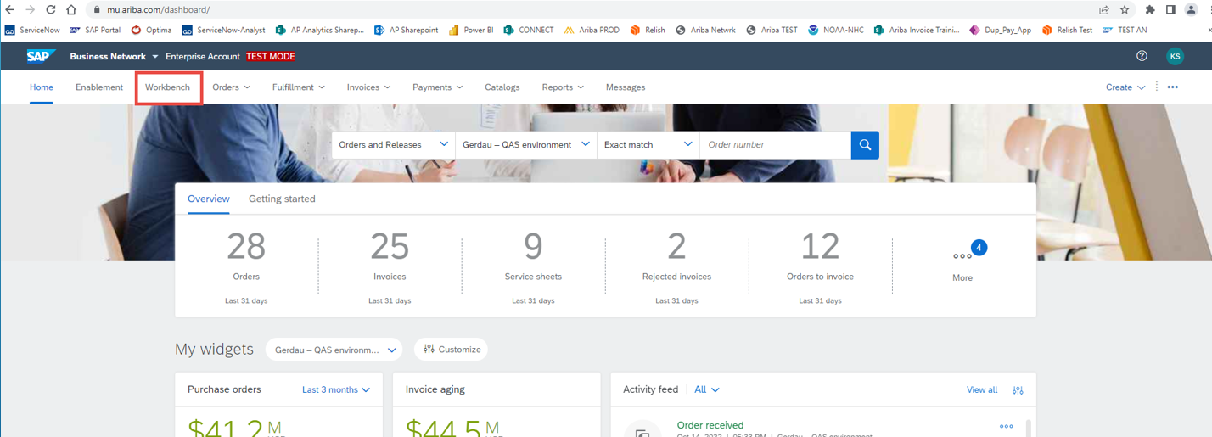
If you have an Enterprise (Subscription) account, Log in to your Ariba Network account and go to the Orders tab at the top of the screen and click on the PO that you want work with. Enterprise accounts can click directly on the header tabs to get to a document without going through the Workbench tab. You can also work from your Home screen to see new Orders, reports, and tasks. The Workbench tab is something that you can use if you want to, but the top tabs will allow you to access the same information and more.
If you have a Standard (Free) account, first get into the Ariba Network by clicking on the link in the order email that you received from Ariba. It will take you directly to that Purchase Order. You can also log directly into your Ariba Network. Set up the Workbench tab so that you will be able to use it to create invoices, access POs, etc. without going back through the original Ariba New Order email multiple times. Configuring this tab will allow you a limited (but similar) functionality to what the Enterprise accounts have available to them.

Slide 3
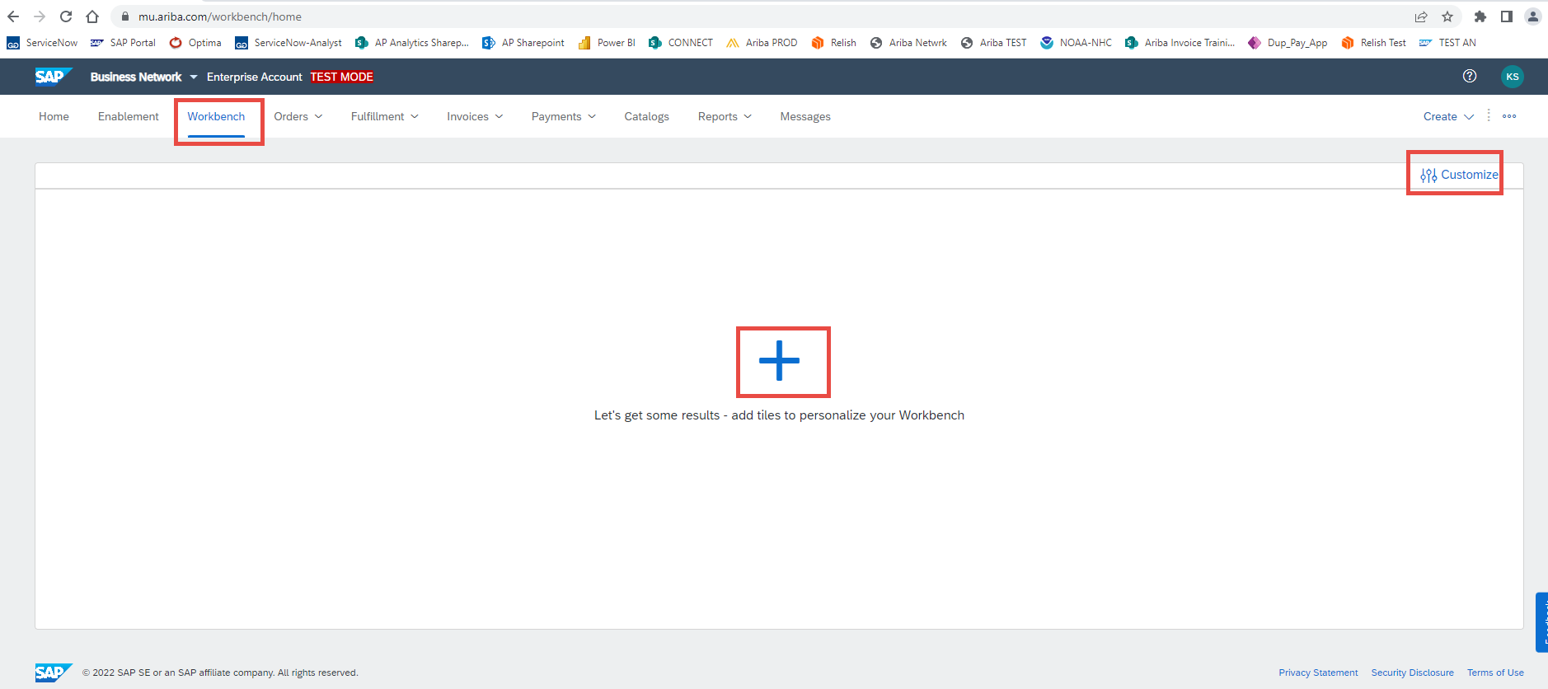
When you go to the Workbench tab, there may already be some tiles with tiles set up for you. If not, that’s not a problem. At any time, you can customize the Workbench to show quick reference buttons (tiles) that will take you to the information you need for working with your orders, service sheets, invoices, and more. To start, you can either click on the Plus or the “Customize” button in the to right side of the screen.
Note that if there is no Plus sign or, when you click on the Customize button, nothing shows, then you are probably not connected to Gerdau’s customer account. Please reach out to your Buyer at Gerdau for assistance.

Slide 4
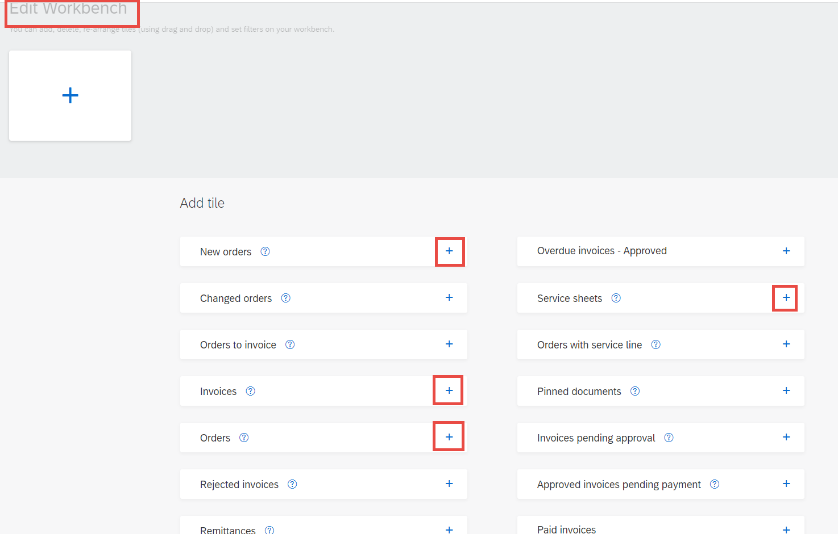
When you click on a Plus, there is a list of information tiles that will appear for you to add to your Workbench page.
You can add up to 10 tiles, but the minimum most basic tiles you should have are: Orders, Invoices, New Orders, and, if you are a Vendor who performs services for Gerdau, the Service Sheets tile.
To add them, click on the plus sign at the end of the tile name.

Slide 5
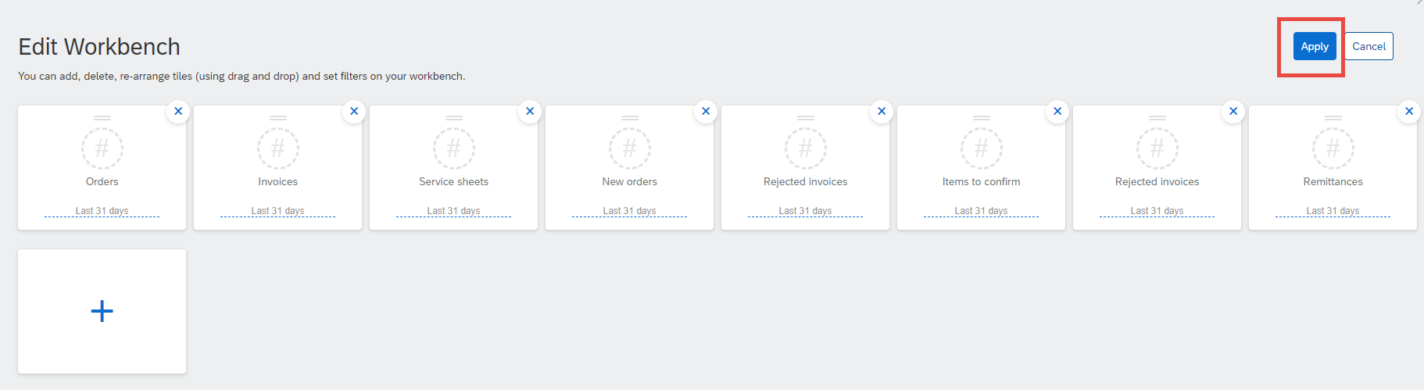
To add more, click the plus sign again to bring the list back up and pick the next tile that you want. Below shows a variety of options as an example. When you are done picking the tiles you want, click on the Apply button to bring the tiles to your Workbench home page.

Slide 6
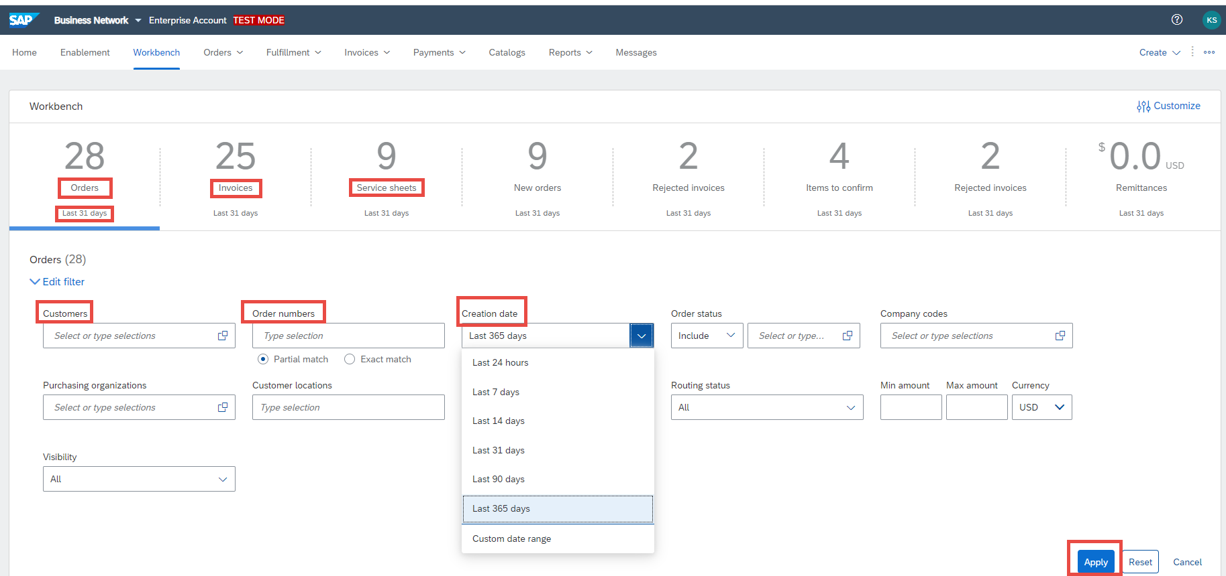
Once you have your selected tiles showing on the Workbench tab, you will see that there are defaulted filters to display only the last 31 days of records. You can change this by modifying the filter by selecting the tile that you want to filter and click on “Edit filter”. Go to the Creation Date and change it to be at least 90 days back, or up to a year (maximum one year only for Standard accounts).
Each information tile has different filtering options, but they all have the date range.

Slide 7
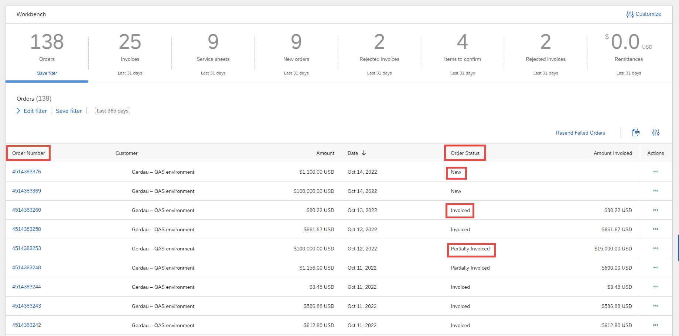
To find an Order to invoice, go to your Orders tile or tab (select Purchase Orders) and click on it. You will get the list of purchase orders that have been received from Gerdau. If you use Ariba with other customers, simply go to the filter and search for Gerdau in the Customers field. You can see the order status of the PO and can see which ones need to be invoiced still. If you click on the Date column header, you can sort oldest to newest. The Status column will show how far along your order is in the process. To go into the PO, just click on the order number. As with everything in Ariba, if the word or number is blue, you can drill into it. Clicking on the PO from here will take you to the screen where you will have the options to create Order Confirmations, Shipping notices, and Invoices.

Slide 8
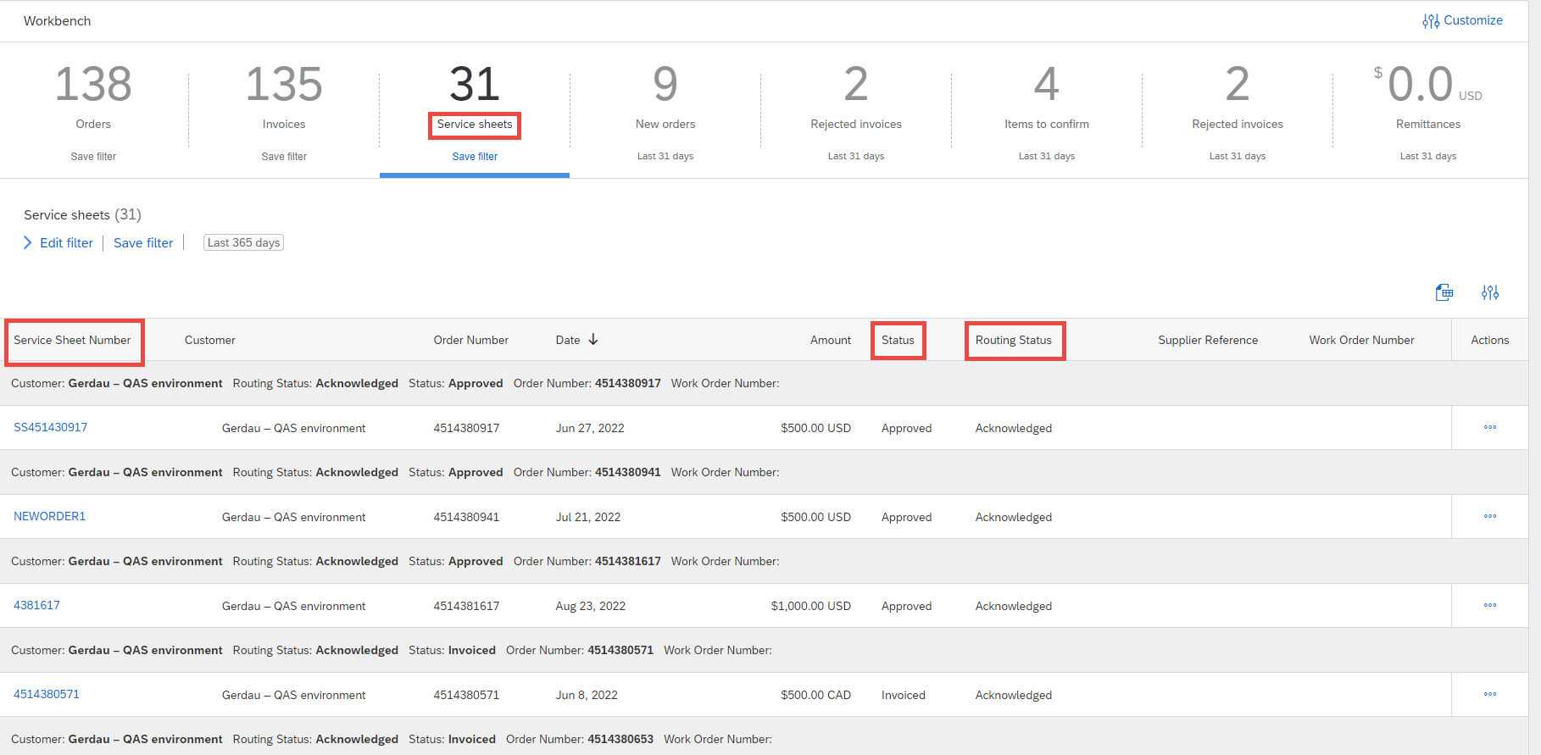
If you are a service vendor for Gerdau, the Service Sheets tile will be very useful to you. Gerdau asks that our vendors create the Service sheet to send to us for approval. Once we have completed the approval process on our end of Ariba, the status on the Service Sheets tile will update to show “Approved” as the status. At this point, the Create button will be available on the order screen and you can generate an invoice. For Enterprise accounts, simply go to the Orders tab, then select Purchase Orders to find the PO. Then click on the Order number to get to the screen to start the SS creation.

Slide 9
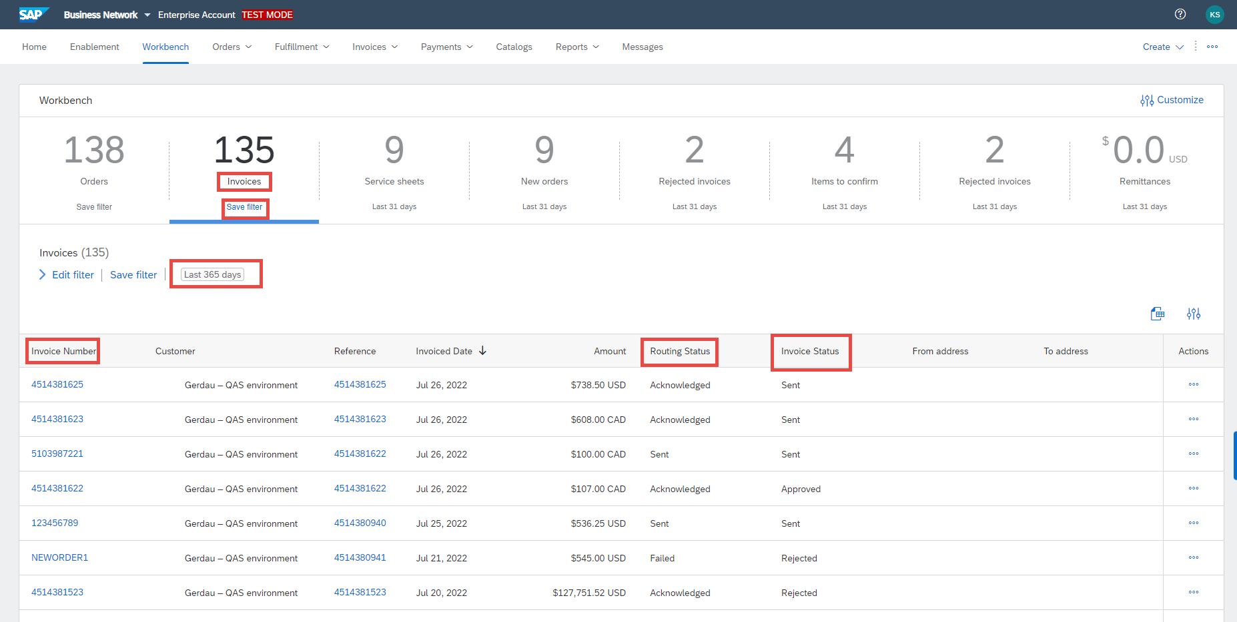
To find an invoice that has already been generated, click on the Invoices tile or tab, adjust your date filters, and check the Invoice Status column. Note again that you can sort the column by date if you click on the Invoice Date header label. The routing status will show if the invoice has been received by Gerdau (Acknowledged), if there was a rejection, or if the invoice failed to send to Gerdau’s side of Ariba. Please note that when an invoice is rejected, you will receive an email from Ariba stating the invoice has been rejected. Please open this email – there will be comments from Gerdau stating why the invoice was rejected. Most often it does NOT mean that we are truly rejecting the invoice, but rather are making an internal correction on our end and there is no action required from the vendor side. Sometimes there may be an action for you to take, so please be sure to read the comments. If you open the Invoice in Ariba, the comments that you would see in the email are also there. Always check the Rejected status invoices.

Slide 10
Thank you!

