Slide 1

How to create a case

Slide 2

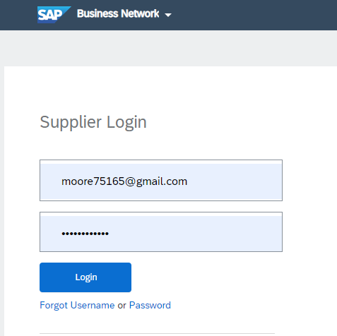
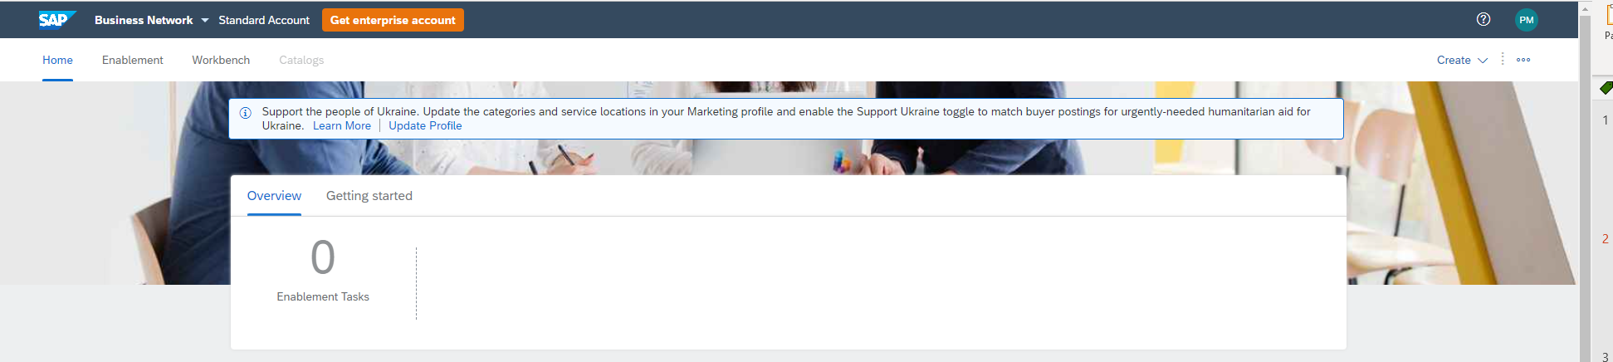
Ariba Log-IN
Gerdau - Ariba - SAP (hyperlink)
Log-in: email@yourcompany.com
Password: XXXXXXXX
Home screen

Slide 3

Create ticket
Top right the Circle ? is support.

Slide 4
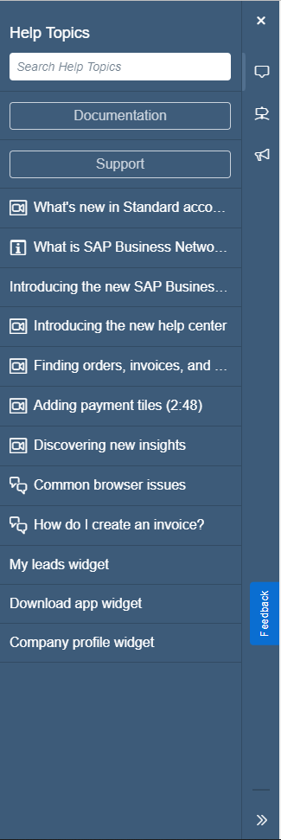
Support
It will open the support menu.
Click the [Support] button on the menu
This will open a new tab in your browser

Slide 5
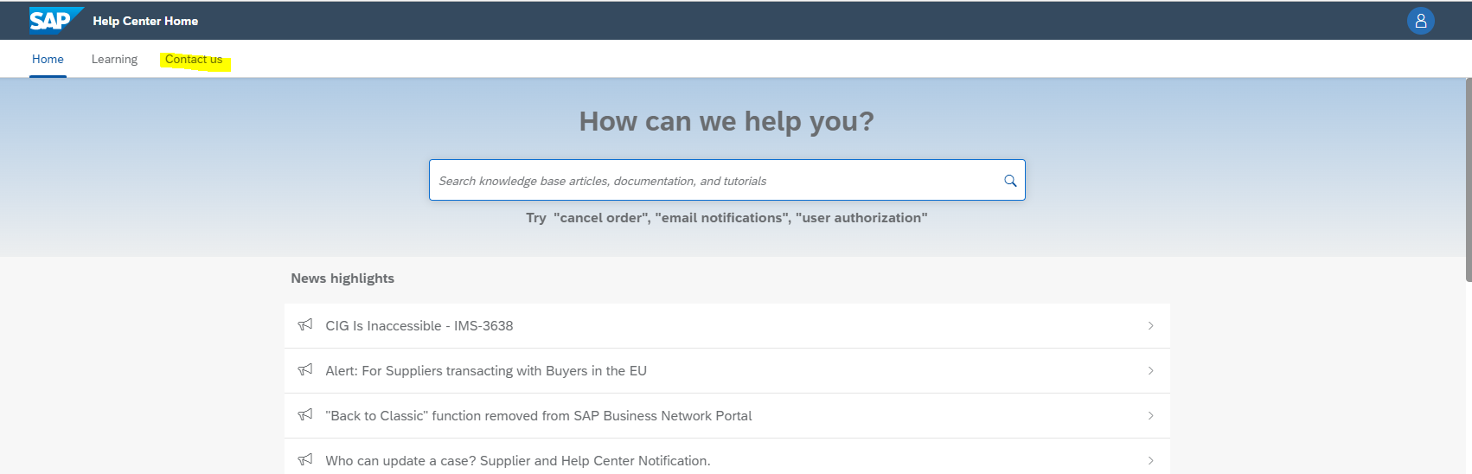
Help center
On the new tab click Contact us.

Slide 6
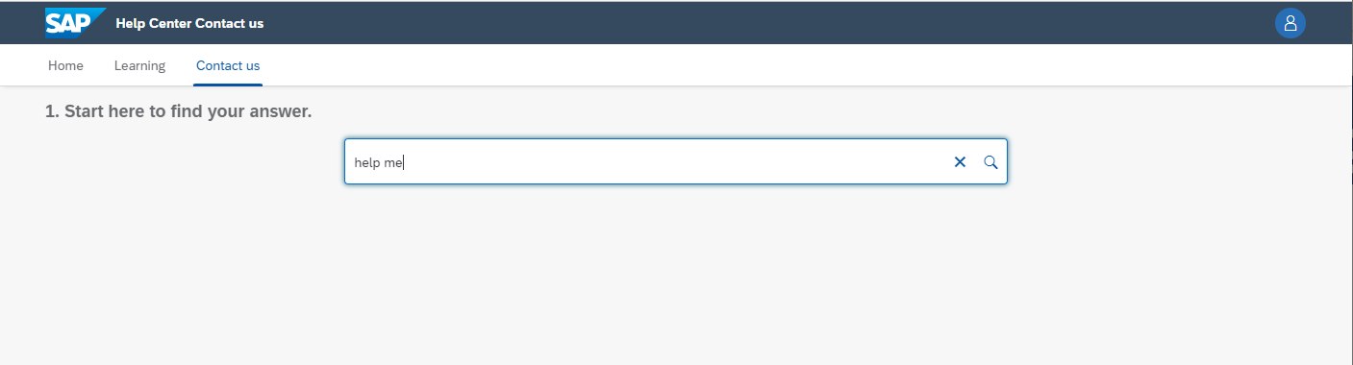
Contact us search
In the search type “help me” click magnifying glass

Slide 7

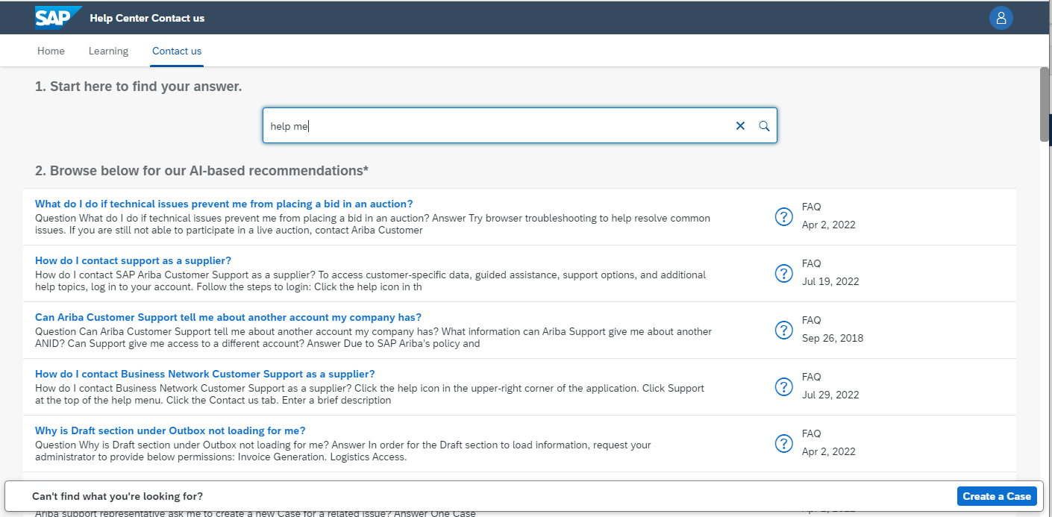
Create a Case
Click on the blue button that has appeared in the bottom right.

Slide 8
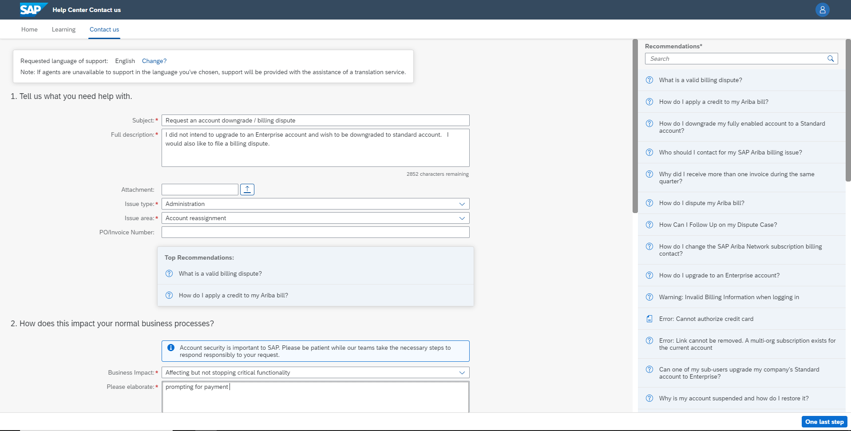

Case creation
Fill out required fields
Then click
@bottom right

Slide 9
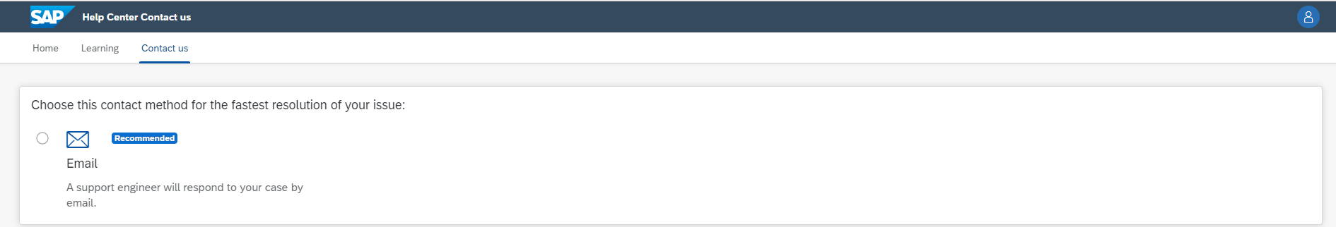

Submit Case
Here you choose method of contact. I believe Enterprise Account may have a phone options as well.
After selection click submit and record case number

Slide 10
Reference Material
TRAINING/TROUBLESHOOTING HYPERLINK: Welcome to your SAP Ariba Network Standard Account
TRAINING/TROUBLESHOOTING SAP Support: Help Center Home (ariba.com)
DO NOT UPGRADE THE ACCOUNT! A STANDARD ACCOUNT IS ALL THAT WE NEED

