Slide 1


Electronic Integration on Ariba Network
Supplier with Gerdau
Speaker’s Name, SAP
Month 00, 2022

Slide 2
Agenda
What is Integration?
Current Status
Project Scope
Project Scope Documents
Supplier Integration Methodology
Project Life Cycle
Best Practices
Timeline Milestones
Roles & Responsibilities – Project Team
Challenges: Impacting Timeline
Project Governance
Transition To Support

Slide 3

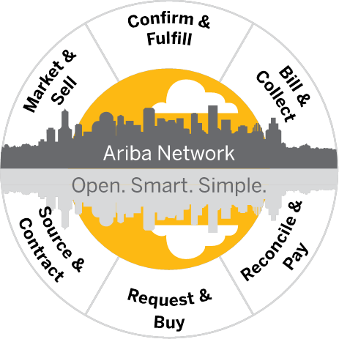



What is integration?
PO Flip suppliers
Standard Account supplier
Integrated suppliers
Supplier
Standard Account
Manual Entry
Customer
Supplier PO Flip
Manual Entry
Supplier Integration
Machine to Machine
Integration

Slide 4

Current Status / Scope

Slide 5

Current Status
Tasks completed to date
Requirement delivered and reviewed by Supplier
Relationship accepted
Y/N
Location
Country
ANIDs
Gerdau- <AN01512756408>
Ariba Network Accounts Configured
Y/N
Supplier - <AN00..>
Catalog
CIF/Punchout

Slide 6
Project Scope
How are items currently purchased?
Procurement Solution
Type of Items in Scope
Email/Legacy integration
P2X/POIA
Catalog
Non-catalog
Test Plan:
Purchase Orders
Catalog / non-catalog PO
Change Order
OC - Order Confirmation
Cancel Order
ASN - Advance Ship Notice
Invoices
Optional, strongly preferred
Optional, strongly preferred
Mandatory
Credit Memo
Mandatory

Slide 7
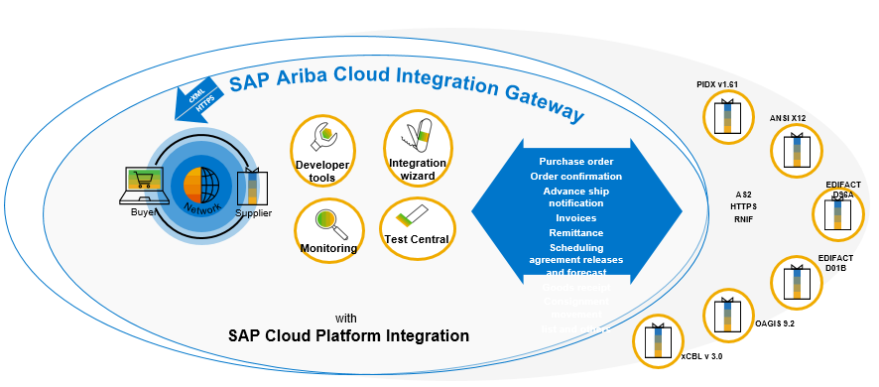
Format
cXML
Transmission
cXML - HTTPS
X12 - AS2
D96A
X12 - (NAMER)
D96A - AS2
SAP Ariba Cloud Integration Gateway is the preferred integration solution for suppliers
transacting on Ariba Network.
    Main Goal: To simplify integration and shorten the integration timeline
    Covering more industry and regional standards
    Providing self testing capabilities
    Support for various formats in addition to cXML
    Please note that the legal binding document is the one on Ariba Network!

Slide 8
Project Scope - Documents
Purchase Order Types Supported | Purchase Order Types Not Supported
New POs | Blanket POs (BPO’s)
Change/cancel POs
Non-catalog POs
POs with attachments
Service POs
Invoice Types Supported | Invoice Types Not Supported
Individual Detail Invoice: applies against single PO referencing line items; line items may be material items. | Non-PO Invoice: invoice against PO not transacted via the Ariba Network
Partial invoice: Invoice against a portion of the items on a PO. | Non-PO invoice against contract or master agreement
Invoice against material PO | Invoice against Blanket PO
lineLevelCreditMemo (cXML 1.2.018 and higher) invoice purpose set to “lineLevelCreditMemo” | Invoice against PCard
Debit Memo | Line level credit supported by negative quantity at item level and positive unit price
Header Credit Memo | Duplicate Invoice: invoice numbers may be reuse in case of reject/fail of original invoice
 | Header Invoice: single invoice applying to single PO without item details
 | Cancel Invoice

Slide 9

Project Planning

Slide 10


Supplier Integration Methodology
– Six stage integration according to our best practice
Planning and Testing are the most critical and time consuming steps
Milestone dates to be determined at kick-off meeting
If Invoice/OC in scope, can supplier start with using Ariba portal whilst integration is ongoing?
Plan
Build
Test
Design
Deploy
Go Live

Slide 11
Supplier Integration Methodology
– Six stage integration according to our best practice
Planning and Testing are the most critical and time consuming steps
Milestone dates to be determined at kick-off meeting
If Invoice/OC in scope, can supplier start with using Ariba portal whilst integration is ongoing?
Plan
Build
Test
Design
Deploy
Go Live

Slide 12
Project Life Cycle – Integration
Plan
Build
Test
Design
Deploy
Go Live
Kick Off Meeting Define Project Scope Documents, business rules, format | Configurations Confirm AN Account (ANID) set up Test account configured Routing configured. | Supplier Development Performs Dev and QA testing of maps | UAT Testing Conduct UAT testing with Customer Pre-defined test scenarios | Migration to Production supplier migrates maps to Production | Production Transactions Confirm successful transactions in Prod
Define Project Plan Agree on milestone dates. | Confirm Relationship established in Test. Define test plan, identify test scenarios | Establish connectivity to the AN | Validate that solution meets requirements | Confirm AN Accounts configured in Production Confirm relationship established in Production | Support SI Post-production support
Commit to target Go Live date Define Project Team and Resources Contacts list and governance model. | Supplier’s technical solution defined. | Submit sample cXML/EDI invoices to SI for validation | Formal sign-off and acceptance | Buyer/Supplier change management steps Communications, internal set ups | Ongoing technical support Project close

Slide 13
Best practices for the supplier
Participate on weekly project follow up meetings (30 Minutes) with Supplier Integrator during the whole integration process;
    NB: When catalog in scope, the supplier must agree on a way to monitor the implementation with their CKE (mail, weekly meeting)
Plan
Get familiar with the cXML guideline, define roles and responsibilities of project resources and agree on milestone dates;
Design
Defines the test scenarios; configure the Ariba account in production and in test mode;
Build
Establish connectivity to Ariba network (suppliers already on the network with other buyers will already have connectivity setup), create a cXML sample for the required transaction documents;
Test
Deploy
Go Live
Technical contact is engaged in day to day testing activities: post documents on Ariba test environment according to the test scenario, log on Ariba and check their status, receive technical advices from Supplier Integrator;
NB: when catalog is scope, the catalog needs to be available before testing phase start
Supplier should migrate his account to production mode; internal communication for the switch to production mode is needed;
Document exchange runs in production mode; Supplier integrator provides technical support during the first two weeks;

Slide 14
Timeline Milestones – will be reviewed and feedback on <Date>
If integration is not completed on time, are you able to do POflip in the meantime?
Phase | Milestone | Owner | Duration | Date Due
Plan | Signoff on Project Plan & Timelines | Supplier | 2 weeks
Design | Buyer specs reviewed | Supplier | 3 weeks
Build | Data mapping completed | Supplier | 4 weeks
Catalog deployed | Catalog is deployed in test an available to send POs | All
Test | Testing completed/Sign off on Test Cases | All | 4 weeks
Deploy | Confirm Cutover activities completed | All | 1 week
Go Live | Confirm Go Live (week 12) | All

Slide 15
Roles & Responsibilities – Project Team Challenges and Governance

Slide 16
Roles & Responsibilities – Project Team
Contact Name | Supplier Role | Responsibility
 | Project Lead (Operational Lead) | Main contact for project coordination Provide commitment to project timeline Understand buyer's transaction validation rules Participate in status meetings
 | Technical (Developer) | Provide technical details for integration to back-end systems Perform data mapping Assist in troubleshooting document failures Coordinate go live with functional resource
 | Testing Contact | Define & Validate catalogue content with buyer Analyze incoming Orders Generate Test Invoice Assist in other testing activities, coordinate go-live Download & validate applicable test transactions; load & process through ERP
Contact Name | Buyer Role | Responsibility
 | Project Lead (Supplier Enablement lead) | Main contact for project coordination Enforce compliance of project timelines
 | Technical (Developer) | Support of cXML/EDI Identified Supplier testing Provide connection parameters to ERP systems Assist in troubleshooting document errors from the application/ERP
 | Testing Contact | Define & Validate catalogue content with Supplier Generate Test Orders Reconcile and approve invoices Assist in other testing activities, coordinate go-live Download & validate applicable test transactions; load & process through ERP
Contact Name | Ariba Role | Responsibility
 | Supplier Integrator | Manage end-to-end supplier integration Troubleshoot failed/rejected documents Ensure timely completion of project milestones Escalate issues to appropriate person/team
 | Supplier Enablement Lead | Consolidate all suppliers enablement status for reporting to Gerdau
 | Catalog Expert | Support Setup and testing of Catalogue with buyer and supplier

Slide 17
Challenges: Impacting Timeline
3rd Party Involvement
Y/N
In case of Y – specify relationship and details
System Maintenance
Dates/ Occurrences
Ex. every Sunday..
Vacation and Holiday Planning
<Supplier-Name of resource: list of holiday dates>
<Buyer-Name of resource: list of holiday dates>
<Ariba-Name of resource: list of holiday dates>

Slide 18
Project Governance
Status Call Cadence
Resources
Ariba Implementation Guides - Go to: http://supplier.ariba.com/help
Cadence: Weekly
Supplier Information Portal (spec guides, project doc) – Log into your production account and go to Customer Relationships.
Search Knowledgebase/Tech Notes – connect.ariba.com
Ariba Cloud Statistics – http://trust.ariba.com - Detailed information and latest notifications about product issues and planned downtime, if any, during a given day
Ariba Network Notifications – http://netstat.ariba.com - Information about downtime, new releases, and new features
Day/Time:<Day and time>
Required attendees: <Person who have to be present from supplier on the call>

Slide 19
Transition to Support

Slide 20
Transition To Support
Post Go-Live Support
Supplier Integrators provide 2 weeks support post Go-Live during Live transactions starting with the first transaction in Production.
After the two week period - a Service Request should be created for any request. (Steps detailed in the file attached)

Slide 21
Thank you.
Contact information:
  F name L name
  Title
  Address
  Phone number

