Slide 1
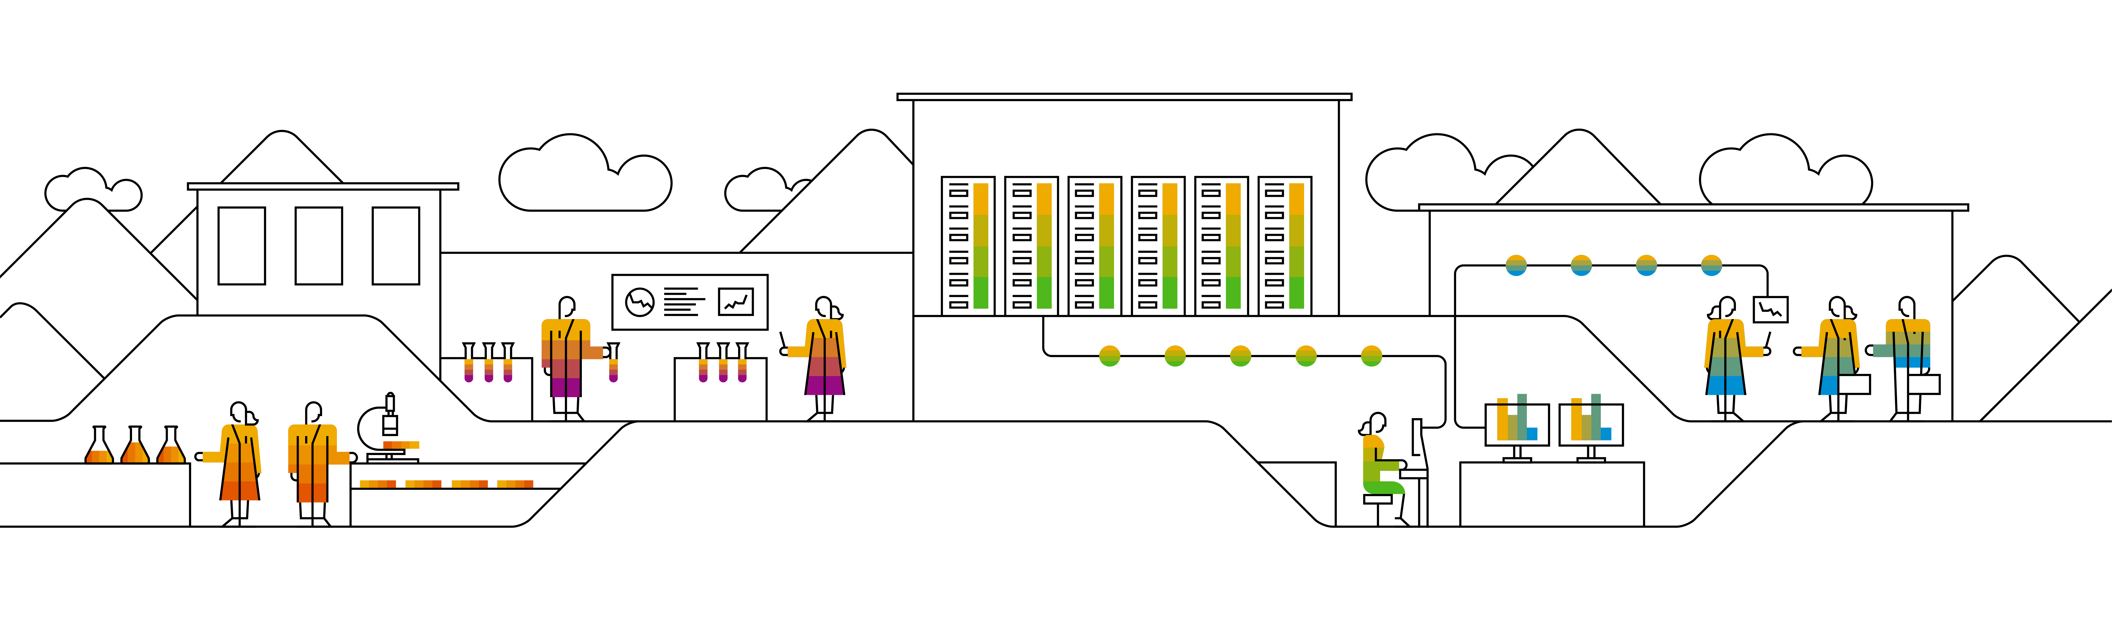
Creating a Service PO Invoice with Auto-generated Service Entry Sheet
April, 2023

Slide 2
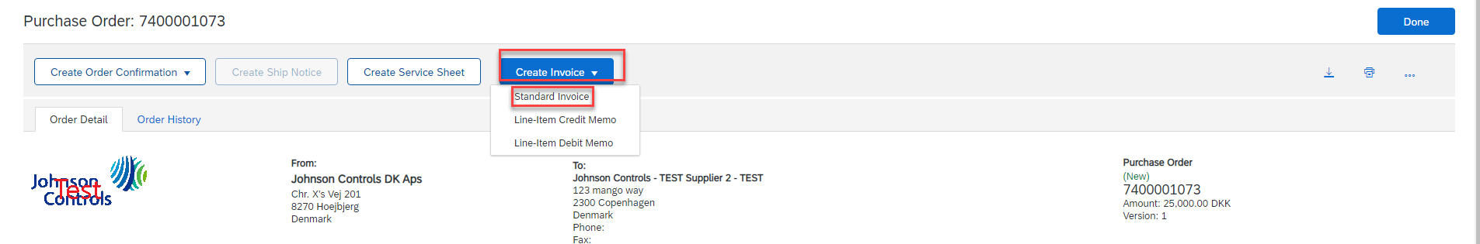
From the open Purchase Order
What is a Service Entry Sheet?
A Service Entry Sheet is an electronic record that contains details of services that have been performed by a Supplier based on the agreed terms of a Purchase Order
When is a Service Entry Sheet Required?
Service Entry Sheets will need to be tied to an Invoice when there are line items on a Purchase Order being referenced that pertain to service(s)
Click Create Invoice
Click Standard Invoice

Slide 3
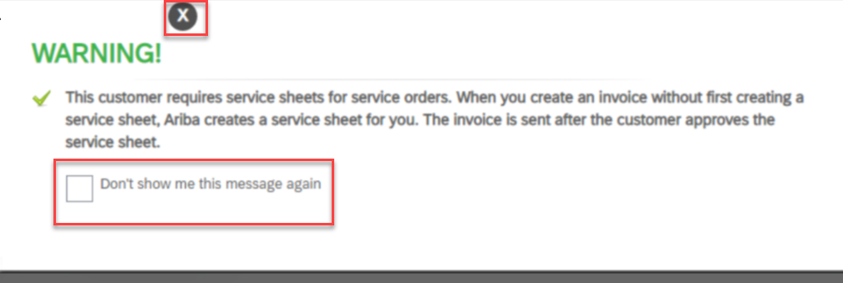
Auto-generation warning pop-up
This can either be closed on a case by case basis, or you can choose to not have the warning show again
  Note: this warning will not pop up if you have already chosen in the past to not show the message again

Slide 4
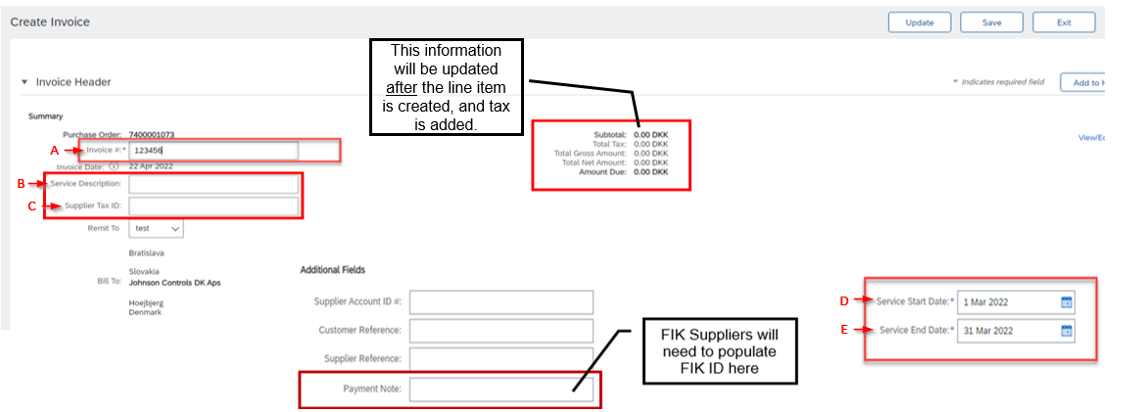
Enter Invoice Details:
A. Invoice ID
B. Service Description
C. Supplier Tax ID (US & CA)
D. Service Start Date
E. Service End Date

Slide 5
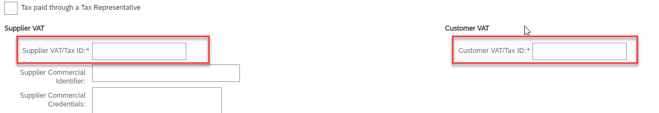
Enter Invoice Details:
Supplier VAT/Tax ID (Non-US & CA)
Customer VAT/Tax ID (Non-US & CA)
    Customer VAT/Tax ID should auto-populate

Slide 6
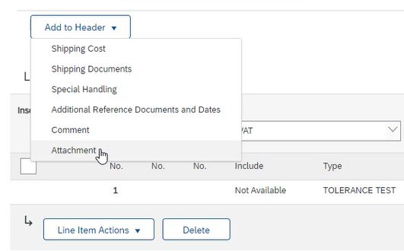
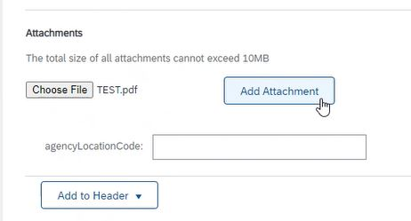
Attach PDF Invoice and additional Supporting Documents
Suppliers in Proforma Countries will need to attach a PDF copy of the Invoice for Tax purposes.
Supporting documents providing service details can be attached for any additional supporting information.
1. Click Add to Header → Attachment
2. Click Choose File and select local document
3. Click Add Attachment

Slide 7
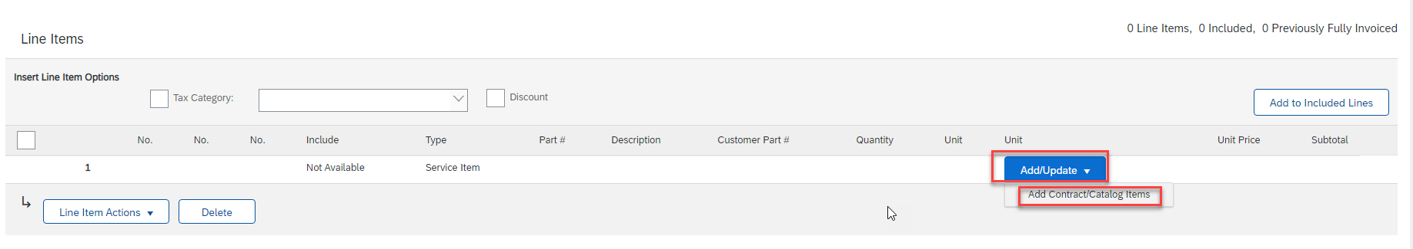

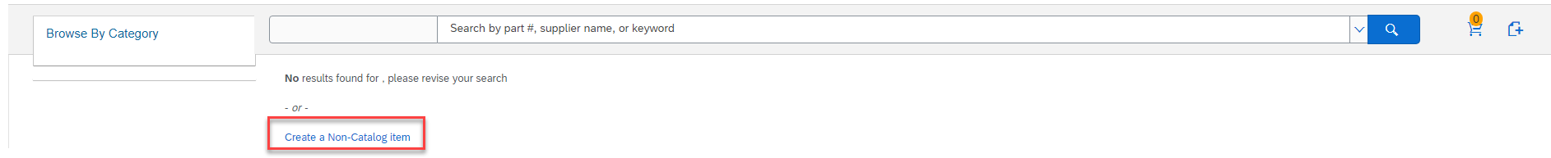
Create Service Sheet / Line Item
1. Click Add/Update
2. Click Add Contract/Catalog Items
3. On the next screen click ‘Create a Non-Catalog item’ or symbol

Slide 8
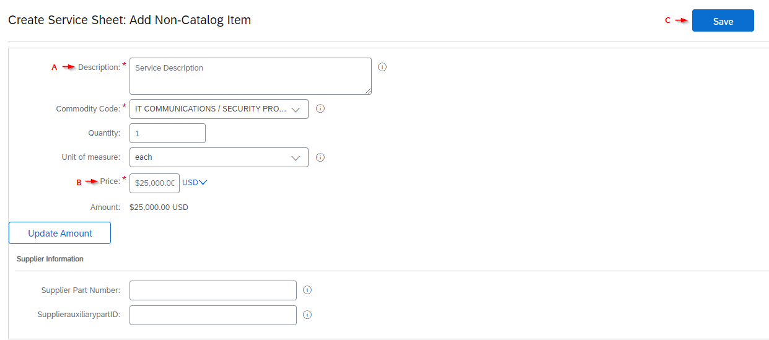
Enter Invoice Details:
A. Description: Brief description of Service provided
B. Price: Amount of your Invoice without tax, shipping, special handling, etc.
C. Click Save

Slide 9
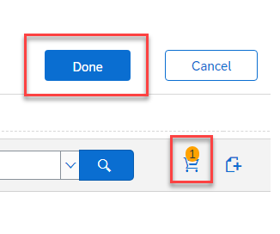
Create Service Sheet / Line Item
The shopping cart should reflect the item has been created
Click Done

Slide 10
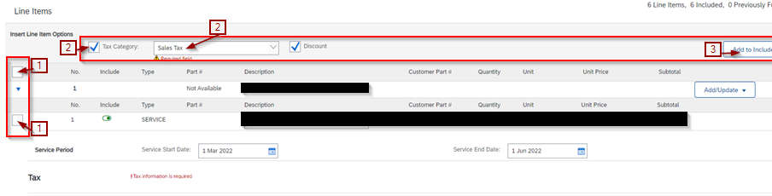
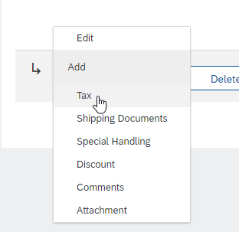
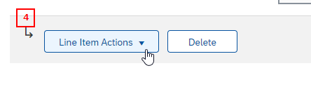
Add Tax to line item
  Choose the line item to add tax to
    The first box will include all lines
    The second box will include individual lines, and can be selected individually.
  Check the Tax Category box, and select the tax type you want to add to the line(s).
  Click ‘Add to Included Lines’ to generate the tax fields at the line level.
4.Alternatively, you can click ‘Line Item Actions’ and select ‘Tax’ after step 1.

Slide 11
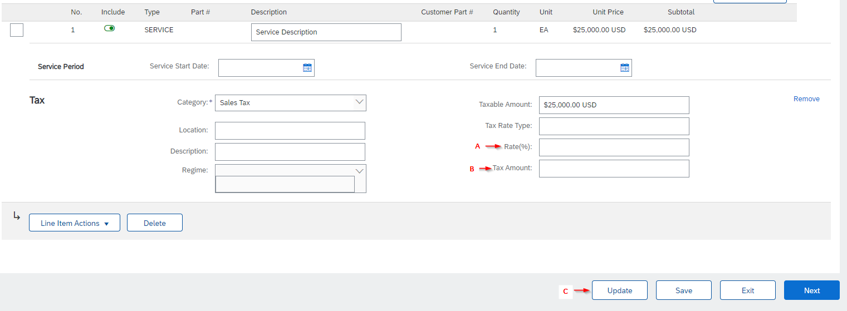
Add Tax to line item
Please Note: Even for instances of an invoice without tax, Tax Rate % and Tax Amount are still required to submit.
  If your invoice does not have tax, you will enter the Rate % as 0
  You can enter the A.Rate(%) OR B.Tax Amount and click C.Update to auto-populate each other.

Slide 12

Finalize and click Next
Update will apply any changes to the invoice.
Save will save the most current version of this invoice, in case of site error.
Exit will allow you to either Save Invoice to submit at a later time or Delete the Invoice to navigate out of the invoicing screen.
Next will bring you to the next screen to review and submit your invoice.

Slide 13
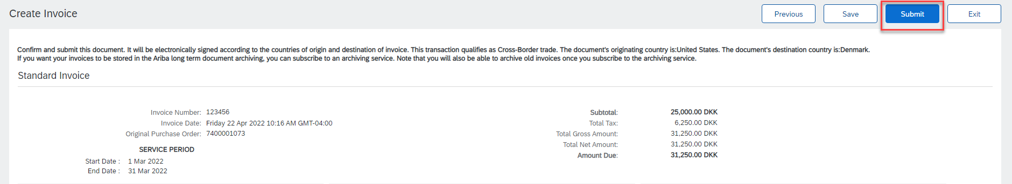
Review Invoice details
If any changes are required, click Previous to edit
If everything is correct, click Submit.

Slide 14
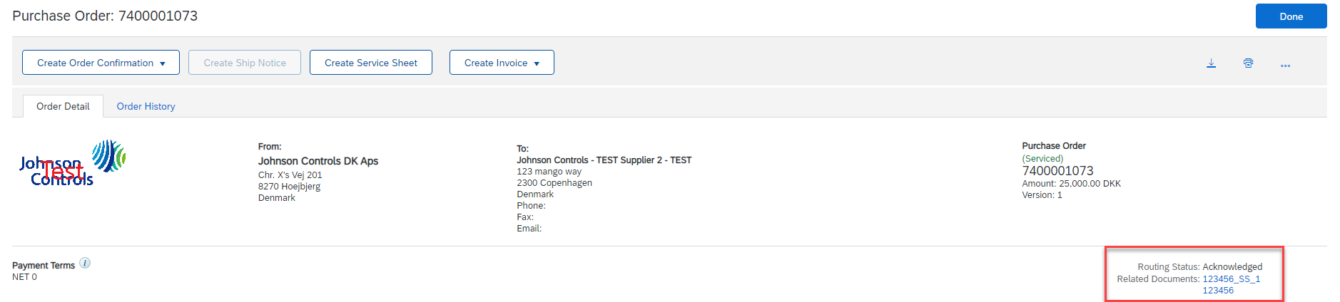
Track Created Documents
Once the Invoice and Service Entry Sheet have been created, they can be viewed from the Related Documents section of the Purchase Order
The Invoice will display a status of “On Hold – Pending Approval” until approved
Note: Please ensure your Ariba Account profile is set to receive Email Notifications, so if the Service Entry Sheet is rejected you will receive the email notification to action

