Slide 1


Ariba Catalogs
Creating and Uploading Catalogs for Dollar Tree

Slide 2
Session Agenda
General Catalog Information
Creating Catalogs for Dollar Tree
Catalog User Interface
Uploading, Validating and Publishing Catalogs
Updating Catalogs
Questions

Slide 3
General Catalog Information
Dollar Tree is implementing an Ariba eCatalog solution
  End Users will shop from the eCatalog, to create requisitions and Purchase Orders
Dollar Tree has identified your company as a catalog supplier
  Catalog scope and specific items will be agreed upon between your company and Dollar Tree
Suppliers are responsible for creating, maintaining and uploading catalogs to the Ariba Network
  Ariba catalog specialists are available to assist you

Slide 4
General Catalog and Enablement Information
Catalog Enablement Process Flow
Customer
Ariba
Supplier
Start
Supplier is
Identified as
a Catalog supplier
Supplier Enablement establishes relationship with Supplier to transact with Customer on the Ariba Network
Suppliers creates Catalog and loads to the Ariba Network
Catalog Type
is determined
Supplier publishes Catalog to the Customer account
Catalog is available to users upon final approval
Loads catalogs into Catalog Server and Catalog Approval Workflow is initiated
Ariba Network validates catalogs to Customer’s requirements

Slide 5
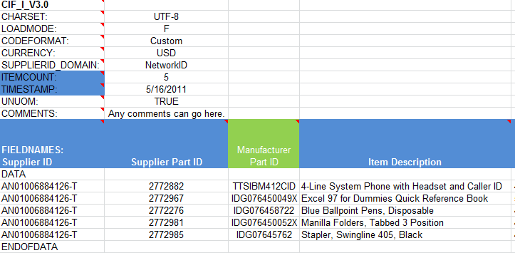
CIF Catalog
A CIF can be built from a comma-separated Excel template.
The supplier is given instructions and an Excel template, then creates and uploads the file to the Ariba Network.
Here is a sample of an Excel CIF file:
Header Section
Data Section

Slide 6
CIF Catalog—cont’d
FIELD NAME | REQUIRED/OPTIONAL | DATA TYPE | MAXIMUM LENGTH
Supplier ID | Required | String | 255
Supplier Part ID | Required | String | 255
Manufacturer Part ID | Optional | String | 255
Item Description | Required | String | 2000
SPSC Code | Required | String | 40
Unit Price | Required | Decimal
Unit of Measure | Required | String
Lead Time | Required | String | 32
Manufacturer Name | Optional | String | 255
Supplier URL | Optional | String | 255
Manufacturer URL | Optional | String | 255
Market Price | Optional | Decimal
Supplier Part Auxiliary ID | Optional | String | 255
Language | Optional | String | 3
Currency | Required | String | 32
Short Name | Required | String | 50
Image | Optional | String | 255
Short Name | Required | String | 50
Here are the fields
and rules for the Dollar Tree CIF file:

Slide 7
CIF Catalog—cont’d
CIF Template and instructions are provided as part of supplier education
All required fields must be populated
  Catalogs with missing data in required fields will be rejected
Data should be submitted in “Sentence case”—using both upper and lower case letters
  Content in all caps or all lower case will be returned
Supplier Part Numbers must be unique per item
Commodity codes must be selected and assigned to each item
Catalogs must be submitted by uploading the CIF file to the Ariba Network

Slide 8
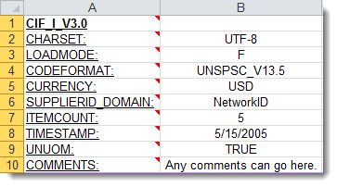
CIF Catalog Creation
Header Section
CIF_I_V3.0—Specifies the catalog format (CIF 3.0), do not change this value
CHARSET—UTF-8 Specifies the data coding type, do not change this value
LOADMODE—F (Full mode) - CIF_I_V3.0 supported by Ariba Applications
CODEFORMAT—Used in the field SPSC Code. Specifies the commodity coding (UNSPSC: United Nations Standard Products and Services Code)
CURRENCY—Specifies the currency used for the prices.
SUPPLIERID_DOMAIN—Specifies the Domain used is the Supplier’s Ariba Network ID Number
ITEMCOUNT—Specifies the number of items of the catalog. Enter the total of all items
TIMESTAMP—Enter the date you created your catalog. For example MM/DD/YYYY
UNUOM—If set to “TRUE”, the Unit Of Measure will be set to UNUOM (United Nations Unit of Measure); if set to “FALSE” , ANSI will be used (Ariba recommends UNUOM). The value TRUE is here by default and should not be updated.
  COMMENTS—This field is optional, but can be used for comments related to your catalog
Note: The only fields (in red) that you should modify in this part of the template are the field CURRENCY , ITEMCOUNT, and the field TIMESTAMP. All the other fields are predefined and should not be modified

Slide 9
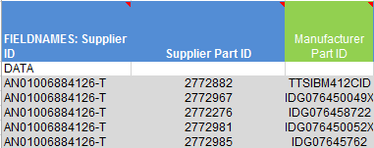
CIF Catalog Creation
Data Section
Supplier ID
Description: Enter your ANID (Ariba Network ID number)
Type of data : String
Maximum length: 255
Mandatory: Yes
Example: AN09067477712
Note: If you publish the catalog in your test account, add the suffix –T to your ANID
Supplier Part ID
Description: Identification number of the supplier’s article. It is necessary to assign an unique code for every item of the catalog. Never use characters ?, {, or }, in Supplier Part IDs, as they cause validation errors.
Type of data: String
Maximum length: 255
Mandatory : Yes
Example: “2772882”
Manufacturer Part ID
Description: Manufacturer’s identification number of the item
Type of data : String
Maximum length : 255
Mandatory : No, but preferred
Example: TTSIBM412CID

Slide 10
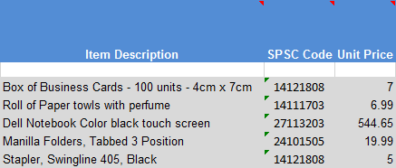
CIF Catalog Creation
Item Description
Description: Description of the product or service. Make your descriptions as clear as possible. Should be organized in the following manner: proper name (the Noun) and a list of key attributes (technical specification, warranties, color, etc.) with no abbreviations.
Type of data : String
Maximum length : 2000
Mandatory : Yes
Example: “Printer, Laser, A4, Epson Stylus Color 740”
SPSC Code
Description: Classification of the products and services according to the UNSPSC codes.
Type of data: String
Maximum length: 40
Mandatory: Yes
Example: 45678900 (level 3) and 45678923 (level 4)
Note: : A file containing the valid UNSPSC Codes is available in your Supplier Information Portal
Unit Price
Description: Unit price negotiated with Dollar Tree
Cannot include any symbols or commas ($, ¢, etc.) Must have minimum of two digits to the right of decimal place when price includes both dollars & cents (five dollars & 90 cents should be 5.90). When unit price includes dollars only, do not include decimal or zeros (00) to right of decimal. Five dollars should be 5.
Type of data: Decimal
Mandatory: Yes
Example: 4.32
Note: In order to separate the integer from the decimal, you must use the dot and not the comma
Data Section

Slide 11
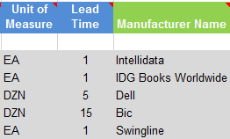
CIF Catalog Creation
Data Section
Unit of Measure
Description: Unit of measure related to the unit price
Type of data: String
Maximum length: 32
Mandatory: Yes
Example: BX
Note: A file containing the valid Units of Measure is available in your Supplier Information Portal
Lead Time
Description: Delivery time of the products or services (number of working days)
Type of data: Integer
Maximum length: 40
Mandatory: Yes
Example: 1
Manufacturer Name
Description: Name of the manufacturer
Type of data: String
Maximum length: 255
Mandatory: No, but preferred
Example : Epson

Slide 12
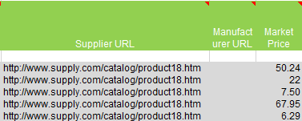
CIF Catalog Creation
Data Section
Supplier URL
Description: A Supplier static page about the item (could be a MSDS, construction info, packaging info, etc.) The URL must be of the format http://host/.. or https://host...
Type of data: String
Maximum length: 255
Mandatory: No, but preferred
Example: http://www.supply.com/catalog/product18.htm
Manufacturer URL
Description: A Manufacturer static page about the item (could be a MSDS, construction info, packaging info, etc.) The URL must be of the format http://host/.. or https://host...
Type of data: String
Maximum length: 255
Mandatory: No, but preferred
Example: http://www.manu.com/catalog/product18.htm
Market Price
Description : Specifies the item’s market price
Type of data: Decimal
Mandatory: No

Slide 13
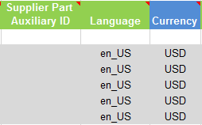
CIF Catalog Creation
Data Section
Supplier Part Auxiliary ID
Description: Uniquely identifies a single article. For example, articles written in multiple languages or available in multiple units of measure that have the same Supplier Part ID
Type of data: String
Maximum length: 255
Mandatory: No
Note: If any articles have the same reference (Supplier Part ID column), this column allows you to differentiate them
Language
Description: Specifies the language used to describe the article.
Type of data: String
Maximum length: 255
Mandatory: Yes
Example: en_US
Note: A file containing the languages codes is available from the Help button of your account
Currency
Description: Specifies the currency used for the prices. Please make sure to use United States Dollars ONLY (USD).
Type of data: String
Maximum length: 32
Mandatory: Yes
Example: USD

Slide 14
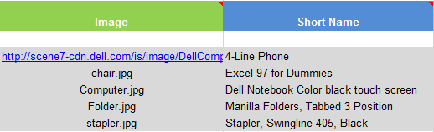
CIF Catalog Creation
Data Section
Short Name
Description: Short description of the item. This will be the title the end users see of your item. Make sure to enter descriptive information of the item.
Type of data: String
Maximum length: 50 characters
Mandatory: Yes
Image
Description: URL of the item’s visual or name of the image in the zip file
Supported image formats: JPG, JPEG, GIF, PNG, BMP
Type of data: String
Maximum length: 255
Mandatory: Yes
Size : 300 x 300 pixels, 72 dpi and 90KB maximum per image.
Note: The names of your image files must be identical to the names you added in the Images column of the CIF Template (capital letters included) with file extension (no text or quotes).
For images that are being hosted by Ariba, they should be labeled with the supplier name and sent in a zip file to: adriana.macias@sap.com

Slide 15
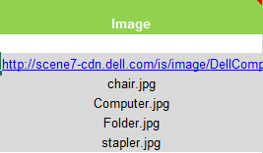
Image field
Option 1
Description: Use this field to provide URL of item image.
Supported Image types: GIF, JPG, JPEG, PNG, TIF, TIFF.
Recommended Image size: No larger than 300 pixels, no larger than 72 dpi and no larger than 90 KB per image.
Data Type: String
Maximum Length: 255
Required: Yes
(see following screen)
Example: https://encrypted-tbn1.gstatic.com/images?q=tbn:ANd9GcSPX3viTLBw74KT91Fp9-73W5gn1l2fp-oB-kNJyPOW4Sm7qMZeTA
Option 2
Description: You can save local images to a zip file and email them to adriana.macias@sap.com
  The image name in the Zip File must be identical to the name in the image field.
Supported Image types: GIF, JPG, JPEG, PNG, TIF, TIFF.
Recommended Image size: No larger than 300 pixels, no larger than 72 dpi and no larger than 90 KB per image.
Data Type: String
Maximum Length: 255
Required: Yes
Example:

Slide 16
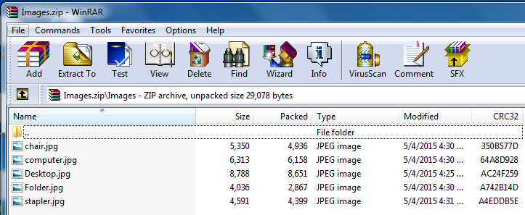
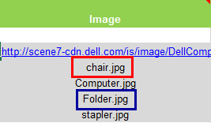
Image field

Slide 17
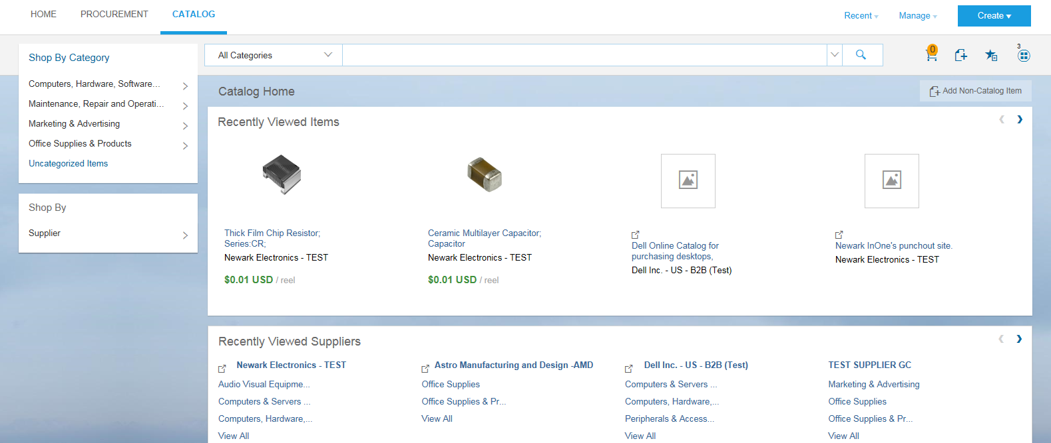
Catalog User Interface
This is the Home page of the Ariba eCatalog. This is similar to what Dollar Tree end users will see.

Slide 18
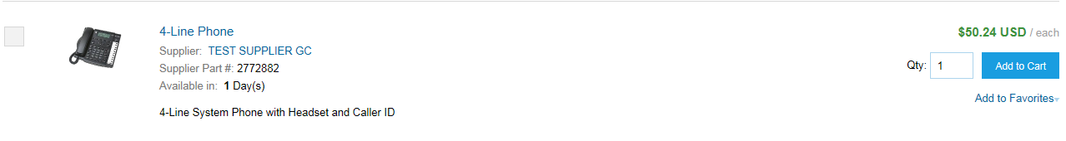
User Interface
This is how a CIF Catalog item is displayed in the catalog interface. Clicking on the Short Name takes you to the Details screen for this item.
Short Name

Slide 19
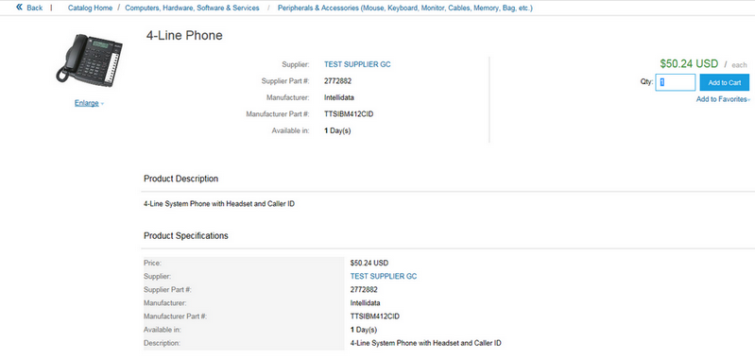
User Interface
This is a how a CIF Catalog item Detail view is displayed in the catalog interface.
Commodity breadcrumbs
Additional fields are displayed here including
optional links to the supplier and manufacturer’s
web sites

Slide 20
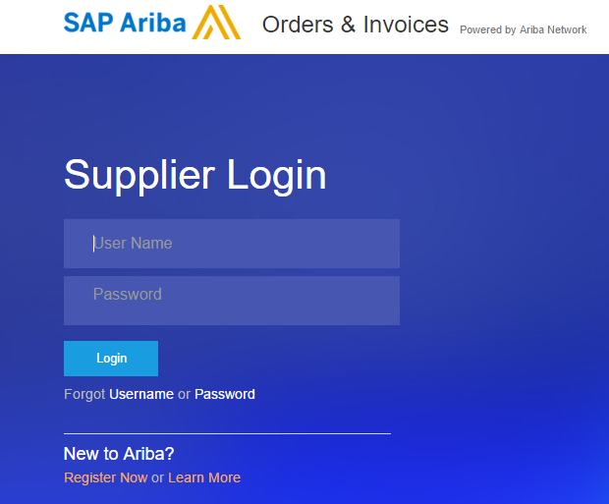
Uploading Catalogs
Login to the Ariba Network
  Go to: http://supplier.ariba.com
  Log in with your Username and Password

Slide 21
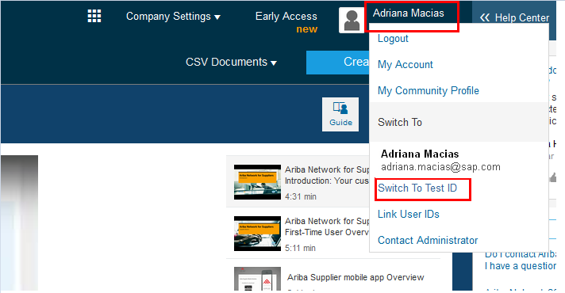
Uploading Catalogs
Switch to your Test Account
  Your catalog should be loaded and tested in your Test Account
  Click on your company name, then click “Switch To Test ID”
  You will get a “Changing Account Mode” warning. Click “OK”

Slide 22
Catalog Upload/Publish Process
When uploading a catalog on the Ariba Network, there are four steps you will follow:
  1. Uploading—Transfers the catalog file from your local drive to the Ariba Network. During the upload process, you enter the catalog name (this becomes the “Subscription”) and descriptive text, and classify it so that buying organizations that are looking for specific products and services can find your catalog
  2. Setting visibility - Allows you to specify whether the catalog version is public or private, which determines which of your customers can access it
  3. Validating—The Network checks the catalog for syntactic and semantic errors, checks for zero price values and does a high-level validation of UNSPSC codes and Units of Measure.
    (Note: Customer-specific validation rules for UNSPSC and UOM codes, and zero price values can be more detailed and much more strict than the high-level network validations, therefore your catalog may pass the network validations but fail the Csutomer-specific validations for these same items)
  4. Publishing—Freezes the current version and notifies your customer of its availability

Slide 23
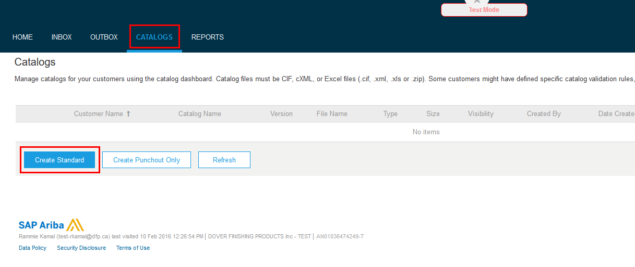
Uploading Catalogs
Navigate to “Catalogs”
On the “Catalogs” screen, click “Create Standard”

Slide 24
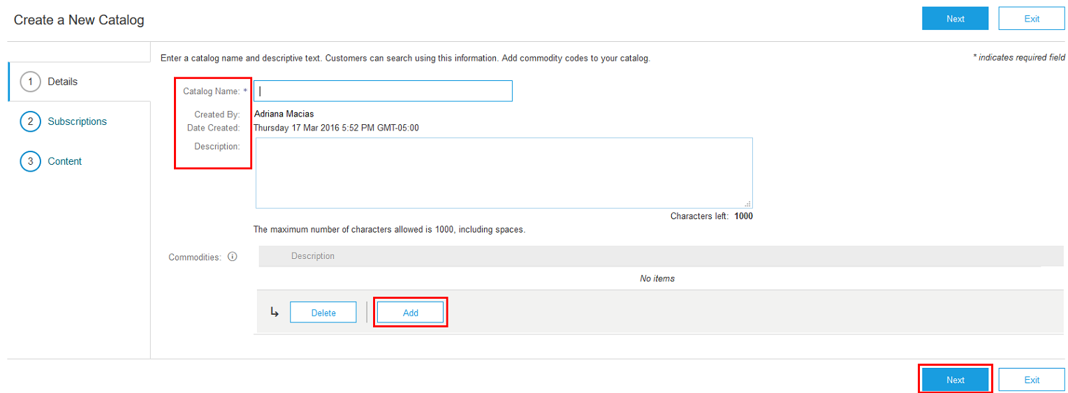
Uploading Catalogs
Enter your Catalog Information
  Catalog Name: For example: Supplier Name.This becomes the “Subscription Name” for this catalog that will not change
  Description: Brief description of the content of your catalog
  Commodities: (Optional) The UNSPSC code corresponding to the items family/ group of your catalog.
  When you complete this screen, click “Next”

Slide 25
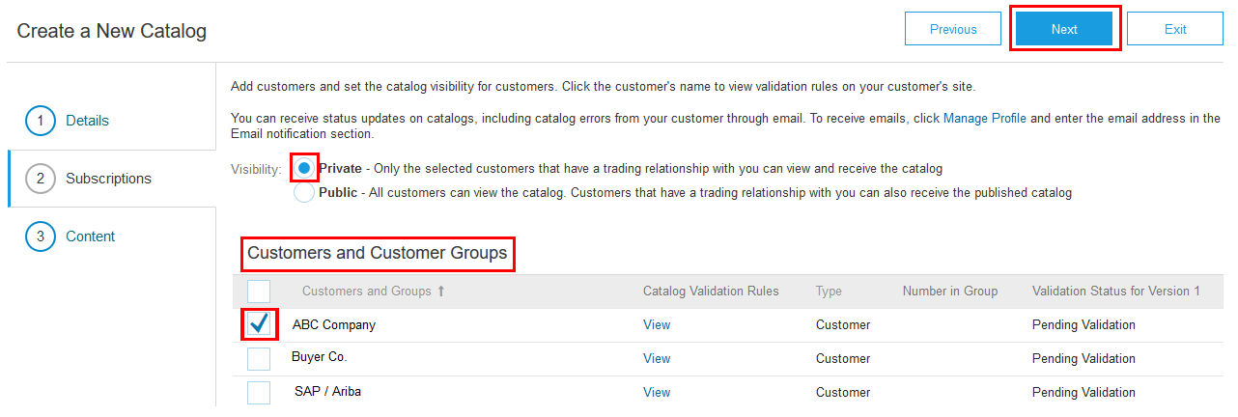
Uploading Catalogs
Setting Visibility for Catalog Subscriptions
  Set the Visibility to “Private”
  Select Dollar Tree from the “Customers” list
    If the Customer does not appear, it means that they have not established a relationship with your company yet. This is required prior to uploading catalog to them
  Click “Next”

Slide 26
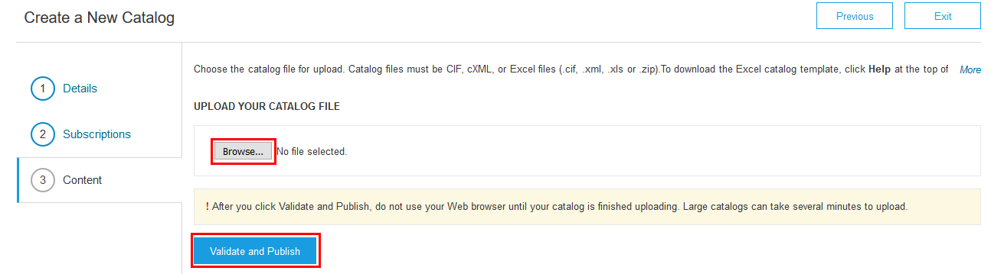
Uploading Catalogs
Validating and Publishing Catalogs
  Select your catalog file, by clicking “Browse” and pointing to your file
    Your Excel or Zip file must not exceed 1 Mb
    If your Excel file is too large, you will need to convert your Excel file to CIF.
  After you have selected your catalog file, click “Validate and Publish”
  As your catalog loads, the status will read “Validating”. Click the “Refresh” button at the bottom of the screen to see the status change

Slide 27
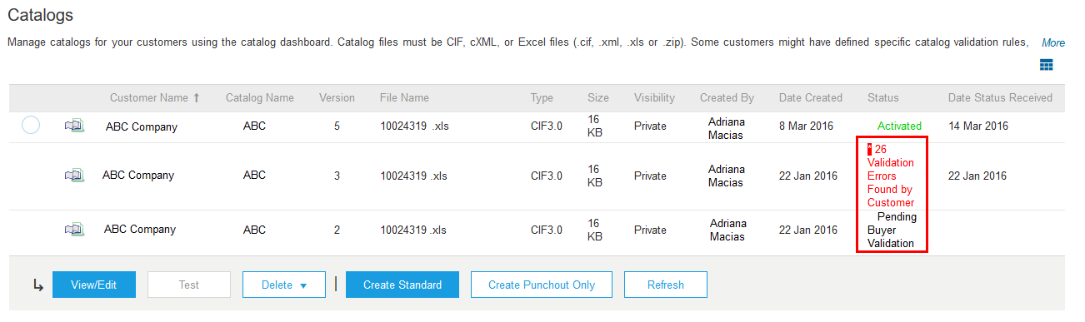
Uploading Catalogs
Network Catalog Validation
  After the Network completes validation, it changes the catalog status from “Validating” to one of the following statuses:
    Published or Pending Buyer Validation—your catalog is error-free
    Errors Found by Ariba Network —the Network detected catalog content that violates syntactic validation rules, standards-based semantic validation rules, or a customer’s catalog rules
    Bad Format—your catalog failed the file validation check. Audit the file for problems in format
  A catalog with an error status means you need to review the error results and correct them before going on

Slide 28
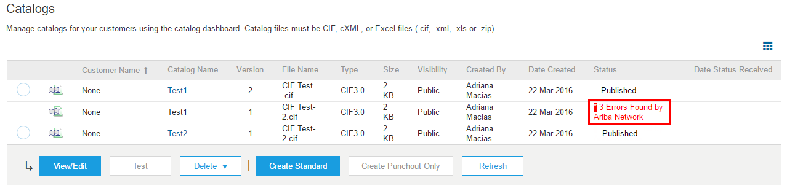
Uploading Catalogs
Correcting Validation Errors
  To see the error detail, click on the “Errors Found” hyperlink:

Slide 29
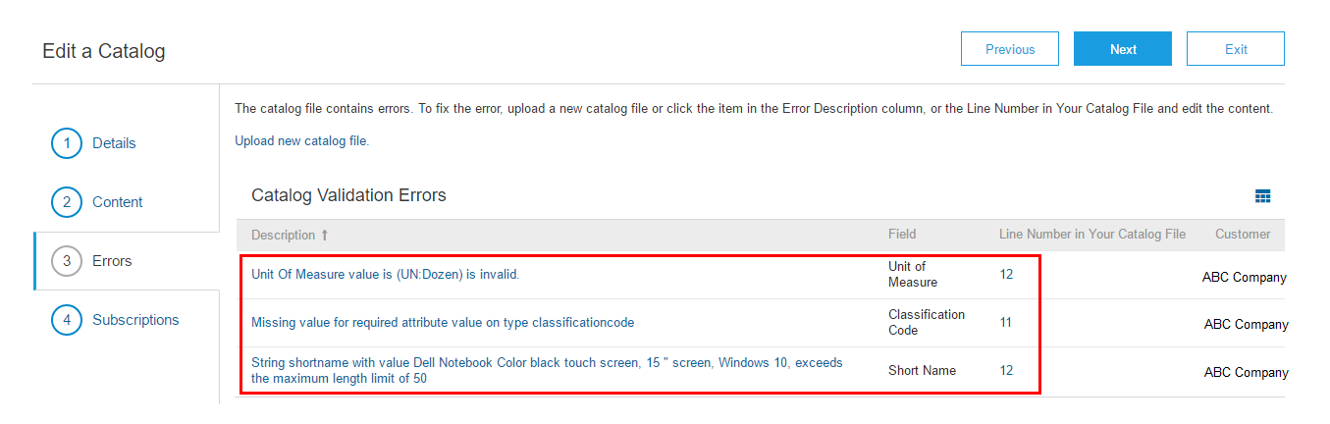
Uploading Catalogs
Viewing Validation Errors
  The Network displays Description, Field and Line Number for each error
  To correct issues, go back to the original Excel catalog file, make the corrections, then upload the catalog file

Slide 30
Uploading Catalogs
Customer Approval
  When your catalog passes the Network upload validation, your customer is then notified to audit, validate and approve your catalog. The Network may show any of these statuses: “Published”, “Validated by Customer” or “Pending Buyer Validation”—these are all valid statuses
  Each customer may have specific validation rules—and these rules may be more strict than the standard Network rules
  If your customer finds anything in your catalog file that requires your attention, you will be notified by e-Mail
    Corrections are made to the original Excel file, then the catalog file will be updated
    Each catalog must pass both the Network validation, and the customer audit before it can be loaded into the customer’s buying application and be available for their Users

Slide 31
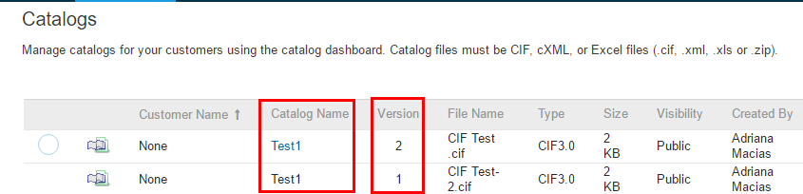
Updating Catalogs
To update an existing Catalog, the steps are almost the same as uploading a new catalog for Dollar Tree.
Log into your Ariba Network account
Navigate to “Catalogs”
Update the Catalog
  When updating a catalog, do not create a new subscription —it is important to keep the same Catalog/Subscription Name. The file name can be different:

Slide 32
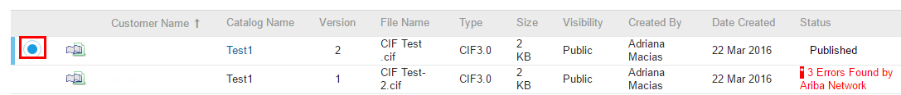
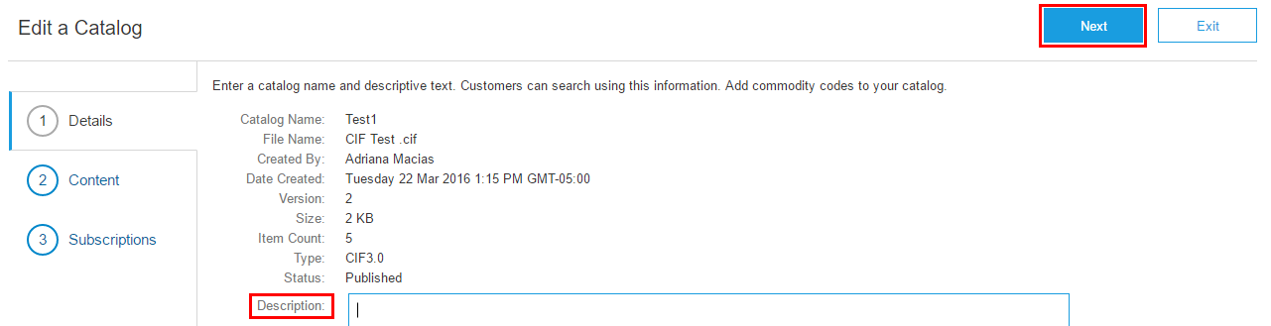
Updating Catalogs
Find the Subscription you wish to Edit
  Click on the radio button to select the Subscription
  Click “View/Edit”
  Enter a description if you wish, then click “Next”

Slide 33
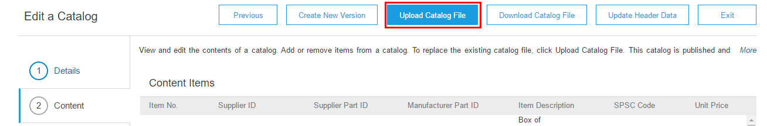
Updating Catalogs
  The Network will display the current catalog (if it is under 4Mb). Click “Upload Catalog File”
  The update process now follows the process for uploading a new catalog

Slide 34
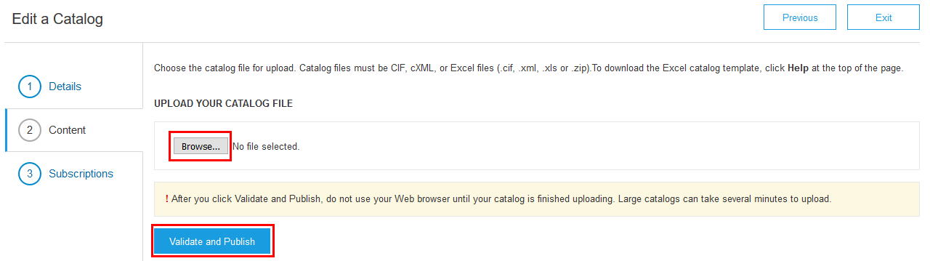
Updating Catalogs
Validating and Publishing Catalogs
  Select your catalog file, by clicking “Browse” and pointing to your file
    Your Excel or Zip file must not exceed 1 Mb
    If your Excel file is too large, see the Appendix—“How to convert an Excel file to CIF”
  After you have selected your catalog file, click “Validate and Publish”
  As your catalog loads, the status will read “Validating”. Click the “Refresh” button at the bottom of the screen to see the status change

Slide 35
Questions?
Flavio Valdez
1.412.222.6330 (Central Time)
flavio.valdez@sap.com
AskAribaCatalog@ariba.com

