Slide 1




Ariba Network
CSV Invoice upload guide
Feb, 2021
Internal

Slide 2
Agenda
  CSV Invoice overview
  CSV Invoices scope
  Data Requirements
  CSV fields mapping
  CSV template use
    Downloading CSV template
    Uploading CSV Invoice
    Tracking Invoice status
  Troubleshooting CSV Invoices
  CSV template Change log
  Contacts and Support

Slide 3

CSV Invoice Overview

Slide 4
CSV Invoice Overview
CSV stands for Comma Separated Value/Variable file.
It represents structured way of data stored as plain text file.
CSV Invoice Upload
Supports the transfer, transformation and loading of comma delimited files (CSV) representing a Supplier’s invoices to be rendered as cXML invoices for their Customers.
Provides an effective means for Suppliers with a large number of invoices to submit these to their Ariba customers electronically when they do not have the immediate means to provide these via cXML or EDI directly.

Slide 5
CSV Invoice Scope

Slide 6
CSV Invoice Scope
    Baker Hughes supports the following CSV invoice types:
    PO Invoices: invoices against purchase order where the purchase order was received through Ariba Network.
    Credit Memos: Line item level credit invoices.
    Invoices submitted through CSV upload have the following requirements:
  Cannot be greater than 10,000 lines in total
  Cannot be greater than 5000 invoices per file
  File cannot exceed 40MB in size.

Slide 7
Data requirements

Slide 8
Additional Data Requirements
Field Name | Mandatory | Field condition
invoiceID | Yes | UPPERCASE and should not exceed 20 characters
invoiceDate | Yes | format mm/dd/yyyy
poNumber | Yes | only AN based POs should be entered
purpose | Yes | Enter 'standard' for regular invoice and 'lineLevelCreditMemo' for credit memo(Required)
originalInvoiceNumber | No | Enter the Invoice number of the invoice available in Ariba network to submit credit memo against it
originalInvoicDate | No | Enter the Invoice date of the originalInvoiceNumber in mm/dd/yyyy format"
ReasonForCreditMemo | No | Enter comments - Reason for credit memo (Required for credit memo)

Slide 9
Additional Data Requirements
Field Name | Mandatory | Field condition
billToName | Yes
billToStreet | Yes
billToCity | Yes
billToState | Yes | Should be 2 character ISO code
billToPostalCode | Yes | When billToCountry = ‘QA’, billToPostalCode is defaulted to ‘00000’. The field can be left blank when billToCountry is QA.
billToCountry | Yes | Should be 2 character ISO code

Slide 10
Additional Data Requirements
Field Name | Mandatory | Field condition
fromName | Yes
fromStreet | Yes
fromCity | Yes
fromState | Yes | Should be 2 character ISO code
fromPostalCode | Yes
fromCountry | Yes | Should be 2 character ISO code
shipToCode | No
shipToName | Yes
shipToStreet | Yes

Slide 11
Additional Data Requirements
Field Name | Mandatory | Field condition
shipToCity | Yes
shipToState | Yes | Should be 2 character ISO code
shipToPostalCode | Yes
shipToCountry | Yes | Should be 2 character ISO code
shipFromName | Yes
shipFromStreet | Yes
shipFromCity | Yes
shipFromState | Yes | Should be 2 character ISO code
shipFromPostalCode | Yes

Slide 12
Additional Data Requirements
Field Name | Mandatory | Field condition
shipFromPostalCode | Yes
shipFromCountry | Yes | Should be 2 character ISO code
supplierVatID | Yes(only when fromCountry is - Chile or CZ or Estonia or Greece or Hong Kong or Iceland or Malaysia or New Zealand or FR or GB) | All EU + UK suppliers submitting invoices to EU + UK Baker legal entities, must fill the SupplierVATID field
buyerVatID | Yes(only when fromCountry is - Chile or CZ or Estonia or Greece or Hong Kong or Iceland or Malaysia or New Zealand or FR or GB) | All EU + UK suppliers submitting invoices to EU + UK Baker legal entities, must fill the BuyerVATID field
buyerTaxID | No
taxExchangeRate | No
alternateCurrency | No
invoiceLineNumber | Yes | Must contain unique numbers – used in numbering the invoice rows
poLineReferenceNumber | Yes | Line number reference of the PO line item
currency | Yes | Must be 3 character ISO code

Slide 13
Additional Data Requirements
Field Name | Mandatory | Field condition
unitPrice | Yes | Should match PO
unitOfMeasure | Yes | Should match PO
quantity | Yes | Should match PO
itemDescription | No
classificationCode | No
supplierPartID | No | Should match PO
buyerPartID | No
headerTaxCategory1 | Yes | All tax categories to be entered as is except ‘Sales Tax’, which should be entered as ‘sales’.
headerTaxAmount1 | Yes
headerTaxDescription1 | No
*When headerTaxAmount(1/2/3/4) = 0 and headerTaxCategory(1/2/3/4) = ‘VAT’. ExemptDetail is set to ‘zeroRated’ internally

Slide 14
Additional Data Requirements
Field Name | Mandatory | Field condition
headerTaxCategory2 | No | All tax categories to be entered as is except ‘Sales Tax’, which should be entered as ‘sales’.
headerTaxAmount2 | No
headerTaxDescription2 | No
headerTaxCategory3 | No | All tax categories to be entered as is except ‘Sales Tax’, which should be entered as ‘sales’.
headerTaxAmount3 | No
headerTaxDescription3 | No
headerTaxCategory4 | No | All tax categories to be entered as is except ‘Sales Tax’, which should be entered as ‘sales’.
headerTaxAmount4 | No
headerTaxDescription4 | No
*When headerTaxAmount(1/2/3/4) = 0 and headerTaxCategory(1/2/3/4) = ‘VAT’. ExemptDetail is set to ‘zeroRated’ internally

Slide 15
CSV File Recommendations
File Requirements
  Alterations or updates to the original CSV file format downloaded from the Network will cause the CSV to fail during the upload process.
  You must keep the CSV file you download in its native format.
  Do not convert to an Excel file, save as a workbook, add macros, delete/add columns or edit the column names in any way. Using excel will cause invoice date format to change and leading ‘Zeros’ in invoice number to disappear at the time of upload. Excise caution while using the Excel file for loading.
The application Ron’s editor is an example of a CSV File editor.
  You can download a free trial at: http://www.ronsplace.eu/Products/RonsEditor?utm_source=killink
  Note that this is not an Ariba software and is not supported by Ariba.

Slide 16
CSV template details

Slide 17
CSV Sample / Field Mapping
  The embedded CSV sample template provides:
    Data sample of valid CSV invoices processed successfully by the Customer. This version of file template might have been changed. Use this file only for reference. You can download the later version in Ariba Network
  The embedded field overview provides:
    Mapping information on field content and requirements.
  For accounting and payment questions:
  Contact Baker Hughes: www.bakerhughes.com
  For CSV upload related questions or errors:
    Contact Ariba Technical Support

Slide 18
CSV template use

Slide 19
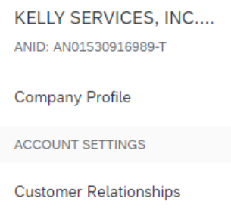
Downloading the CSV Template
From the Home Page of your production AN account, Click the Company Settings tab.
Click Customer Relationships.
AN will display a list of all customers that you have a relationship with on the Ariba Network.
Click on Baker Hughes link within your list.

Slide 20
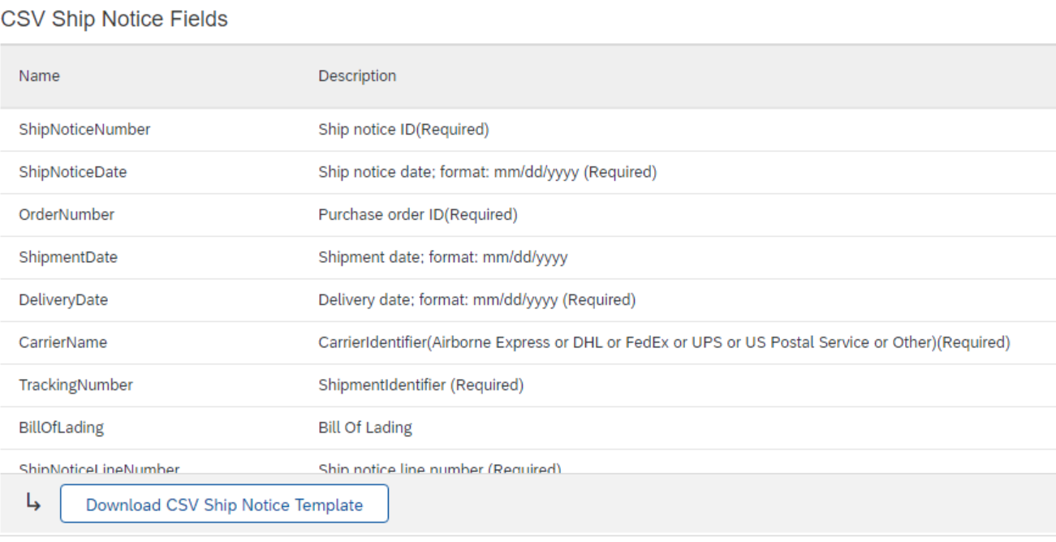

Downloading the CSV Template (continued)
Click the Download CSV Invoice Template button. You will be prompted to Open or Save the file.
Save the file to your local hard drive.
Once you are finished saving the template file, click the Done button to exit this section.
You will be back at your Customer Relationship page.

Slide 21
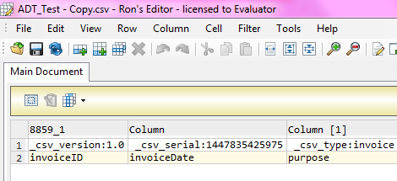
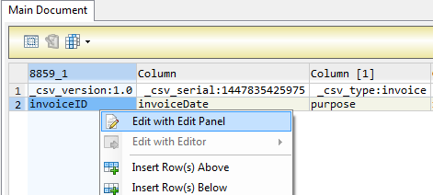
Populate the CSV Invoice Template
Ron’s CSV Editor
Populate each available invoice field as appropriate – starting in Row 3, Cell A
Note that . Rows 1 and 2 are CSV File information rows and cannot be removed or modified in any way. If these fields are changed or removed, the file will fail at upload.
To populate value for each field select that cell, right click and chose option ‘Edit with Edit Panel.
When you have completed populating all fields for your particular invoice, Save the file to your local drive.
Standard Rows – Do Not Change
Begin Invoice Data

Slide 22
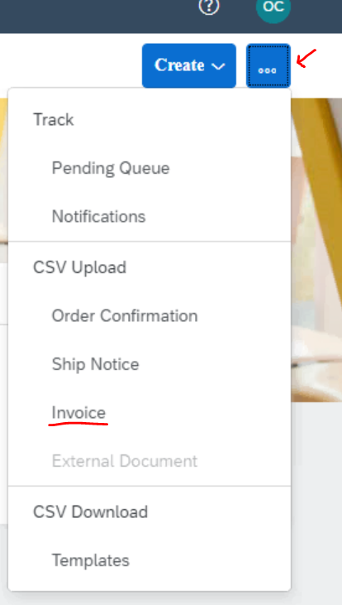
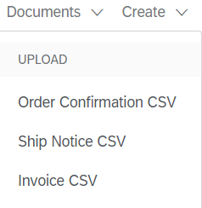
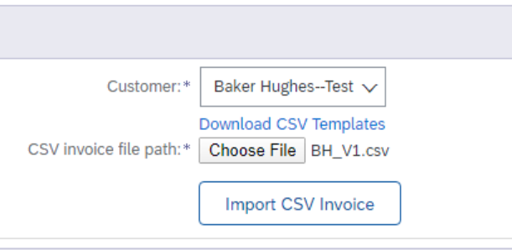
Upload the CSV Invoice
From the Home Page, locate the Documents or three dots link on the right side of the page.
Click Invoice CSV or Invoice under CSV Upload.
You will see an Import CSV Invoice box.
Ensure Customer is selected in the Customer drop-down box.
  Note: Each customer using the CSV Invoice method has a customized template. You cannot use any other customer's template for Baker Hughes.
Click the Choose File button and find the CSV File you have created and saved.
Once the file path is shown, click the Import CSV Invoice button.
OR

Slide 23
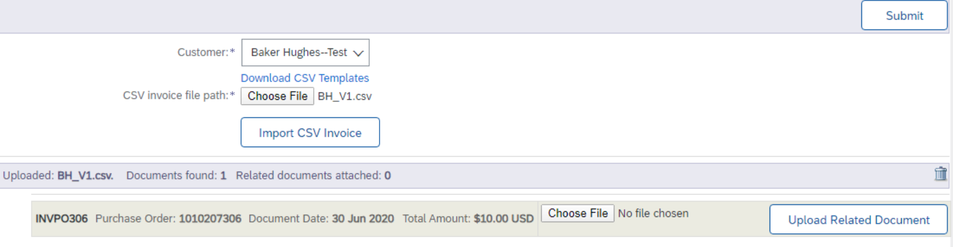
Upload the CSV Invoice
To add attachments, click on ‘Choose File’ option, browse for the file(attachment) and click on the ‘Upload Related Document’ button.
Click on Submit button to submit the invoice(s).

Slide 24
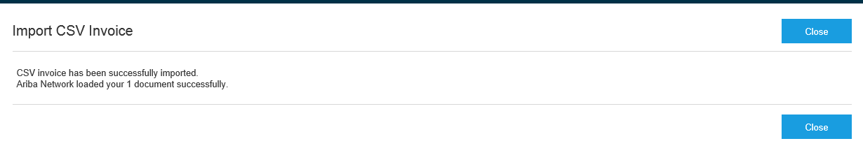
Upload the CSV Invoice
Once you click on Submit, the CSV Invoice will be successfully imported. Click on Close button

Slide 25
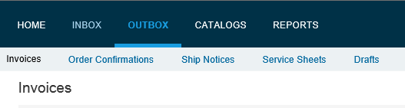
Tracking CSV Invoice status
Checking Invoice Status
From your Home Page, click on the Outbox tab.
You will again, see a listing of all of the invoices you have sent.
Each invoice number is a link to open and view that invoice.
There are two status types provided:
    Routing Status: show the routing status of the invoice through the Ariba network to Baker Hughes.
    Invoice Status: shows the status of the invoice itself specifically through it’s payment process.

Slide 26
Tracking CSV Invoice status
Routing Status
  Obsoleted: You canceled the invoice.
  Failed: The invoice failed the Baker Hughes invoicing rules as set within their Ariba Network account.
  Queued: Ariba Network received the invoice from a suppliers Network account, but has not sent it to the Baker Hughes network account.
  Sent: Ariba Network sent the invoice to Baker Hughes Ariba Network account. The invoice is awaiting download into the Baker Hughes invoicing application.
  Acknowledged: The invoice has been sent from the Baker Hughes network account into their invoicing application.

Slide 27
Tracking CSV Invoice status
Invoice Status
Sent : Baker Hughes has received the invoice.
Rejected: Baker Hughes has rejected the invoice. If Baker Hughes subsequently accepts the invoice or approves it for payment, invoice status updated to Sent indicating invoice was accepted .
Failed: Ariba Network experienced a problem routing the invoice.
Approved: Baker Hughes has approved the invoice for payment.

Slide 28
Troubleshooting CSV Invoices

Slide 29
Troubleshooting CSV Invoices
General Checks
Be sure that the application that is being used to create the file is a true CSV editing application.
Be sure that all value fields such as unit price, tax, subtotal, gross, etc., are entered properly, (for example 2.25 or .58).
Ensure that the file does not contain any special characters, (dollar sign, asterisk, quotation marks, etc.).
Ensure that none of the file data within the first three rows of the template sample has been modified from its original state.
Ensure you are using the correct version of the CSV template for Baker Hughes.
Check whether there is any blank lines after the last row of invoice data. This may not be visible for naked eye.
IMP - Once the invoices are uploaded using the CSV channel , Supplier will see the message saying –‘ csv file uploaded successfully’ but may not immediately see the invoice on the Network GUI .This is because the server may take sometime to update the UI screen . In case the Supplier need to refer the invoice immediately but doesn’t find it on the UI , they may use the invoice search option to find the uploaded CSV invoice. The server will process the request and fetch the invoice from the Database.

Slide 30
Troubleshooting CSV Invoices
When is the problem occurring?
Is it at the point of uploading the file?
Is it after the file is uploaded and invoices show a failed status?
Is it after the file is uploaded and invoices show a rejected status?
If the problem happens at #1
The file itself does not meet the basic CSV requirements. You will see specific error messaging on the screen to help identify which field needs to be reviewed/changed. This could be:
  Missing header information or missing data in a required field
  Incorrect formatting in any field
  The problem within the file must be corrected and the entire file must be uploaded again – nothing was loaded from the CSV file.
If the error happens at #2
The invoices (as opposed to the file) failed the invoice rule validation. When the invoices are converted from the .csv file to actual individual invoice documents on the AN, they are then validated based on the Invoice Rules set in Customer Ariba Network account.
  Check the ‘History’ tab on the individual invoice to see which rule was violated and caused the invoice to fail.
  The problem within the file must be corrected BUT only those invoices that failed need to be resent.
If the error happens at #3
The invoices passed .csv validation and Ariba Network validation but were rejected by Customer (either by their invoicing system automatically or by an end user manually).
  Check the History tab on the individual invoice for additional details.
  The problem with the individual invoices must be corrected and only those invoices that were rejected need to be resent. Invoice numbers must be modified.

Slide 31
CSV template Change log

Slide 32
Moving from one version to another
Important notice:
Whenever new version of csv template is released or mapping rules are modified there is new unique template serial number generated by Ariba Network. This number is part of the template and being sent back with upload (sample: _csv_serial:1423025640524).
If csv template header’s are not changed it is still possible to use the old version of the template however supplier is notified every time outdated version is used.
In case csv template change consists of headers update or add of new columns suppliers have to download new version and start using this one.
Otherwise upload will fail with mapping failure message.

Slide 33
Contacts and Support

Slide 34
Training and Resources
Baker Hughes Supplier Information Portal
  Supplier Information Portal contains specific documentation and training material.
  From the home page of your account, click the Company Settings and then click the Customer Relationships tab.
  The portal link is located next to your customers name in the middle of the screen

Slide 35
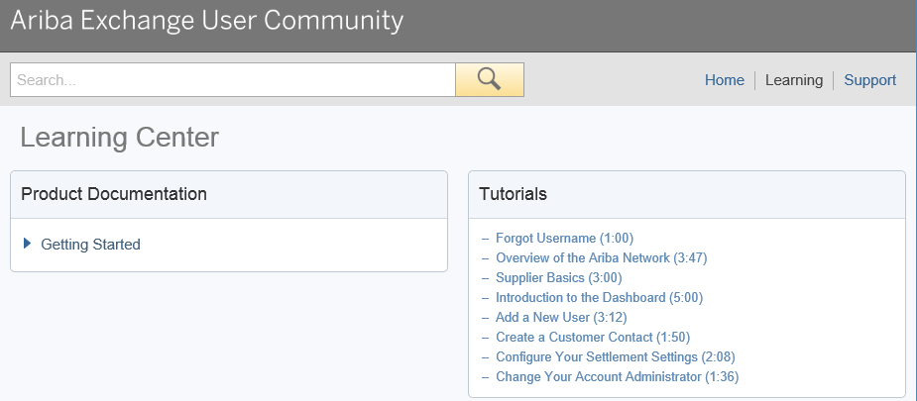
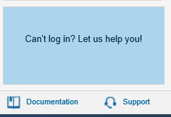
Ariba Network Standard Documentation
  Go to: http://supplier.ariba.com
  Click on the Help Center in the upper right hand corner of the page.
  Bottom right hand corner has access to Documentation. Click to view Product Documentation.

Slide 36
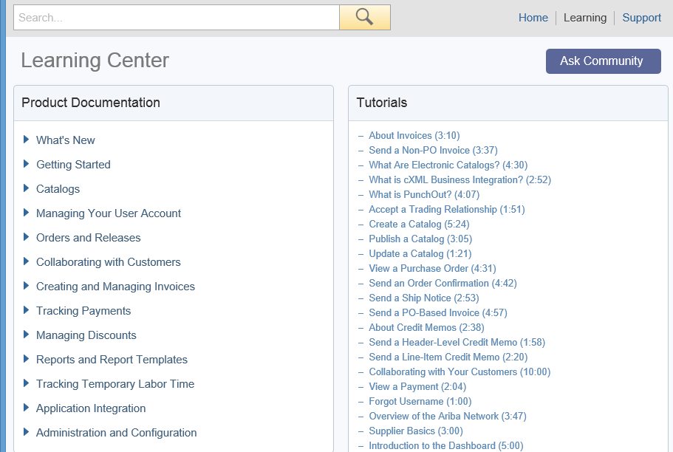

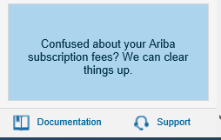
Ariba Network Standard Documentation
  Standard Documentation can also be accessed from your account. Click on Help Center button on Home page of your account,
  Click Documentation on bottom right hand corner to view Ariba Network Administrator’s documentation.

Slide 37
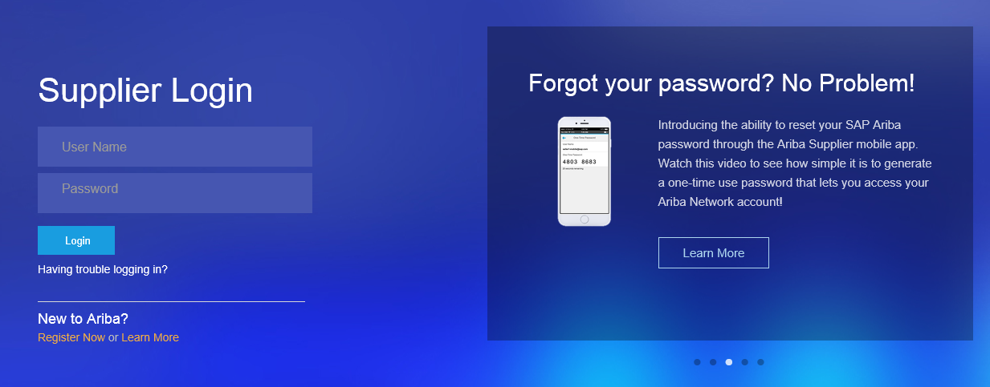
Supplier Support
    Go to http://supplier.ariba.com
    If you forgot your username or password click on the link Having trouble logging in?

Slide 38
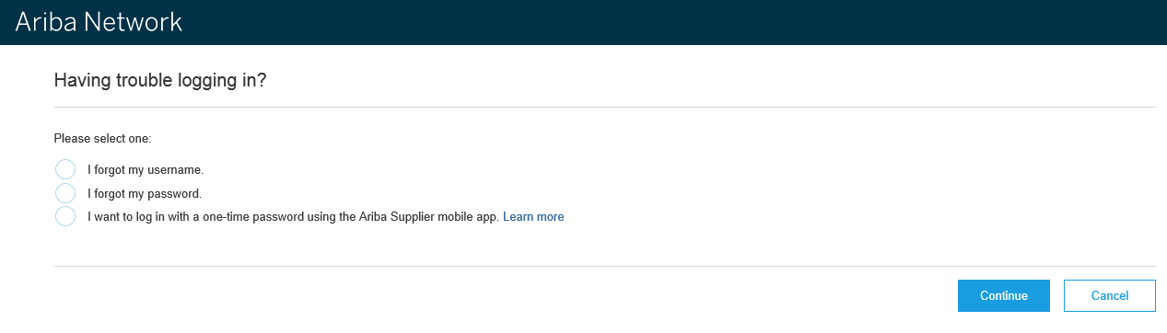
Supplier Support
    Upon clicking the link Having trouble logging in? , new page opens up where you can choose from one of the options and click on Continue.

Slide 39
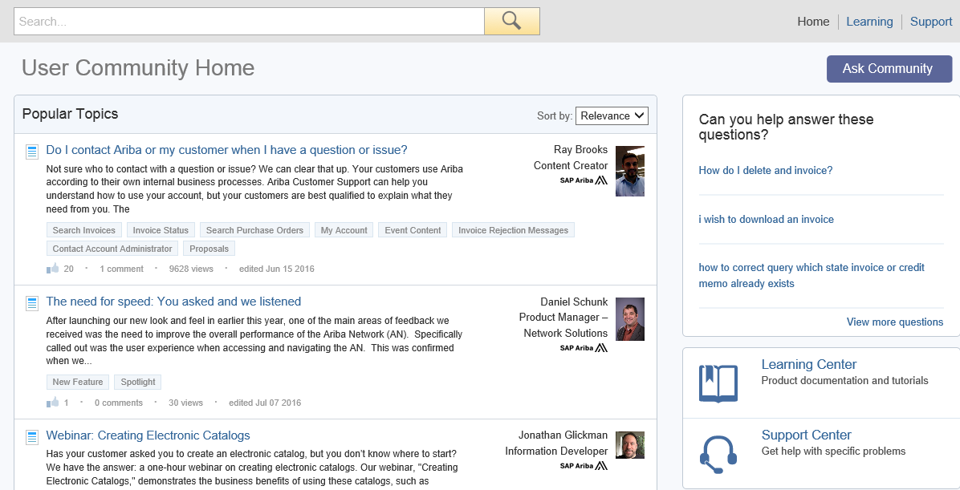
Supplier Support
Log into your account.
Click Help Center, View More.
You will find lists of Popular Topics FAQ’s and link to contact Support Center.

Slide 40
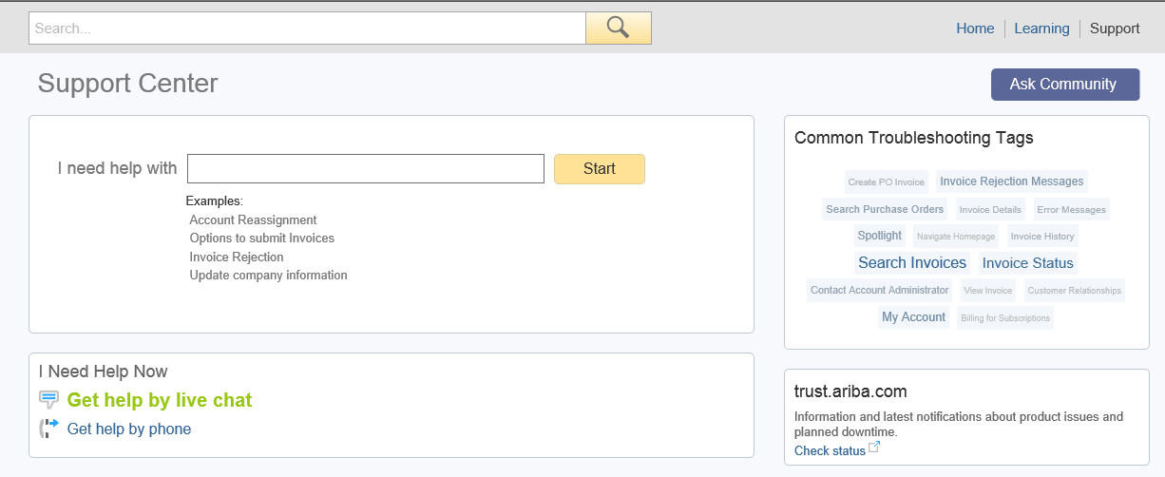
Supplier Support
Ariba Network Support by Web – Get help by phone
Click on the Support link from the Help Center Page.
Click on I Need Help Now, Get help by phone link.
You will be brought to a page listing all Ariba customer support numbers. Have your account information (ANID) ready and customer’s name when you call.

Slide 41
Who Should You Contact?
Supplier Support During Deployment
  Baker Hughes Business Process Support
  Please contact the Supplier Enablement team at TBD for business-related questions.
  Supplier Support Post Go-Live
  Please follow as mentioned in the attached document below.

Slide 42
Thank you

